Slide 1
Publishing in Development Engineering
Berber Kramer, International Food Policy Research Institute (IFPRI) and Editor-in-Chief Social Science DevEng

Slide 2
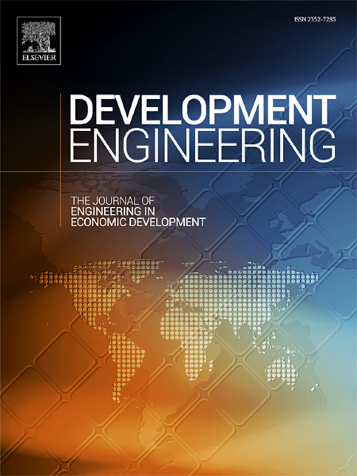
Development Engineering:
The Journal of Engineering in Economic Development
Open access, interdisciplinary journal applying engineering and economic research to the problems of poverty.
Published studies present novel research motivated by a specific global development problem.
Bridge between engineers, economists, and other scientists involved in research on human, social, and economic development.
Focus on quantitative, scientific approaches, but intended to inform wider audience of practitioners and policy makers.
Support engineering and applied economics faculty who conduct research or teach in "technology for development".
Editors-in-Chief:
Dr. Susan Amrose, MIT, USA
Dr. Amy Bilton, University of Toronto, Canada
Dr. Berber Kramer, IFPRI, USA/Kenya
elsevier.com/locate/
deveng
Notes:
Aims and Scope as shown in the journal home page at Elsevier.com. Data source: PROMIS.

Slide 3
Why publish in Development Engineering?
Contribute to an emerging field: inform design, implementation and evaluation of scalable products and services for low-resource settings
Publish high quality research: we strive to increase publication opportunities for researchers from developing and developed countries
Open access: Your article will be immediately and permanently free to access and read by everyone. For fee waivers, please contact the editors.
Rapid online publication: Articles receive full volume and page citation details upon proof correction, so your work can be cited straight away
Special issues: (i) Cost estimation as a tool for resource-constrained design and, linked to this event, (ii) Geospatial Analysis for Development
elsevier.com/locate/deveng

Slide 4
Special Issue: Geospatial Analysis for Development
Data scarcity often constraints a rapid and effective response to global development challenges. Geospatial data (e.g., satellites, sensors, mobile phones) can help address these gaps, but promising applications remain underutilized.
DevEng aims to publish the latest research leveraging geospatial analysis for global development.
Nighttime Light data sets for studying human economic activity and development trends
Use cases of other geospatial data for monitoring poverty and economic development
Geospatial analysis to study implications of COVID-19 for economic activity or development
Impact evaluations using geospatial data, incl. e.g., infrastructure or humanitarian relief
Comparative studies (alternative types of geospatial data, and/or comparisons with other data).
Research that highlights tools and methods increasing accessibility of geospatial data
Papers presented at CEGA’s 2020 Geo4Dev Symposium and Workshop will be fast-tracked and submissions in by Dec 31 will be eligible for full fee waivers from Elsevier.
elsevier.com/locate/deveng

