Slide 1
How do we Randomize?
Jenny C. Aker
Tufts University

Slide 2
Course Overview
Introduction to ATAI and J-PAL
Using randomized evaluations to test adoption constraints
From adoption to impact
Alternative strategies for randomizing programs
Power and sample size
Managing and minimizing threats to analysis
Common pitfalls
Randomized evaluation: Start-to-finish
Notes:
We have spent most of the morning talking about evaluation, the difference between monitoring and evaluation, and why randomization can help to accurately measure the impact of a program. In this session, we are going to talk about the different ways in which randomization can be conducted.

Slide 3
Why are we here?
What is the impact of the intervention?
What is the impact of NERICA on rice yields?
What is the impact of improved bags on cowpea losses?
Was this (observed) impact due to the program or something else?
Unbiased treatment or program effect
Attribution

Slide 4
Measuring Impact
“Treated” farmers yields
“Control” farmers yields
10 kg
Farmers use seeds
Farmers don’t use seeds
Offer farmers improved quality seeds
Is this unbiased? Too big or too small?

Slide 5
Measuring Impact
“Treated” farmers yields
“Control” farmers yields
10 kg
Farmers in treated villages use seeds
Farmers in control villages don’t use seeds
Choose villages away from a paved road to get seeds
Is this unbiased? Too big or too small?

Slide 6
Experimental
Quasi-Experiment
Non—Experimental
Randomization
RDD
DD
Matching
PSM
IV
High
internal validity
Lower internal validity
Lower
external validity
Higher external validity

Slide 7
What is randomization?
Randomization involves randomly assigning a potential participant (individual, household or village) to the treatment or control group
It gives each potential participant a (usually equal) chance of being assigned to each group
The objective is to ensure that the only systematic difference between the program participants (treatment) and non-participants (control) is the presence of the program
Notes:
But what if we need to change X in real people's lives? (call these people the treatment group)
To make the comparison we need someone else whose X didn't change but who was otherwise identical to the treatment
group. (call these people the control group)
But…we can’t observe the same person with and without the program.
Also known as treated and untreated, treatment and control, comparison, etc

Slide 8
Basic setup of a randomized evaluation
Target Population
Not in evaluation
Random number generator, calebasse, Excel, STATA
Evaluation Sample
Random Assignment
Treatment group
Participants
No-Shows
Control group
Non-Participants
Cross-overs
7
Notes:
7

Slide 9
How can randomization be useful to measure a program effect?
It gives each potential participant a (usually equal) chance of being assigned to each group
On average, and if the sample size is large enough, observable and unobservable characteristics between the program participants (treatment) and non-participants (control) is the same
The only difference is the presence of the program
(But we need to check that it worked)
Notes:
But what if we need to change X in real people's lives? (call these people the treatment group)
To make the comparison we need someone else whose X didn't change but who was otherwise identical to the treatment
group. (call these people the control group)
But…we can’t observe the same person with and without the program.
Also known as treated and untreated, treatment and control, comparison, etc

Slide 10
Possible Randomization Designs
Simple lottery
Randomization in the “bubble”
Randomized phase-in
Rotation
Encouragement design
These are not mutually exclusive.
Notes:
Simple lottery
Randomization in the “bubble”
Partial lottery with screening
Randomized phase-in
Rotation
Encouragement design
Note: These are not mutually exclusive.
Simple lottery
Randomization in the “bubble”
Partial lottery with screening
Randomized phase-in
Rotation
Encouragement design
Note: These are not mutually exclusive.

Slide 11
Lecture Overview
Unit and method of randomization
Real-world constraints
Revisiting unit and method
Variations on simple treatment-control
Notes:
In this section, we’re going to cover the elements of randomization – namely, the units and methods, real-world constraints and some real-life examples.

Slide 12
Lecture Overview
Unit and method of randomization
Real-world constraints
Revisiting unit and method
Variations on simple treatment-control
Notes:
Unit and method of randomization
What levers does the program pull?
Unit analysis
Simple lottery
Real-world constraints
Revisiting unit and method
Variations on simple treatment-control

Slide 13
Unit of Randomization: Options
Randomizing at the individual level
Randomizing at the group level “Cluster Randomized Trial”
At which level should we randomize?
Notes:
This should be general, using pictures
Randomizing at the individual level (also plots across individuals)
Randomizing at the group level “Cluster Randomized Trial”
Class
School
Community
Health center
School
District
Which level to randomize?

Slide 14
Unit of Randomization: Individual?

Slide 15
Unit of Randomization: Individual?

Slide 16
Unit of Randomization: Clusters?
“Groups of individuals”: Cluster Randomized Trial

Slide 17
Unit of Randomization: Farmers’ Group?

Slide 18
Unit of Randomization: Farmers’ Group?

Slide 19
Unit of Randomization: Village?

Slide 20
Unit of Randomization: Village?
Notes:
For agriculture, we could also envision randomizing at the farmers’ group level, the village (community) level, as well as randomizing across plots for one individual household.

Slide 21
How do we choose the level?
What unit does the program target for treatment?
What is the unit of analysis?

Slide 22
How do we choose the level?
Nature of the Treatment
How is the intervention administered?
What is the catchment area of each “unit of intervention”
How wide is the potential impact?
Aggregation level of available data
Power requirements
Generally, it is best to randomize at the level at which the treatment is administered.
Notes:
What might be the problem with distributing household-by-household
What might be the problem with distributing to individual children within the school?
How is the intervention administered?
By the NGO, the Ministry of Agriculture
What is the catchment area of each “unit of intervention”?
a) Ie, in health, it is often the health center; in agriculture, an NGO field worker or ag extension worker might have a certain catchment area
How wide is the potential impact?
Individual households?
Entire village?
Entire group within a village?

Slide 23
Example: Tree-Planting in Malawi (Jack 2011)
Intervention: Tree-planting contract for farmers (same subsidy, different payment schemes)
Treatment Level: Farmers (or farm households)
Catchment level: Agricultural extension agent
Randomization level: Individual (500 farmers across 23 villages)
Oversubscription, so additional public lottery

Slide 24
Example: Fertilizer Tree Adoption in Zambia
Intervention: Promotion of fertilizer “trees”
Treatment level: Farmers’ group and individual farmers
Randomization level:
Farmer group (each group randomly offered different price for tree)
Individual: Reward cards for maintaining trees randomized across farmers within the group

Slide 25
Example: SMS-Based Price Information in India
Intervention: SMS-based price information in India
Treatment level: Farmers within the village
Randomization level: Village
Ten farmers selected in each village
Farmers received subscription to a SMS-based price information service (Reuters Market Light)
Intensity of treatment varied across villages (ie, number of farmers)

Slide 26
Lecture Overview
Unit and method of randomization
Real-world constraints
Revisiting unit and method
Variations on simple treatment-control
Notes:
Unit and method of randomization
Real-world constraints
Program constraints
Technical: Spillovers/crossovers
Practical: Logistical, Political
Statistical: Sample size
Revisiting unit and method
Variations on simple treatment-control

Slide 27
Real-World Constraints
Fairness and ethical issues
Political Concerns
Resources
Crossovers/spillovers
Logistics
Sample size
Notes:
Unit and method of randomization
Real-world constraints
Program constraints
Technical: Spillovers/crossovers
Practical: Logistical, Political
Statistical: Sample size
Revisiting unit and method
Variations on simple treatment-control

Slide 28
Fairness
Randomizing at the individual level within a farmers’ association
Non-treated farmers might be unhappy
Randomizing at the household-level within the village
Non-recipient households or the village chief might be unhappy
Randomizing at the village or farmers’ association level
Ministry of Agriculture might be unhappy
Notes:
Randomizing at the household-level within the village
Households and/or village chief might get angry
Randomizing at the class-level within schools
Teachers and parents get angry
Randomizing at the community-level
Households may not know
But community leaders or Ministry of Agriculture may get angry

Slide 29
Political Concerns
Lotteries are simple and common
Randomly chosen from applicant pool
Participants know the “winners” and “losers”
Simple lottery is useful when there is no a priori reason to discriminate
Can be perceived as fair
Transparent
Notes:
Niger example in villages

Slide 30
Resources
Many programs have limited resources
Vouchers, Subsidies, Training
More eligible recipients than resources
How will program recipients be chosen?
Clear-cut criteria
Arbitrary criteria
Random process
Some combination of the above
Notes:
How do you allocate these resources

Slide 31
Spillovers/Crossovers
Contamination of the control group can be due to:
Spillovers – positive or negative
Crossovers – movement to treatment (or control) group
Notes:
Agriculture example?
For this, use Balsakhi as the example
Positive spillovers (treatment -> control): because treatment kids are no longer in class, teacher can concentrate on the control kids
Negative spillovers (treatment → control). Because treatment households are treated, yields are better in the village, so control households see less of a need to invest in agricultural techniques
Negative spillovers (control → treatment): if all households were treated, then improved variety seeds could be adopted by all in the community. However, because only some are treated, there could be cross-pollination between traditional and improved varieties, thereby creating a “hybrid” and affecting the efficacy of the improved seeed.
Spillovers
Positive (treatment → control)
Negative (treatment → control)
Negative (control → treatment)
Crossovers
Control households get treated (e.g. move to a treated village or attend an agricultural training)
Treatment kids don’t get treated (e.g. transfer to control villages)
Impartial or non-compliance:
won’t bias the ITT, but could affect the magnitude of the treatment effect if low take-up

Slide 32
Logistics
Is it possible or feasible for staff to implement different programs in the same catchment area?
Agricultural extension agent provides training in improved NRM techniques
Training is one of many responsibilities of the agent
The agent might serve farmers from both treatment and control villages within his/her catchment areas
It might be difficult to train them to follow different procedures for different groups, and to keep track of what to give whom

Slide 33
Sample Size
The program is only large enough to serve a handful of communities
Might not be able to survey (or implement the program in) enough communities to detect a (statistical) effect
Notes:
The program is only large enough to serve a handful of communities
More discussion on this tomorrow

Slide 34
Lecture Overview
Unit and method of randomization
Real-world constraints
Revisiting unit and method
Variations on simple treatment-control
Notes:
Unit and method of randomization
Real-world constraints
Revisiting unit and method
Unit
Randomization within the bubble
Phase-in
Rotation
Encouragement
Variations on simple treatment-control

Slide 35
Possible Randomization Designs
Simple lottery
Randomization in the “bubble”
Randomized phase-in
Rotation
Encouragement design
These are not mutually exclusive.
Notes:
Simple lottery
Randomization in the “bubble”
Partial lottery with screening
Randomized phase-in
Rotation
Encouragement design
Note: These are not mutually exclusive.
Simple lottery
Randomization in the “bubble”
Partial lottery with screening
Randomized phase-in
Rotation
Encouragement design
Note: These are not mutually exclusive.

Slide 36
Randomization in “the bubble”
A partner may not be willing to randomize among eligible people.
However, a partner might be willing to randomize in “the bubble.”
People “in the bubble” are those who are borderline in terms of eligibility
Just above the threshold → not eligible, but almost
What treatment effect do we measure? What does it mean for external validity?

Slide 37
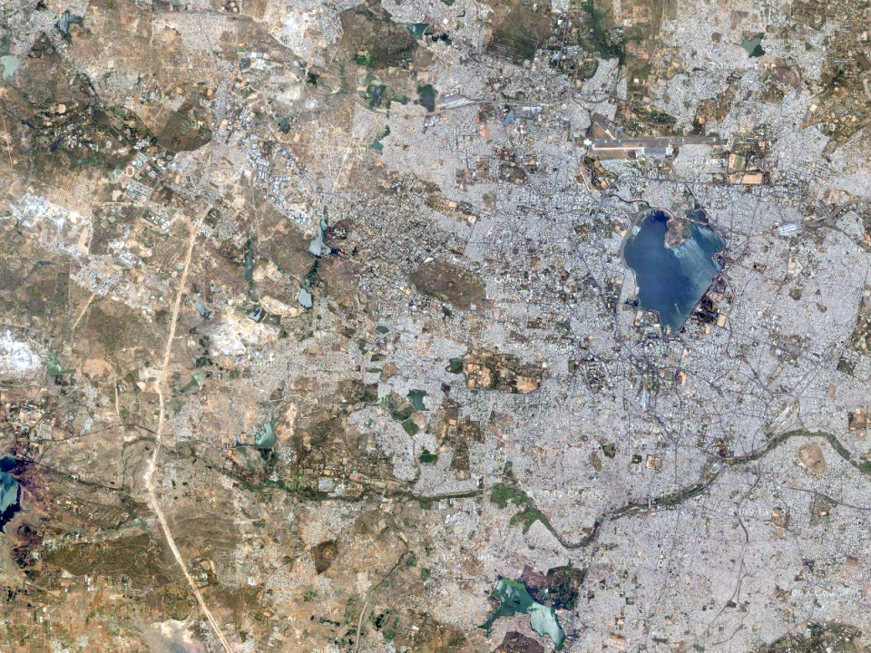
Randomization in “the bubble”
Treatment
Within the bubble, compare treatment to control
Non-participants
> .25 ha
Participants
<=.25 ha
Control

Slide 38
Randomization in the Bubble
Must receive the program
Randomized assignment to the program
Ineligible
Notes:
For instance, we could do a lottery among the eligible population to create a valid counterfactual. Some are not suitable, and ineligible for the program. Others may be in very high need and must receive the program-But we could randomly assign from within the eligible, who gets the program

Slide 39
Randomization in “the bubble”
Program still has discretion to treat “necessary” groups
Example: Agricultural grant program in Niger (PRODEX)
Example: Expansion of consumer credit in South Africa
Notes:
Program officers can maintain discretion
“Worthy” individuals are selected
Others are allocated slots via lottery
Example: Training program
2000 candidates
1000 meet key criteria: formal agricultural institutions and poor enough to qualify
250 out of 1000 chosen based on particular attributes
NGO allocates remaining 250 slots by lottery
Example: Expansion of consumer credit in South Africa
Top applicants were all selected
Below a certain cutoff, all were rejected
Between the two, credit was randomly assigned

Slide 40
Randomized Phase-In
Takes advantage of the program expansion (ie, the NGO cannot implement in all villages the first year)
Everyone gets program eventually
If everyone is eligible for the program, what determines which villages, schools, branches, etc. will be covered in which year?
Notes:
Everyone gets program eventually
Natural approach when expanding program faces resource constraints
“In five years, we will cover 500 schools”
What determines which schools, branches, etc. will be covered in which year?
Some choices based on need, geography, etc.
Others largely arbitrary

Slide 41
Randomized Phase-In
3
Round 1
Treatment: 1/3
Control: 2/3
1
2
3
2
2
2
3
3
2
1
3
3
Round 2
Treatment: 2/3
Control: 1/3
2
1
1
3
2
2
1
2
3
3
3
3
2
3
2
2
Randomized evaluation ends
1
1
2
1
2
1
1
3
3
3
Round 3
Treatment: 3/3
Control: 0
1
1
2
3
3
1
1
2

Slide 42
Randomized Phase-In
Advantages
Everyone gets something eventually
Provides incentives to maintain contact
Concerns
Can complicate estimating long-run effects
Be careful with phase-in windows
Do expectations of change actions today?

Slide 43
Rotation
Groups get treatment in turns
Group A gets treatment in the first period
Group B gets treatment in the second period
Notes:
Groups get treatment in turns
Group A gets treatment in first period
Group B gets treatment in second period
Advantages
Perceived as fairer; easier to get accepted
Concerns
If people in Group B anticipate they’ll receive the treatment the next period, they can have a different behavior in the first period
Impossible to measure long-term impact since no control group after first period

Slide 44
Rotation design
Round 1
Treatment: 1/2
Control: 1/2
Round 1
Treatment: 1/2
Control: 1/2
Round 2
Treatment from Round 1 → Control
——————————————————————————
Control from Round 1 → Treatment

Slide 45
Rotation
Advantages:
Might be perceived as fairer, therefore easier to get accepted
Disadvantages:
If those in Group B anticipate treatment, they might change their behavior
Cannot measure long-term impact because no pure control group
Notes:
Groups get treatment in turns
Group A gets treatment in first period
Group B gets treatment in second period
Advantages
Perceived as fairer; easier to get accepted
Concerns
If people in Group B anticipate they’ll receive the treatment the next period, they can have a different behavior in the first period
Impossible to measure long-term impact since no control group after first period

Slide 46
Randomized Encouragement
Sometimes it’s not possible to randomize program access (vaccines, savings program, etc)
But many programs have less than 100% take-up
Randomize encouragement to receive treatment
Notes:
Sometimes it’s practically or ethically impossible to randomize program access
Flu vaccines.
Employee savings programs.
But most programs have less than 100% take-up
Randomize encouragement to receive treatment

Slide 47
Encouragement design
Encourage
compare encouraged to not encouraged
Do not encourage
These must be correlated
participated
do not compare participants to non-participants
did not participate
Complying
adjust for non-compliance in analysis phase
Not complying

Slide 48
What is “encouragement”?
Something that makes some individuals more likely to use program than others
Not in itself a treatment
E.g., vouchers, training, visit from agent, etc
For whom are we estimating the treatment effect?
Think about who responds to encouragement (compliers)
Notes:
Something that makes some folks more likely to use program than others
Not itself a “treatment”
Bad idea: Training as encouragement for credit
Good idea: Marketing efforts
For whom are we estimating the treatment effect?
Think about who responds to encouragement
Are they different from whole population?

Slide 49
Summary of Possible Designs
Simple lottery
Randomization in the “bubble”
Randomized phase-in
Rotation
Encouragement design
These are not mutually exclusive.
Notes:
Simple lottery
Randomization in the “bubble”
Partial lottery with screening
Randomized phase-in
Rotation
Encouragement design
Note: These are not mutually exclusive.
Simple lottery
Randomization in the “bubble”
Partial lottery with screening
Randomized phase-in
Rotation
Encouragement design
Note: These are not mutually exclusive.

Slide 50
Methods of randomization - recap
Design | Most useful when… | Advantages | Disadvantages
Basic Lottery | Program oversubscribed | Familiar Easy to understand Easy to implement Can be implemented in public | Control group may not cooperate Differential attrition

Slide 51
Methods of randomization - recap
Design | Most useful when… | Advantages | Disadvantages
Phase-In | Expanding over time Everyone must receive treatment eventually | Easy to understand Constraint is easy to explain Control group complies because they expect to benefit later | Anticipation of treatment may impact short-run behavior Difficult to measure long-term impact

Slide 52
Methods of randomization - recap
Design | Most useful when… | Advantages | Disadvantages
Rotation | Everyone must receive something at some point Not enough resources per given time period for all | More data points than phase-in | Difficult to measure long-term impact

Slide 53
Methods of randomization - recap
Design | Most useful when… | Advantages | Disadvantages
Encouragement | Program has to be open to all comers When take-up is low, but can be easily improved with an incentive | Can randomize at individual level even when the program is not administered at that level | Measures impact of those who respond to the incentive Need large enough inducement to improve take-up Encouragement itself may have direct effect

Slide 54
Grants to Farmers’ Association in Niger
Intervention: Provide capacity-building grants to farmers’ association (World Bank, GoN)
Treatment level: Farmers’ association
Randomization level: Farmers’ association
Randomization design:
Partial lottery
Randomized phase-in
Encouragement scheme
But huge implications for sample size!

Slide 55
What if you have 500 applicants for 500 slots?
Consider non-standard lottery designs
Could increase outreach activities
Is this ethical?
Notes:
Consider non-standard lottery designs
Could increase outreach activities
Is this ethical?
Consider carefully what you are trying to evaluate
Would you evaluate the program if it never grew beyond these original 500 applicants?

Slide 56
Non-Standard Lottery Designs
There are 2000 applicants
Application screening identifies 500 “eligible” candidates for 500 slots
In this case, a simple lottery will not work
What are our options?

Slide 57
Non-Standard Lottery Designs
Selection procedures may exist only to reduce eligible candidates in order to meet a capacity constraint
What are they screening for? Which elements are essential?
If certain screening mechanisms appear “arbitrary” (although not random), randomization can serve the purpose of filtering and help with evaluation

Slide 58
Lecture Overview
Unit and method of randomization
Real-world constraints
Revisiting unit and method
Variations on simple treatment-control
Notes:
Unit and method of randomization
Real-world constraints
Revisiting unit and method
Variations on simple treatment-control
Multiple treatments
Crossing or “interacting” treatments
Stratified randomization
Varying levels of treatment
Multiple-stage randomization

Slide 59
Variations on Simple Treatment and Control
Multiple treatments
Crossing or interacting treatments
Varying levels of treatment
Stratified randomization
Multiple-stage randomization
Notes:
Unit and method of randomization
Real-world constraints
Revisiting unit and method
Variations on simple treatment-control
Multiple treatments
Crossing or “interacting” treatments
Stratified randomization
Varying levels of treatment
Multiple-stage randomization

Slide 60
Multiple treatments
Sometimes the core question is deciding among different possible interventions
Ie, in-person extension agent visits versus a call-in hotline
You can randomize these interventions
Does this teach us about the benefit of any one intervention?
Do you have a control group?

Slide 61
Multiple treatments
Treatment 1
Treatment 2
Treatment 3

Slide 62
Cross-cutting treatments
Test different components of treatment in different combinations
Improved seeds only, improved seeds plus training, training only, no treatment
Test whether components serve as substitutes or complements
What is most cost-effective combination?
Advantage: win-win for operations, can help answer questions for them, beyond simple “impact”!
Notes:
Test different components of treatment in different combinations
Test whether components serve as substitutes or compliments
Is the whole (the interaction):
Greater than, less than, or equal to the sum of its parts
What is most cost-effective combination
Advantage: win-win for operations, can help answer questions for them, beyond simple “impact”!

Slide 63
Varying levels of treatment
Some villages are assigned full treatment
All households receive access to SMS-based price information
Some villages are assigned partial treatment
50% of households receive access to SMS-based price information
Testing subsidies and prices
Vary the price of seeds, inputs or access to market information via mobile phone

Slide 64
Stratified Randomization
Randomization should, in principle, ensure balance in the treatment and control groups if the sample size is large enough
What happens when it is small?
Stratified randomization can help to ensure balance across groups when there is a small(er) sample
Divide the sample into different subgroups
Select treatment and control from each subgroup
What happens if you don’t stratify?

Slide 65
Stratified Randomization
Stratify on variables that could have important impact on outcome variable (bit of a guess)
Stratify on subgroups that you are particularly interested in (where may think impact of program may be different)
Stratification more important when small data set
Can get complex to stratify on too many variables
Makes the draw less transparent the more you stratify
You can also stratify on index variables you create

Slide 66
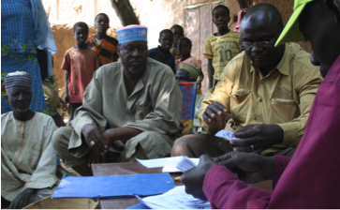
Mechanics of Randomization
Need sample frame
Pull out of a hat/bucket/calabasse
Use random number generator in spreadsheet program to order observations randomly
Stata program code
What if no existing list?
Source: Jenny Aker
Notes:
Need sample frame
Most methods need a pre-existing list
Pull out of a hat/bucket
Transparent
Time consuming, complex if large group
Hard to stratify on many dimensions
Use random number generator in spreadsheet program to order observations randomly
Stata program code
Circulate some examples
What if no existing list?
Walk ins, randomize on the spot

Slide 67
Mechanics of Randomization

