Slide 1
\
EASST: History of East Africa Social Science Translation Collaborative
Prof. Edward K. Kirumira
Principal College of Humanities and Social Sciences
Makerere University
EASST Impact Evaluation Summit
June 18, 2014 | Kigali, Rwanda

Slide 2
Historical/context Issues
Paradigms for development in Africa and African governments' (re)definition of development
Capacity of our governance institutions and systems to deliver services and plan, manage and evaluate interventions
Implementation challenges for National Strategies for Sustainable Development (NSSDs) – e.g. Visions 2020, 2030, 2040; or MDGs and recently the 2015+ Country Ownership Agenda
The disconnect between academic/research institutions and policy makers and practitioners

Slide 3
Example of platforms – Uganda National Academy of Sciences Forum
Promoting a regular and on-going exchange of information and ideas
Clarifying policy and research issues and identifying options that require additional emphasis and research
Informing public and private sector decision-makers and policymakers
Formulating priority and collaborative initiatives

Slide 4
Role of UNAS Forum
Providing a structured opportunity for stakeholder discussion and scrutiny of critical scientific and policy issues
Stimulating original thinking about new as well as long-standing problems in the national development process
Facilitating discussion and inquiry into the most pressing and cross-cutting set of issues

Slide 5
UNAS FORUM Experiences
Regular convening mechanism of representatives from the upper policy and decision-making levels and academia
Forum members organizing around problem-solving and issue-identification activities : roundtables, conferencing
Publication of summary reports and policy advisory briefs for evidence-based decision making

Slide 6
The Google Attempt
May-September 2008 submission of proposal to Google Foundation (Ted, Edward and Temina)
Multi-university partnership seeking to improve provision of basic public services in East Africa
Developing and evaluating new tools to empower community engagement in public sector oversight
14-16 January 2009 the EASST Collaborative Summit Meeting in Kampala
We were not successful by a whisker …!
Notes:
The network then sought to include the media and also link with what Google was planning to do with Uganda radio Network and the example of Tanzania’s REPOA. We planned as well shorter-tine Fellowships of 3 months.

Slide 7
EASST Collaborative
What is it?
Network for researchers committed to rigorous evaluation of social programs in Eastern Africa
Joint administration by CEGA and Makerere University with peer institutions including Addis Ababa University, University of Dar es Salaam, African Population & Health Research Centre (APRC) in Nairobi and the National University of Rwanda
Notes:
EASST is an additive network. It is dedicated to supporting rigorous evaluation of social programs in Eastern Africa. We want to build the leadership of East African researchers in this novel field, and also equip young researchers with the skills needed to translate their research findings for governments and NGOs.

Slide 8
Goals
Build the leadership of East African researchers in the field of impact evaluation
Promote “research into action” by collaborating with government, journalists, private sector
Fostering research exchange and learning in the region

Slide 9
Why Impact Evaluation?
Policy makers have difficult questions and options to make in resource constrained economies – for instance:
What are the most cost-effective ways to improve literacy and numeracy in primary schools?
Will short-term subsidies for fertilizer increase farmer’s use over the long term?
Which package of job placement services will improve youth employment outcomes?
Notes:
Why is EASST so interested in “Impact Evaluation”? We see it as a tool to help inform policy-makers, who have to make difficult choices about how, where, and when to allocate money for social programs.
Education policy-makers have a range of options for investing in primary schools– but to improve basic literacy and numeracy among primary school students, should they focus on textbooks and school grants? Teacher training? Pay-for-performance schemes in schools? Parent involvement? There are many options that could work… but which ones are actually effective in our context? Which ones are most cost-effective?

Slide 10
Why Impact Evaluation?
How to select among many plausible alternatives? Impact Evaluation!
Rigorously evaluate multiple options
Measure their costs and impacts
Focus limited resources where they will have the greatest effect.

Slide 11
Why academia/researchers
Impact evaluation is a tool that the university community can bring to public policy
Work with program managers and decision-makers to design innovative new solutions, and then test them out experimentally
EASST aims to cultivate the capacity for East African academics to lead in the field of impact evaluation

Slide 12
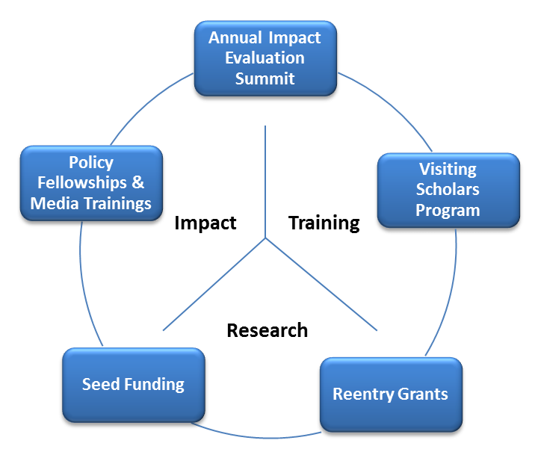
Notes:
The EASST program has several components. The first is our annual “Summit” – we have held one in Uganda (July 2012) and in Dar es Salaam (2013). In addition, EASST runs a Visiting Scholars program that sends our young researchers to U.S. universities for sabbaticals, where they network and collaborate with leading evaluators. EASST has a competitive research grants program, to catalyze new evaluations of social programs led by researchers in the Eastern Africa region.
Another exciting program is our policy fellowship, which will give senior researchers an opportunity to participate in the policy-making process while learning about the role of impact evaluation in government decision-making. We will be selecting 2 fellows from the East Africa region, to be seconded to a high-level government agency or office for a few months.
Our fellows will be able to bring economic and technical information to decision-makers, while also learning how to communicate and participate effectively.

Slide 13
EASST: Next Steps
Opportunities for researchers to:
Learn about ongoing evaluations in the Eastern Africa region and elsewhere
Become actively engaged in impact evaluation
Participate in the policy-making process
Notes:
In the coming months and years, EASST hopes to continue providing several opportunities for East African researchers to engage in impact evaluation.
This will include learning opportunities through conferences, our website, visiting fellowships, and curriculum development.
It will also include “doing” opportunities – with collaborative research grants that will provide hands-on experience in implementing an impact evaluation.
We welcome your participation in the network, and hope that you will help us to grow and nurture this new effort.

