Slide 1
Progress on Registration in Political Science
Jeremy M. Weinstein
(on behalf of Experiments in Governance and Politics – EGAP)

Slide 2
The problem: What is fishing?
Say that there is a set of approaches that could be used in a given context.
Each approach is associated with a set of possible conclusions and that before the implementation of the research the conclusion to be drawn from a given approach is a “random variable.”
We say that a result is “fished" when the decision to report the findings of some approach depends on the realization of the conclusion.
Eg:
report the findings from an entire study only if you like the results,
keep a particular outcome variable in analysis only if...
estimate effects using a particular statistical model only if…

Slide 3
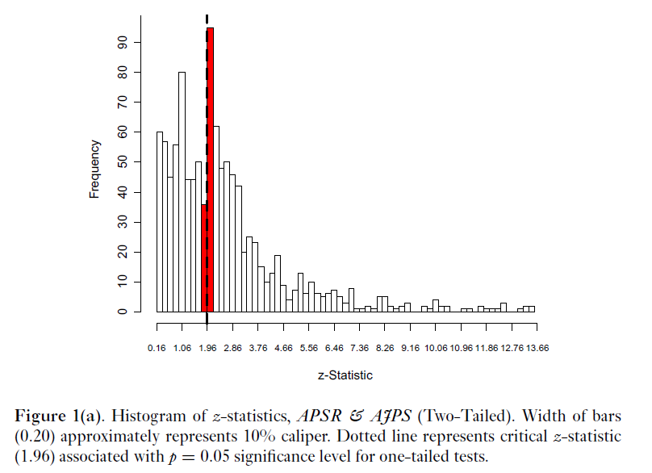
A problem in practice
From: Gerber and Malhorta 2008

Slide 4
A problem in how journals think
"Overall, I think the paper addresses very important research questions. The authors did well in trying to address issues of causality. But the lack of results has weakened the scope and the relevance of the paper. Unless the authors considerably generate new and positive results by looking say at more heterogeneous treatment effects, the paper cannot, in my view, be published in an academic journal such as [Name of Prestigious Journal].“
[April 2012: Received by anonymous colleague, from anonymous reviewer for anonymous journal, but true!]

Slide 5
A proposal from EGAP
Journal led
Non-mandatory registration for all research that
claims to provide a test of a theory or hypothesis and
employs prospective data to researchers at time of registration
Nonbinding registration:
Researchers should be able to modify plans during analysis
When they do this though they should signal it and should, where possible, report results from planned analysis also
Recognition for authors:
Journals indicate that a piece has been registered (in whole/in part?) and is compliant or not (how much?)

Slide 6
Key principles of EGAP proposal
Compatible with other initiatives
Voluntary and non-binding
Focus on prospective research
Open with respect to subject matter
Core mandatory elements, plus flexible fields
Submissions subject to basic review
Publically searchable
Sunset provision for private registration
Deviations acknowledged
Report results within registry, regardless of whether published
Recognized by journals

Slide 7
Cycle

Slide 8
6 Major Questions Discussed with Journals
What should the scope of registration be (Prospective designs? Only experimental?)
How best to incentivize authors?
How much flexibility should authors have (Should this be voluntary and nonbinding or something requiring greater commitment?)
Who should own it/host it? (Should the registry be housed at APSA? Polmeth? EGAP? Elsewhere?)
Should there be quality control? Or purely bureaucratic certification?
Strategy: what would it take to pilot this from the perspective of your journal / organization? What parties would have to give their agreement?

Slide 9
Key Issues Raised
Impetus for registration is helped if research is consequential (e.g. medicine)
Independent assessments of “compliance” would generate disagreement; better to have it policed by broader community
Public registry could interfere with anonymity unless anonymized registrations are made available to journals
Demonstration of utility in other fields?
Cannot be imposed by journals; should be demand-driven
Advantages and disadvantages of broadening the scope beyond experiments
Authors could send this signal without journal action
Need to minimize burdens on journals

Slide 10
Next Steps
Shared goal: to provide a facility to allow research that has been registered to be recognized as such so that reviewers and readers can use this information in their assessment of findings
Statement by journal editors: announce that they will recognize research as being “registered” if the study was registered before analysis with any registry meeting specified conditions AND if the submission includes a reference to the registry and describes clearly how the analysis in the paper is consistent with or deviates from the pre-analysis plan
Onus is on others to create registries that meet pre-specified conditions (timestamp, unique identifier, publically accessible, registration info available to journals, minimum data fields)
Focus on norm adoption, and enabling signaling

Slide 11
Most important point of push back: This will stifle innovation, sometimes people need to fish?
If you have to fish you can:
Declare that you want to do soak and poke exploration (ie exploration that might be valuable but is not itself amenable to ex ante description) and signal that that is what you are doing by not registering.
Do principled exploration and register the process used for discovery. Alternatively, split the data in two; do unregistered exploration in one set, then form hypotheses, register, and test in the second set.
Declare that really you are interested in the estimation of various quantities, not tests of particular claims about quantities, and register that.
Register some weakly motivated hypotheses because you feel you have to register something concrete; not listen to what the data is trying to tell you when you see things working very differently. (Worst choice?)

