Slide 1
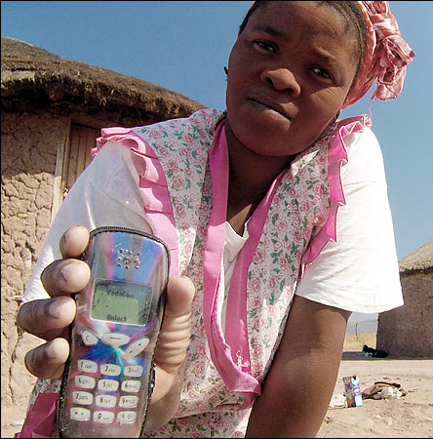
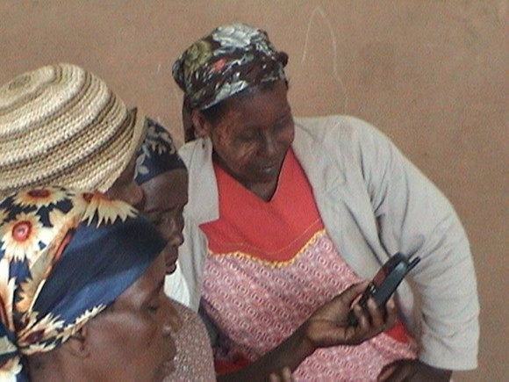
Sending a Message: Can Mobile Phone Technology Promote Government Accountability and Empower Women?
CEGA 2011 Research Development Challenge
April 28, 2011
Ruth Carlitz

Slide 2
Context
Huge growth of mobile phones in developing world
5.3 billion mobile subscriptions as of 2010, 3.8 billion in the developing world
Mobile phone penetration in developing countries now stands at 68% — higher than any other technology before
Tanzania represents trends well
40 mobile phone subscriptions per 100 habitants
Mobile phone subscriptions outnumber fixed telephone lines by 101 to one
Mobile phone subscriptions have grown from about two million in 2004 to over 17 million in 2009.

Slide 3
How is this new technology changing people’s lives?
Studies to date have mostly examined economic impact
Key finding: reduction in communication costs has improved agricultural and labor market efficiency and producer and consumer welfare (in specific circumstances and countries.)
Less conclusive scholarship on political impact
Help solve collective action problems?
Transmit information to enable monitoring/accountability?
Facilitate riots (e.g. Kenya)
What about gender?
Unequal access promoting “mobile gender gap”?
Mobiles may empower women and girls by increasing employment opportunities, or access to schooling
Notes:
Aker & Mbiti (2010) cite tendency for development agencies/donors to “jump on the information technology bandwagon” without properly assessing its effects.

Slide 4
Case study: Daraja (Tanzania)
I will document the experience of a Tanzanian non-governmental organization (Daraja) initiative that encourages rural citizens to monitor the quality of their local water supply via text messaging.
Daraja serves as an intermediary, transmitting citizens’ text messages about water quality to relevant government officials as well as the local media.
Unique opportunity to investigate potential for mobile phones to empower women and girls
Women less likely to participate publicly in monitoring government
Lack of access to clean water of particular significance to women and girls, who typically bear responsibility for household water provision

Slide 5
Theoretical Framework/ Relevant Literature
Political agency framework (principal-agent problems)
Nascent literature on improving governance and public service delivery through community participation in monitoring
Bjorkman & Svensson
Olken (2007)
Broader lit suggesting that citizens’ access to better info (via media) promotes greater gov’t responsiveness
Strömberg (2004); Strömberg & Snyder (2010); Ferraz & Finan (2008); Besley & Burgess (2002)
Notes:
Björkman and Svensson (2009) conduct a randomized field experiment on community-based monitoring of public primary health care providers in Uganda, which demonstrates large increases in utilization and improved health outcomes.
Olken (2007) conducts a randomized field experiment on reducing corruption in over 600 Indonesian village road projects, examining the effects of increasing the probability of audit as well as applying two different community participation 'treatments' (invitations to attend "accountability meetings” and distribution of anonymous comment forms). He finds that audits have a much more significant effect on reducing corruption than does community participation in monitoring.
In all these studies, citizens lack info and can’t monitor their politicians effectively. But in my case more of a principal-agent problem b/w politician principal and bureaucratic agent (DWE). Or could think about it in terms of signaling intended voting behavior.

Slide 6
Research Design
Hypothesis
Local monitoring (via mobile phones) will improve the quality of the rural water supply by mobilizing pressure for “accountability from below” - creating incentives for local officials to respond to demands from citizens in their communities, particularly women
Preliminary investigation in Fall 2011
Track mobile use patterns by gender in the villages targeted by Daraja’s intervention, as well as in neighboring villages
Interviews to investigate gender-related barriers to mobile phone access, as well as cross-gender differences in incentives for monitoring.
Compare # of text messages sent in a given region with # of articles published about water access in local newspapers
Analyze data from Daraja’s partner NGO WaterAid, which has begun an extensive water point mapping project, using GIS

Slide 7
Thank You!!

