Slide 1
The Political Economy of Hydrocarbon Wealth and Fuel Prices
EEG Research & Matchmaking Conference
November 3-4, 2016
Paasha Mahdavi, Georgetown University
Michael L. Ross, UCLA

Slide 2
Toward an improved understanding of the role of extractives in energy provision
How do fossil fuel discoveries impact development?
What is the relationship between hydrocarbon discoveries and fuel pricing policies?
  Why do some countries subsidize fossil fuel consumption, while others tax it?
  Why do their policies change, and why are these changes sustained or reversed?
  Can we better measure what governments do?

Slide 3



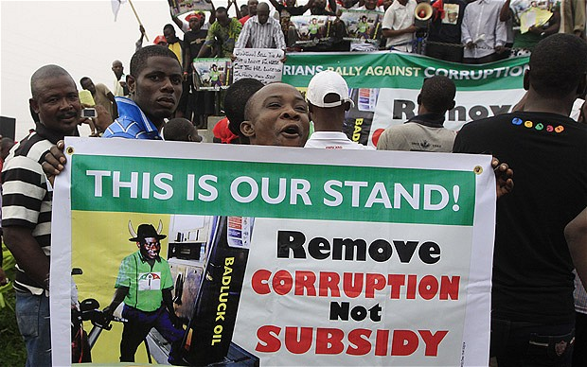
Removing subsidies…
Myanmar, August 2007
Bolivia, December 2010
Jordan, November 2012
Nigeria, January 2012

Slide 4
What we know so far…
Estimating the effects of subsidies:
  Fiscal impact: ~$5.3 trillion in 2015 (6.5% global GDP)
  Negative externalities: global climate change, local air pollution, congestion, traffic deaths
  Regressive: the rich primarily benefit
Factors determining subsidies:
  Political economy: populism, “path dependence”
  Regime type: dictators vs. democrats
  Resource wealth: exporters vs. importers
Reforming subsidies:
  Fiscal pressures
  Consumer expectations

Slide 5
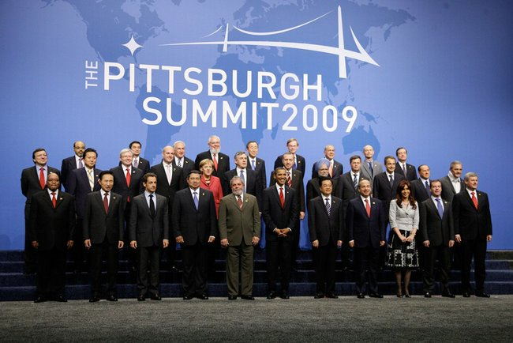

Slide 6
Improving the state of knowledge
How large are taxes/subsidies & how do they vary across countries?
Where do we observe reform? Backsliding?
Are global subsidies rising or falling?
Need for more refined, precise measures

Slide 7
Fossil fuel subsidies
Consumer subsidies vs. producer subsidies
Pre-tax (below supply costs) vs. post-tax (below supply cost + cost of social/environmental externalities)
Petroleum, natural gas, coal

Slide 8
Fossil fuel subsidies
Consumer subsidies vs. producer subsidies
Pre-tax (below supply costs) vs. post-tax (below supply cost + cost of social/environmental externalities)
Petroleum, natural gas, coal

Slide 9
Fossil fuel subsidies
Consumer subsidies vs. producer subsidies
Pre-tax (below supply costs) vs. post-tax (below supply cost + cost of social/environmental externalities)
Petroleum, natural gas, coal

Slide 10
Fossil fuel subsidies
Consumer subsidies vs. producer subsidies
Pre-tax (below supply costs) vs. post-tax (below supply cost + cost of social/environmental externalities)
Petroleum, natural gas, coal

Slide 11
Fossil fuel subsidies
Consumer subsidies vs. producer subsidies
Pre-tax (below supply costs) vs. post-tax (below supply cost + cost of social/environmental externalities)
Petroleum, natural gas, coal
  Gasoline & diesel → ~10% of all greenhouse gas emissions
  Fastest growing source of GHG
  Biggest single beneficiary of fossil fuel subsidies (pre-tax, consumer)

Slide 15
Recent price reforms?
Prices among the 22 persistent subsidizers (Jan 2014-June 2016)

Slide 16
Hydrocarbon discoveries and price policy changes: Bolivia

Slide 17
Hydrocarbon discoveries and price policy changes: Vietnam

Slide 18
Future research: Improving knowledge of government policies and their dynamics
Sources of changing taxes and subsidies
  Supply shocks; political transitions; fiscal crises
Sources of changing fixity policies
  Driven by different factors than subsidies?
Comprehensive price data for non-petroleum fuels
  Coal; natural gas; electricity
Microfoundations of subsidies and subsidy reform
  Public perceptions; behavioral responses

