Slide 1
The Political Economy of Aid for Power Sector Reform
Neil mcculloch
John ward
Esme Sindou

Slide 2
Background
Aid is political …
… and achieving a developmental objective requires a deep understanding of the politics

Slide 3
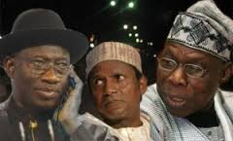
Power sector reform is particularly “political”
It is a natural monopoly (due to economies of scale)
It is a key part of the developmental narrative of many countries
It provides a centralised, easy and large opportunity for both rent extraction and patronage

Slide 4
The questions and the answers
The Questions
How have donors taken politics into account in designing and implementing power sector reform programmes in Sub-Saharan Africa and South Asia?
What can be done to improve the way in which power sector projects are implemented?
The Answers
Remarkably little
A lot … but it would require changes in the way in which donors operate and projects are designed

Slide 5
Approach
Literature Review
What does the literature tell us about how donors have managed the politics of power sector reform?
Review of Project Documentation
Collected project documentation from the major donors to the sector in Tanzania and Orissa
Interviews with senior donor officials
Focussed on officials with knowledge of power sector reforms in Tanzania and Orissa.

Slide 6
Literature Review
Donors have played a major role as architects of reform in the power sector in developing countries (Bacon and Besant-Jones, 2002; Wamukonya, 2003; Dornan, 2014)
Until the early 2000s, donors pushed the “standard model” of reform (corporatisation, commercialisation, legislation, regulation, restructuring, privatisation and competition) – there was a belief that “one size fits all”. (Gratwick and Eberhard 2008; Joskow, 2006; Littlechild, 2006; Hunt, 2002)
There were a variety of motives for the approach donors took – ideological, technical, commercial (Bacon, 1995; Thompson and Bazilian, 2014)
The standard model has yielded rather limited results, often because it failed to take account of the underlying political constraints (Eberhard, 2004; Dubash and Rajan, 2001)
Donors have attempted to move away from “cookbook” solutions (Besant-Jones, 2006; Levy 2007; Fritz et al. 2014) – but have struggled to change their approach (Naqvi, 2016)

Slide 7
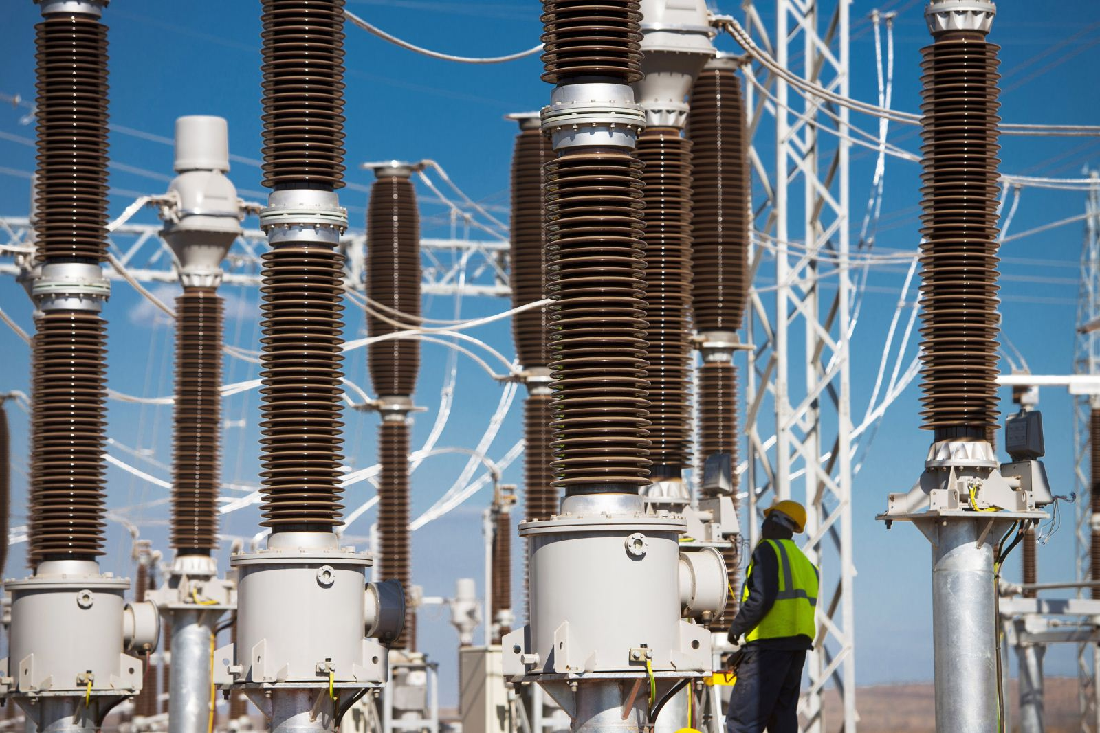
The Tanzania story
Dominated by TANESCO – a state-owned utility. It has struggled financially for years resulting in low investment and very poor quality service
Donor driven reforms in 1990s applied the standard model – but never successfully implemented
Management contract tried from 2002-2006, but was terminated
New Act creates EWURA and REA in 2008
Emergency Power Producer contracts led to a corruption scandal and very high costs
Difficult relationship with key donors

Slide 8
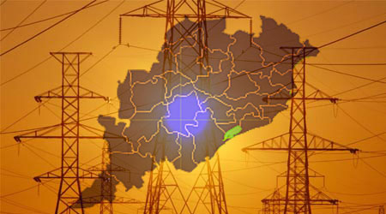
The Orissa story
State government initiated reform in early 1990s, supported by DFID and World Bank
Aim was to unbundle the transmission and distribution functions and privatise them
New distribution companies failed to provide significant new investment, increase collections, or reduce T&D losses … in part because of the refusal by the state government to correctly acknowledge losses
So the private sector withdrew and the distribution companies went back in public hands

Slide 9
Key lessons from our interviews
Analysing the underlying politics of change in a country is valuable – but only if used
Very few donors conducted any kind of political economy analysis prior to the initiation of their programmes. Even when this was done, it was a separate exercise with little bearing on the substance of the proposed project.
Flexibility is important – but it is difficult
Much has been made of flexible and adaptive approaches to project management. But making contracts flexible is complex; and allowing a slower and more experimental approach runs against the need for “results”
Dialogue, trust and personal relationships are of critical importance for reform
But rotation of staff and the burden of process compliance reduces the ability to build trust.
Mental models matter
Many international consultants still apply the “standard model” because they are unaware of, or find it harder to deal with the “messy” hybrid models that have evolved.
There may be an opportunity to build domestic demand for reform
Donors place very little effort on building a broader coalition for reform with civil society and the private sector

Slide 10
What we know and what we don’t know
What we know
What we don’t know
Power sector reform projects have a particularly bad record of failure because they are particularly prone to clashing with local political constraints
Donors are keenly aware of these political issues, but have struggled to modify their approach to take them into account
The underlying contexts and political factors that make success more or less likely
Why donors don’t significantly adapt their programmes when they know the political problems
Why power sector reform is successful when it is – and what the role of external actors has been in this
What sorts of communication can build wider support for power sector reform

Slide 11
How EEG research can fill these gaps
1. Explore how power sector reform options link to the underlying political settlement
There is extensive literature on political settlements now – but very little work has explored its (major) implications for power sector reform work
2. Assess how donors incorporate PEA into programming in the power sector
Understanding why it is so difficult for donors to incorporate political economy analysis into programming in the power sector
3. Case studies of successful power sector reforms
Examine the approach was taken in each case: what was the influence of external factors and actors?; how did the government build support for reform?; what obstacles were faced and how did they overcome them?
4. Survey what people think about power sector reform
Implement a survey experiment to test how ideas about reform shift with new information. This could provide policy recommendations about the messages most likely to build support for reform.

