Slide 1
EEG Research & Matchmaking Conference
Professor Catherine Wolfram
UC Berkeley
Washington, D.C.
November 3rd and 4th, 2016

Slide 2

Development Angle

Slide 3


Slide 5

The primary objective of the Applied Research Program on Energy and Economic Growth (EEG) is to generate rigorous evidence for policy-makers on the mechanisms by which investments in energy systems can translate to inclusive economic growth.

Slide 6
EEG is focused on the following six themes:
Theme 1: Linkages between electricity supply and economic growth
Theme 4: Constraints to use of large-scale renewable energy sources
Theme 2: Financial and policy instruments for encouraging appropriate large-scale power infrastructure
Theme 5: Extractives for electricity provision and sustainable development
Theme 3: Supply and efficiency measures in supporting sustainable urbanisation
Theme 6: Appropriate design of larger-scale, centralised energy infrastructure
Cross-cutting themes:
Gender Data Climate Change

Slide 7
EEG timeline
Year
Part 1 (beginning April 2016)
Producing 18 state-of-knowledge papers
Hosting policy workshops, research conference
Designing research framework for empirical work in Phase 2
1
2
Part 2 (beginning second half of 2017)
Commission 12 million GBP in empirical research
Support the execution of high-quality, high-impact work
Work with policymakers to maximize research uptake
3
4
5

Slide 8

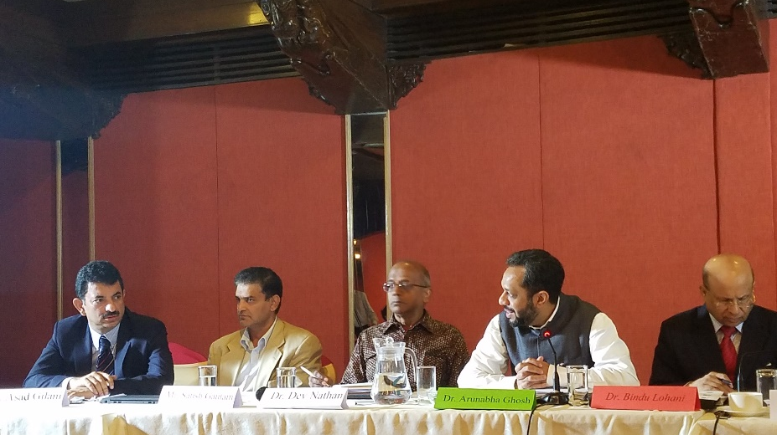
Regional Policy Workshops
Tanzania
Nepal
Dar es Salaam (July 2016)
Kathmandu (September 2016)
Common themes:
Disciplining state-owned utilities
Data and forecasting
Potential for generation, regional trade etc.

Slide 9


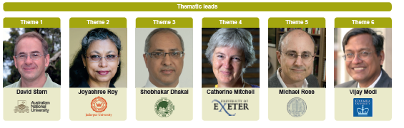

EEG Leadership

Slide 10


The Rural Electric Power Project (REPP) in Kenya
In 2013, we formed a partnership with the Rural Electrification Authority to answer four questions.
1
What is the last-mile opportunity?
2
What is the demand curve for power?
Research
Partnership
3
Economies of scale in mass connections?
4
Social and economic impacts?

Slide 11
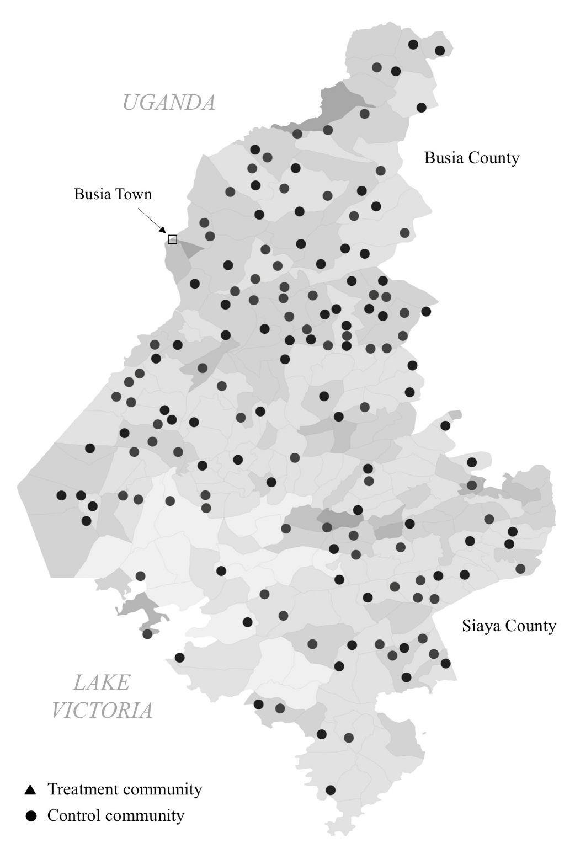
Building our sample of communities
In September 2013, we worked with REA to identify a representative sample of 150 rural transformers in Western Kenya installed in the past five years.

Slide 12
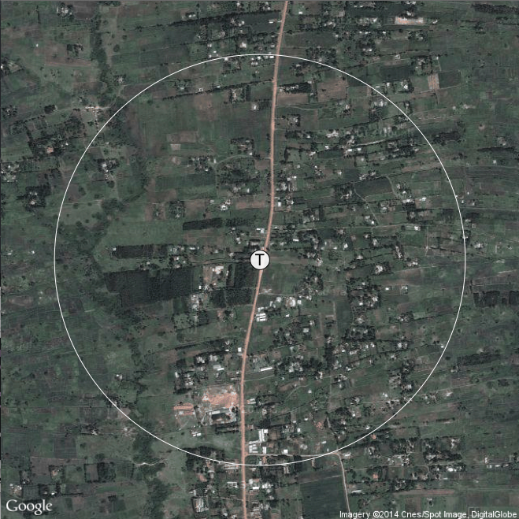
Transformer community example
Legend
T
Transformer &
600 meter radius
600 meters

Slide 13
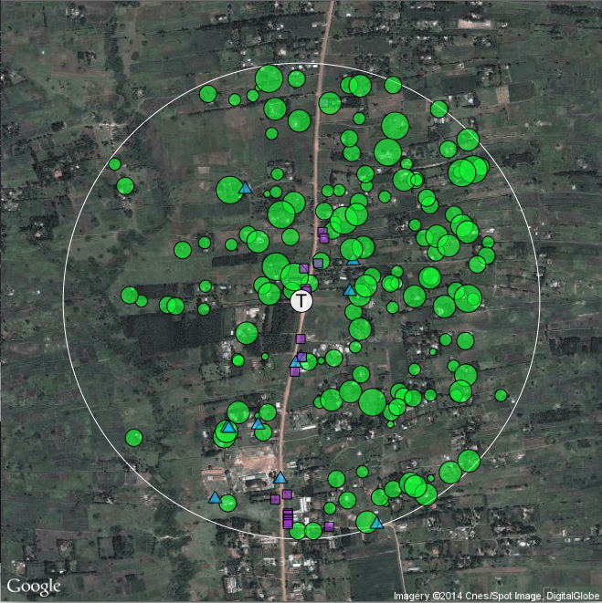
Transformer community example
Legend
T
Transformer & 600
meter radius
Households (scaled by
household size)
Businesses
Public facilities
(e.g. schools, health)

Slide 14
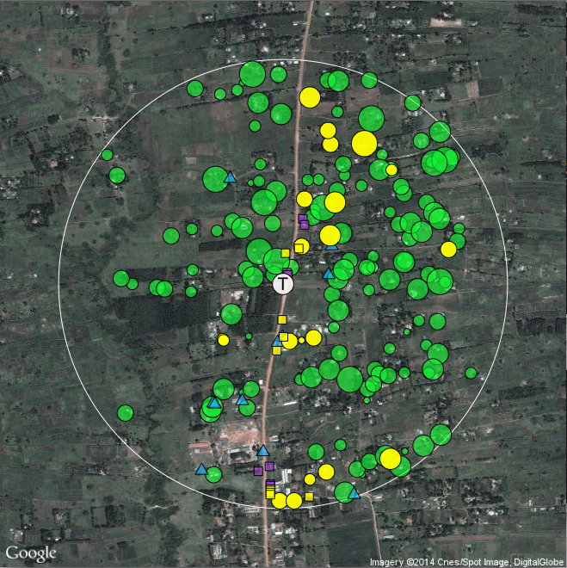
Transformer community example
Legend
T
Transformer & 600
meter radius
Households (scaled by
household size)
Businesses
Public facilities (e.g. schools,
health)
Electrified households
Electrified businesses
Electrified public facilities

Slide 15
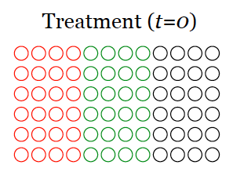
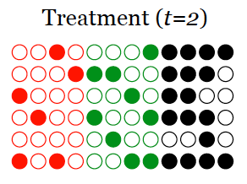
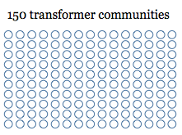
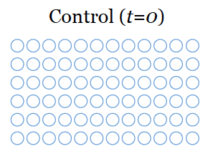
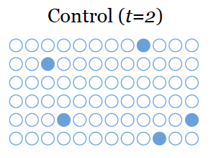
Randomized controlled trial (RCT)
Different levels of randomized subsidies for households in treatment group
Communities are randomly divided into a treatment and a control group
Compare changes in social and economic outcomes for both groups

Slide 16
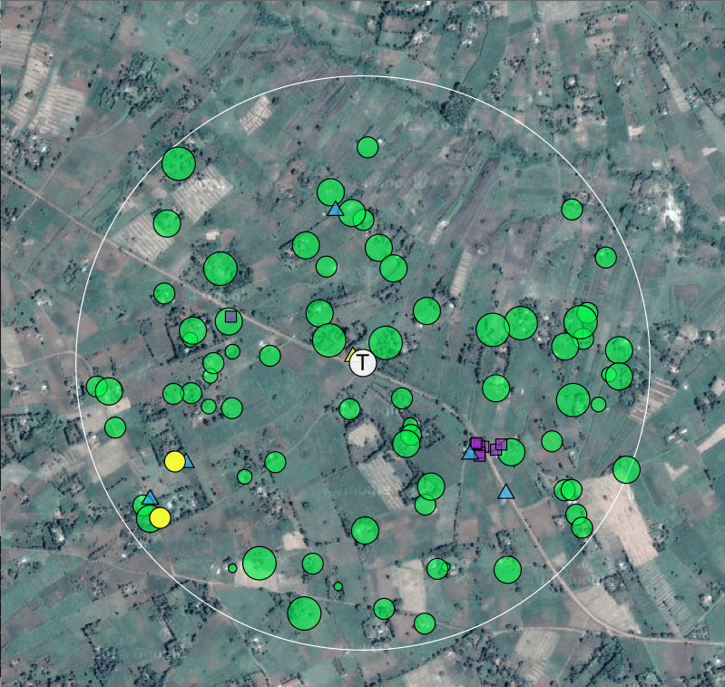
Using our maps of all households…
Legend
T
Transformer & 600
meter radius
Households (scaled by
household size)
Businesses
Public facilities (e.g. schools,
health)
Electrified households
Electrified businesses
Electrified public facilities

Slide 17
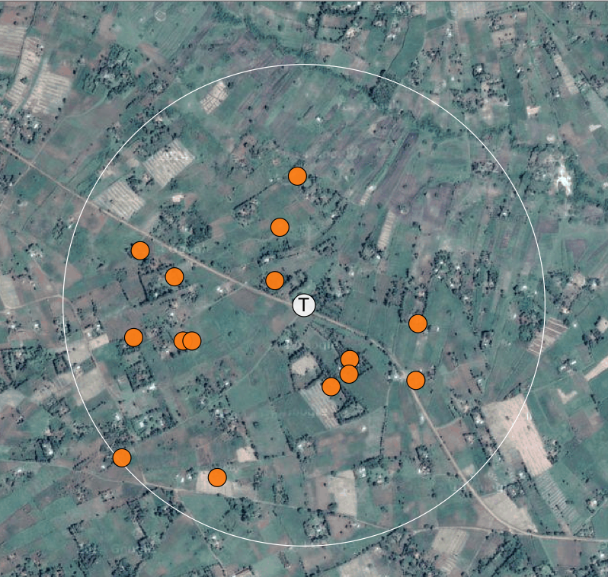
…we sampled 15 households per community
Legend
T
Transformer & 600
meter radius
Randomly selected REPP
households
Random sampling:
Distance to LV line is approximated by the distance of the unconnected household to either: (1) a transformer, or (2) a connected household, public facility or business.
This sampling procedure was determined in collaboration with REA, in order to reduce the average costs of connections.

Slide 18
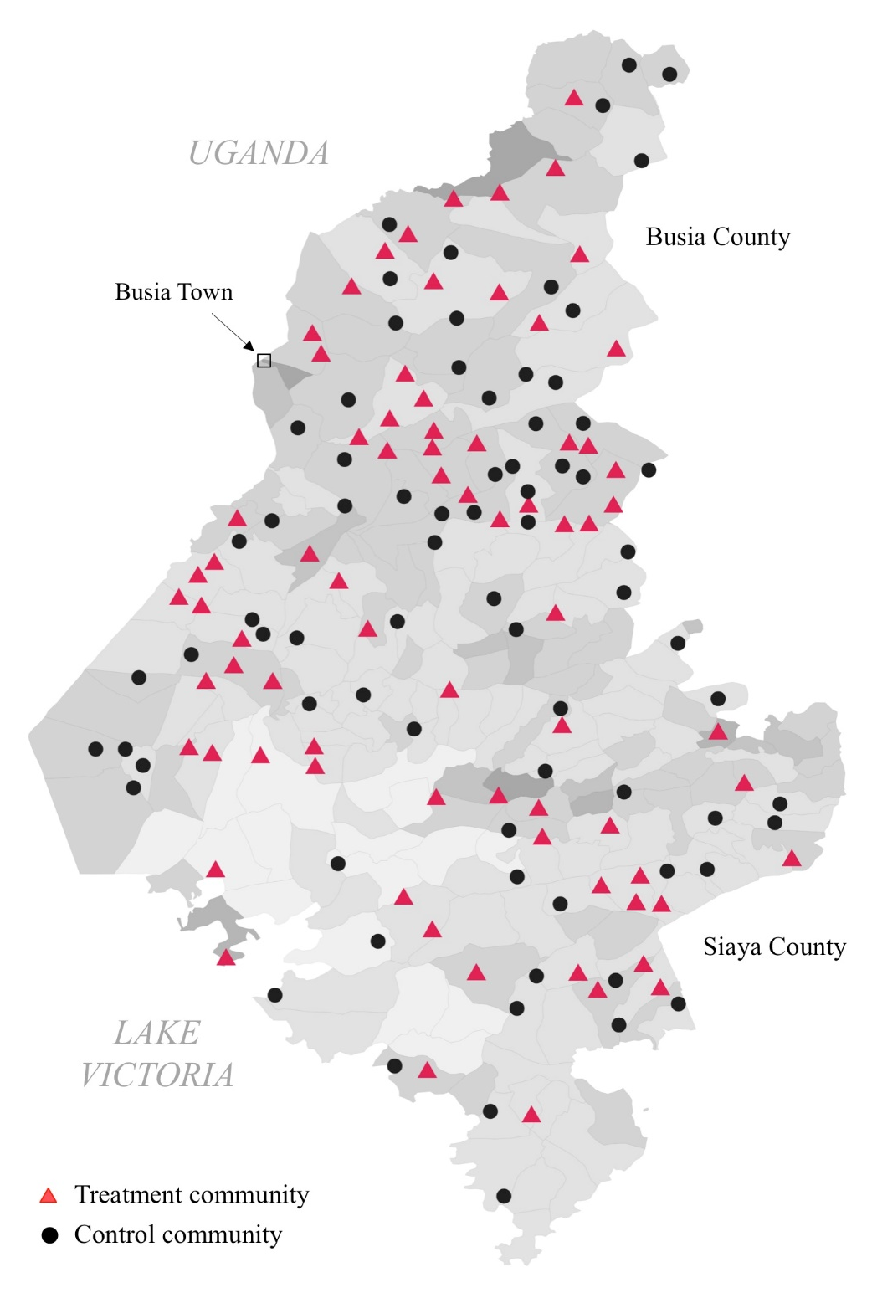
Intervention: Subsidized connections
150 transformer communities.
2,504 households in total.
Treatment households provided with a subsidized grid connection:
  0 KSh
  15,000 KSh
  25,000 KSh
  35,000 KSh
The experiment generated random variation in:
Price: Assigned at community level.
Scale: Number of households connected at the same time.

Slide 19
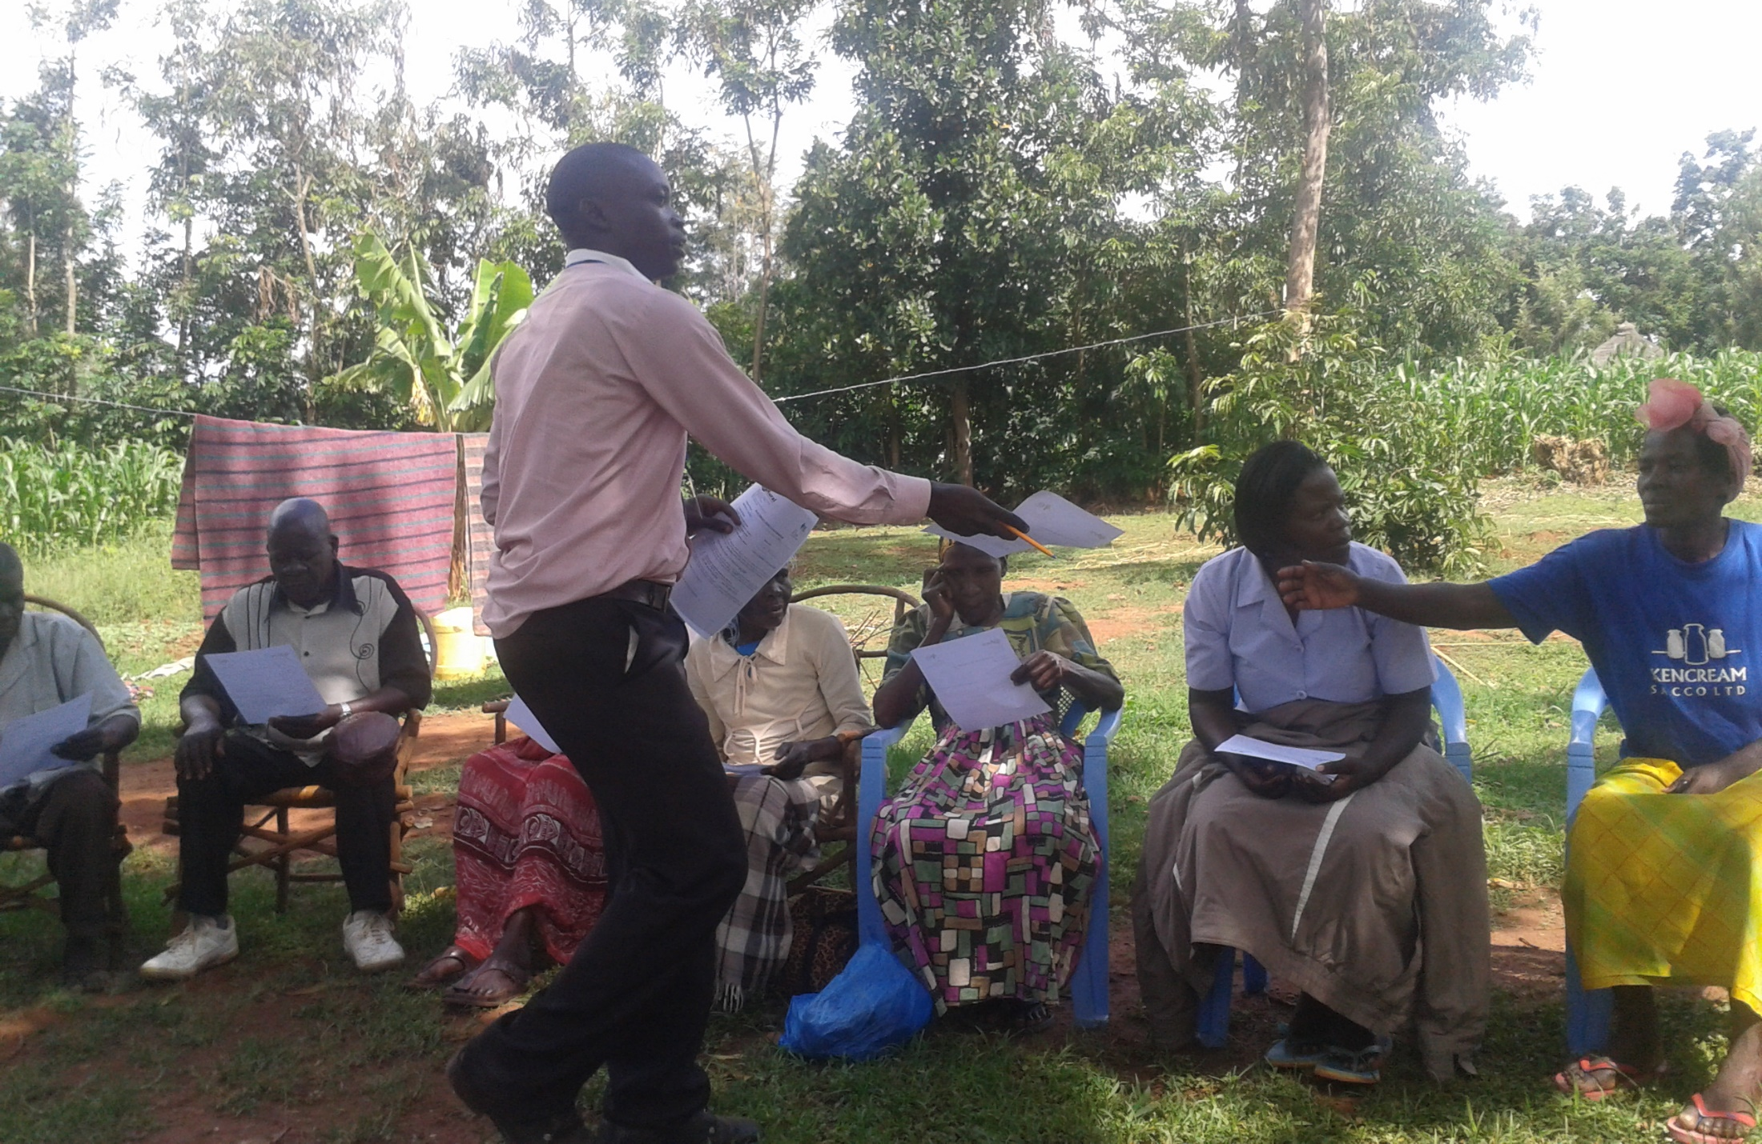
Step 1: IPA distributes “subsidies” to households

Slide 20
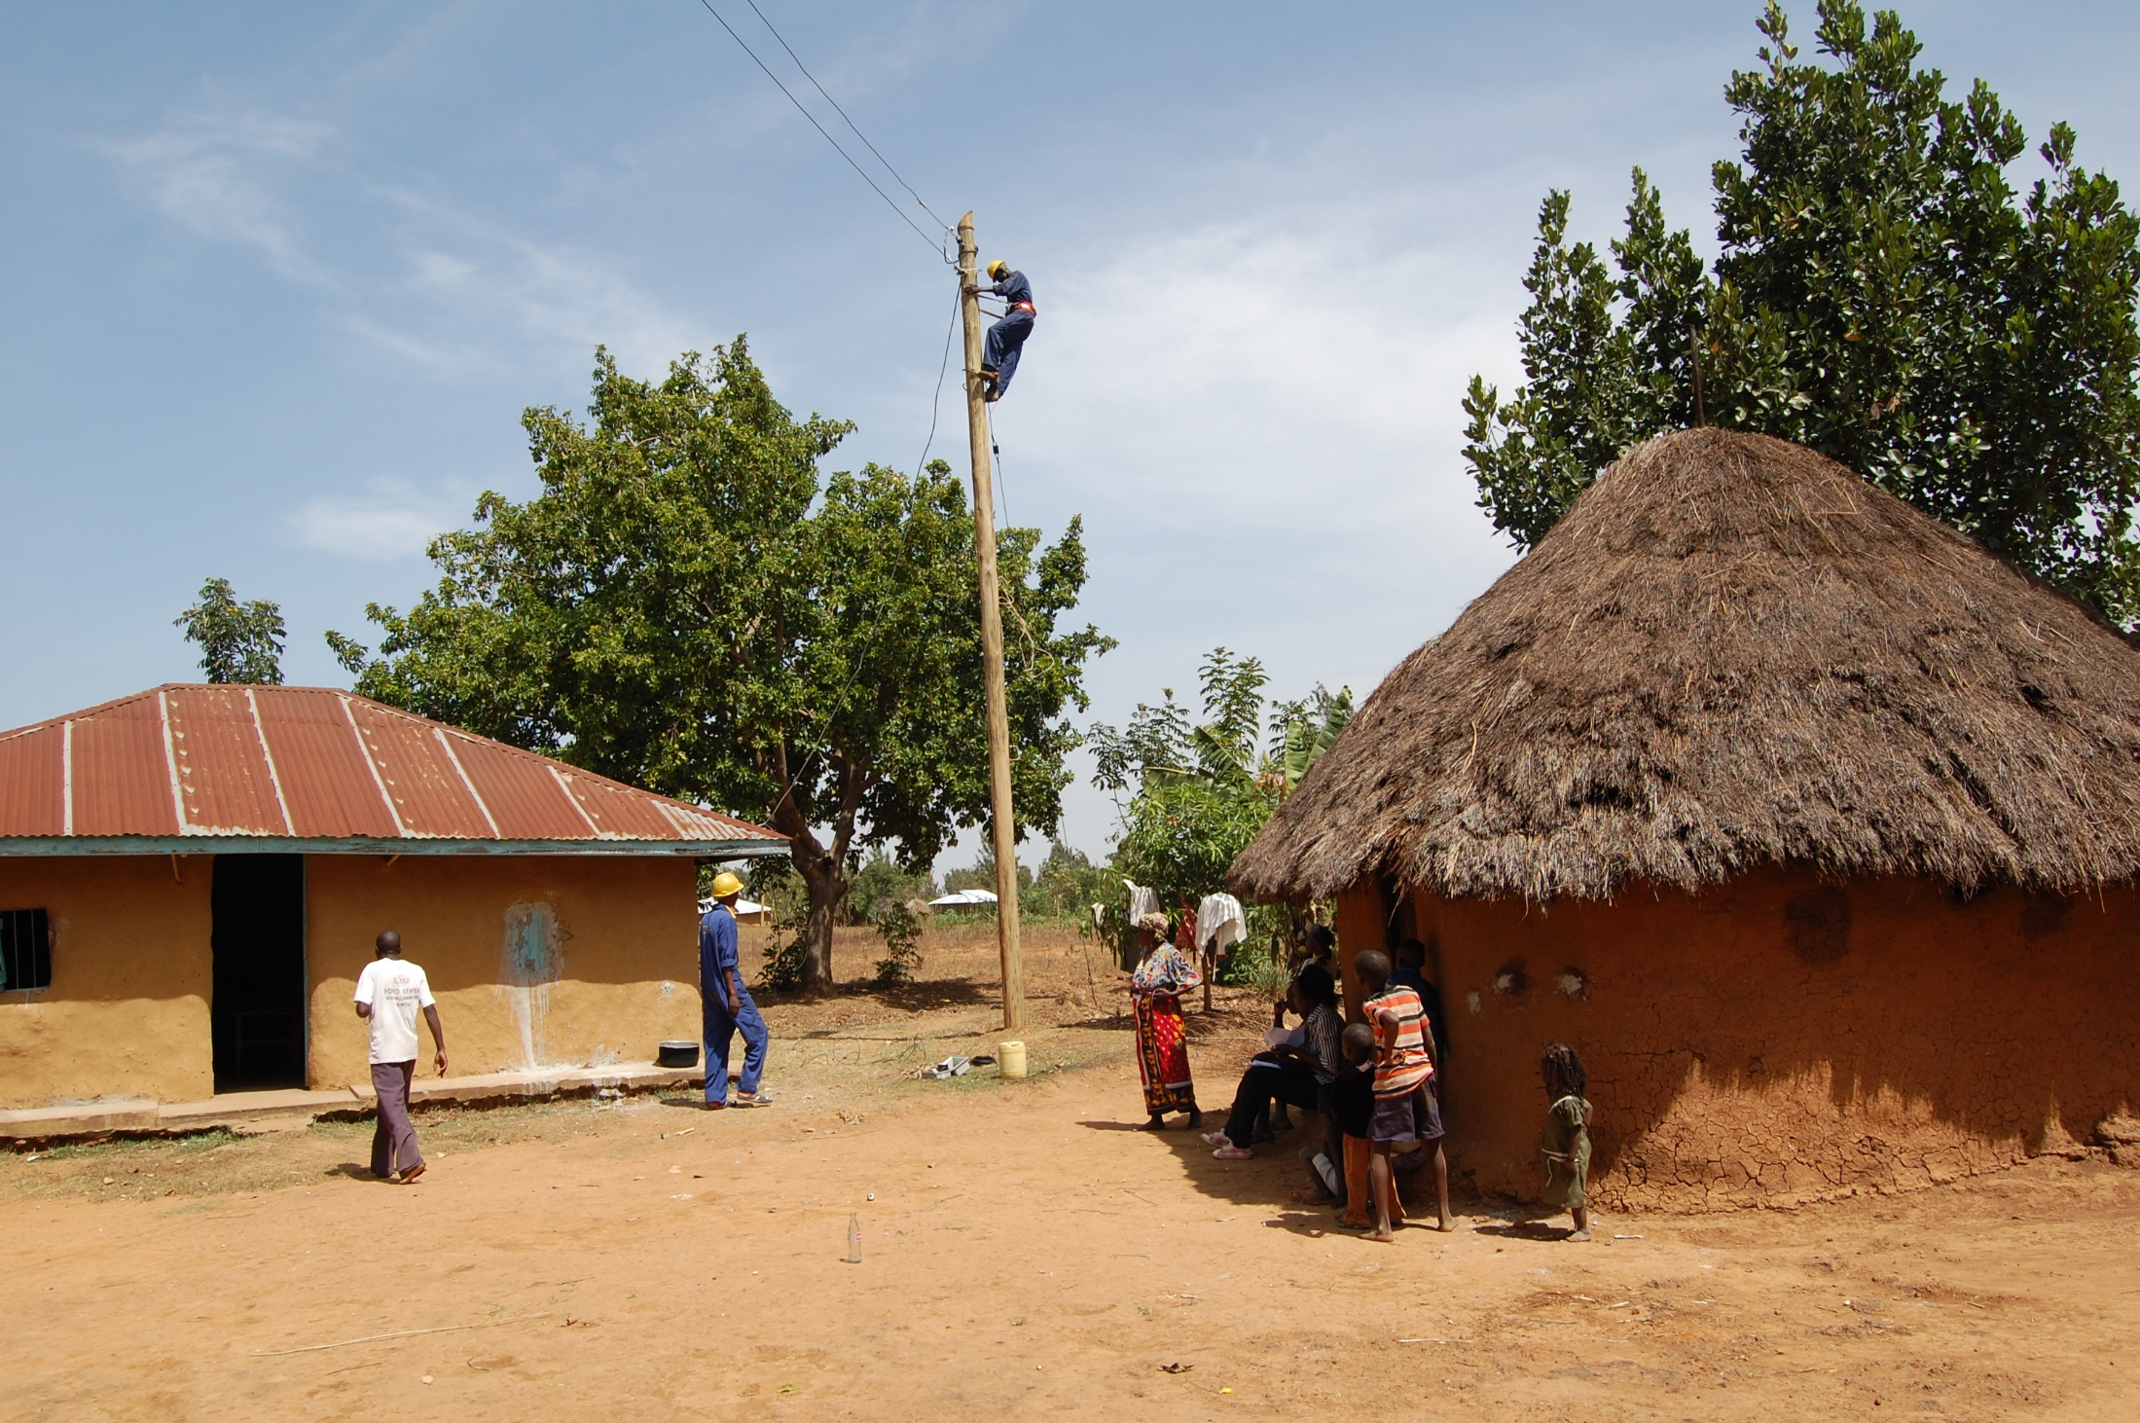
Step 2: REA extends national grid to households

Slide 21
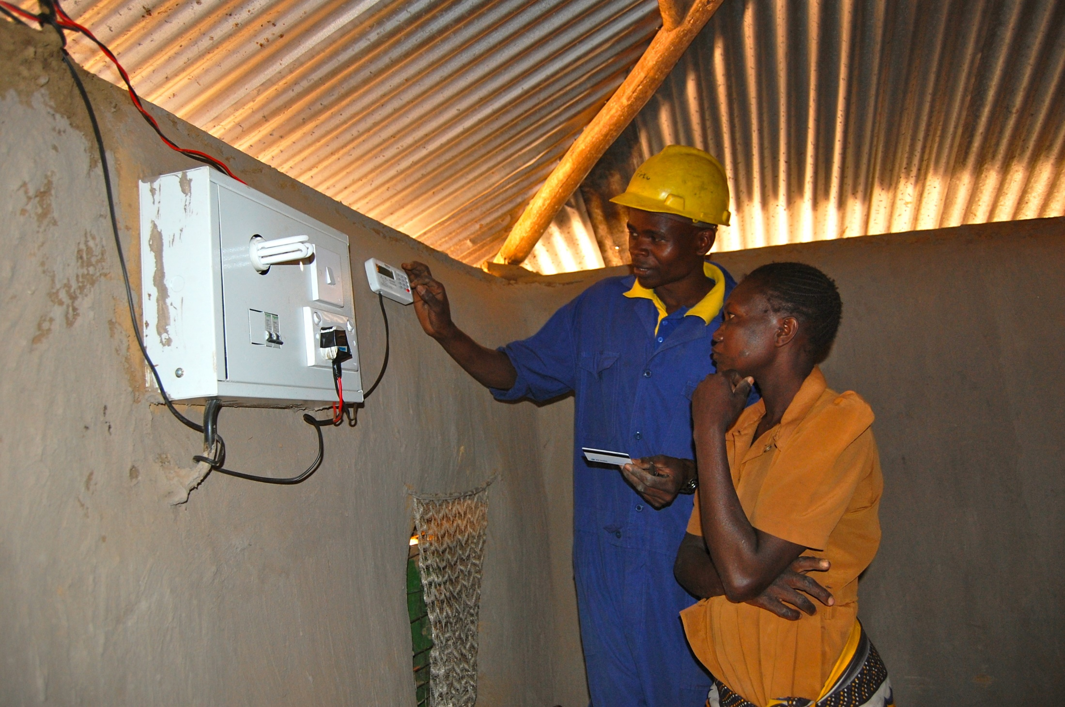
Step 3: Kenya Power installs prepaid meters

Slide 22
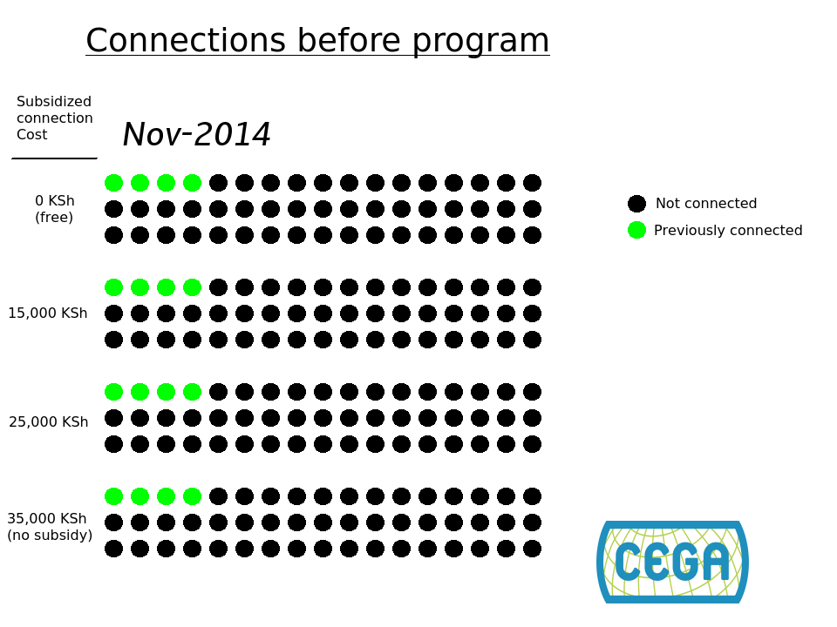
Household demand at different price points

Slide 23
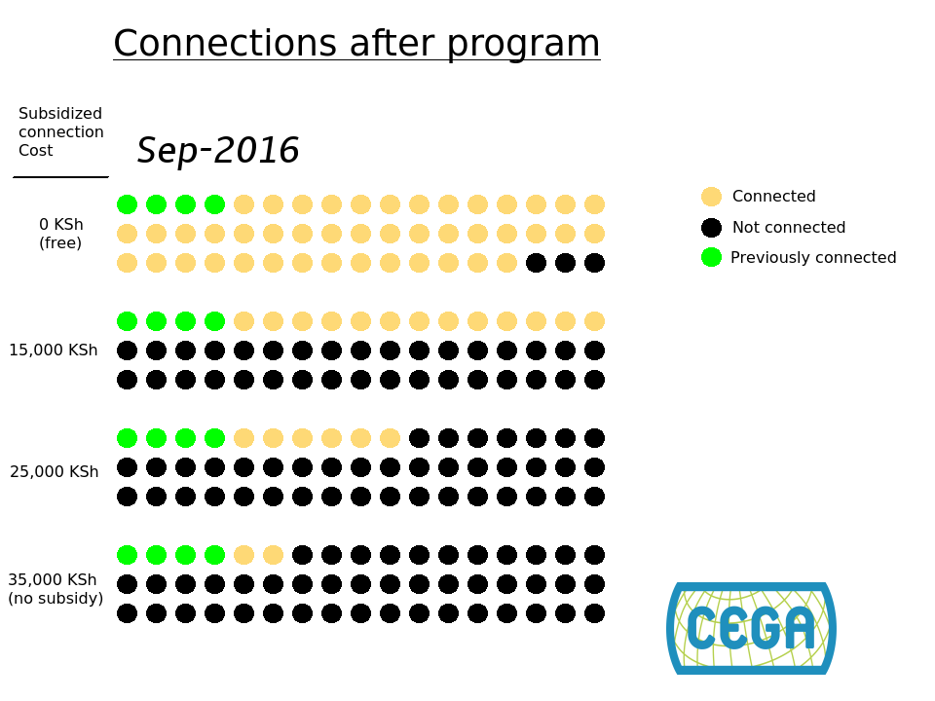
3 November 2016
© 2016 Applied Research Programme on Energy and Economic Growth
24

Slide 24
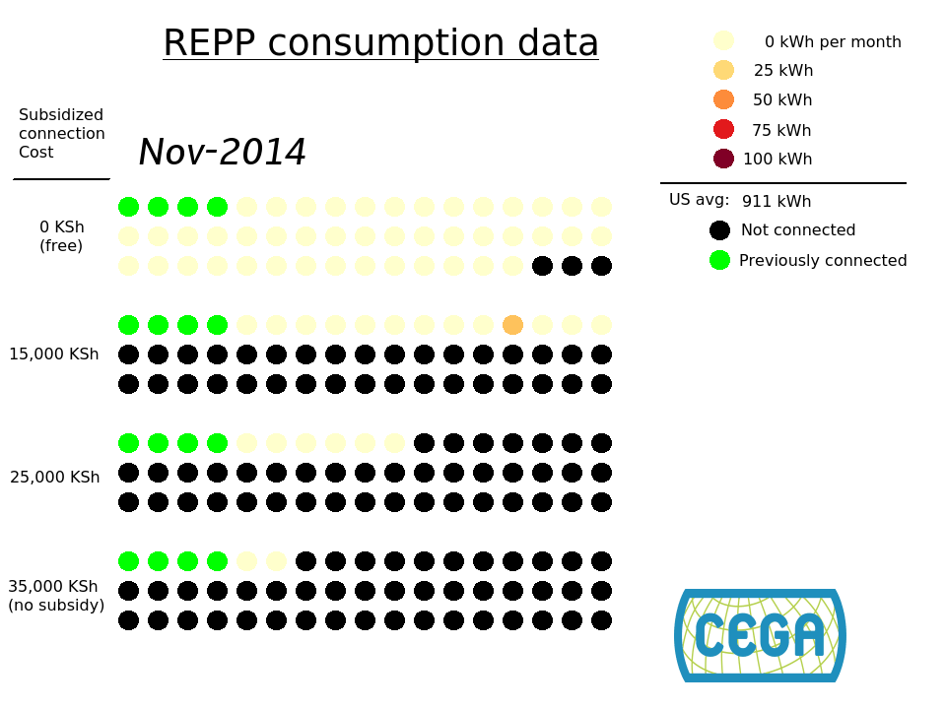

3 November 2016
© 2016 Applied Research Programme on Energy and Economic Growth
25

Slide 25
We collected endline data at the level of the…
Household
Grid connection? Y/N
Monthly spending in electricity
% employed or running own business
Female
Male
Annual consumption of 23 goods ( estimated)
3 November 2016

Slide 26
We collected endline data at the level of the…
Household
Respondent
Grid connection? Y/N
Hours worked in the past 7 days
Monthly spending in electricity
Life satisfaction
(1 to 10)
% employed or running own business
Index of health symptoms (past month)
Female
Male
Index of political and social awareness
Annual consumption of 23 goods ( estimated)
3 November 2016

Slide 27
We collected endline data at the level of the…
Household
Respondent
Child
Grid connection? Y/N
Hours worked in the past 7 days
Math and English (reading) test scores
Monthly spending in electricity
Life satisfaction
(1 to 10)
% employed or running own business
Index of health symptoms (past month)
Female
Male
Index of political and social awareness
Annual consumption of 23 goods ( estimated)
3 November 2016

Slide 28
Households are connected and spending more on electricity…
Household
Respondent
Child
+
Grid connection
89%
Hours worked in the past 7 days
Math and English (reading) test scores
+
Monthly spending in electricity
KSH 175
Life satisfaction
(1 to 10)
% employed or running own business
Index of health symptoms (past month)
Female
Male
Index of political and social awareness
Annual consumption of 23 goods ( estimated)
3 November 2016

Slide 29
But employment and consumption were not affected
Household
Respondent
Child
+
Grid connection
+89%
Hours worked in the past 7 days
Math and English (reading) test scores
+
Monthly spending in electricity
+KSH 175
Life satisfaction
(1 to 10)
0
% employed or running own business
Index of health symptoms (past month)
Female
Male
0
Index of political and social awareness
Annual consumption of 23 goods ( estimated)
3 November 2016

Slide 30
Nor was health, political awareness, or test scores
Household
Respondent
Child
+
Grid connection
Hours worked in the past 7 days
0
+89%
Math and English (reading) test scores
+
Monthly spending in electricity
+KSH 175
Life satisfaction
(1 to 10)
0
% employed or running own business
0
Index of health symptoms (past month)
Female
Male
0
0
Index of political and social awareness
Annual consumption of 23 goods ( estimated)
3 November 2016

Slide 31
Small impacts on female employment, hours worked and satisfaction
Household
Respondent
Child
+
Grid connection
-
Hours worked in the past 7 days
0
+89%
Math and English (reading) test scores
+
Monthly spending in electricity
+KSH 175
+
Life satisfaction
(1 to 10)
0
% employed or running own business
0
Index of health symptoms (past month)
+
Female
+8.1%
Male
0
0
Index of political and social awareness
Annual consumption of 23 goods ( estimated)
3 November 2016

Slide 32
Lots of questions for future work
What might we find if we went back in another ~2 years?
How representative is Western Kenya?
  Local incomes, institutions, other infrastructure.
How important is reliability?
  20/150 transformers were down for a median of 4 months.
What are the development impacts of electrifying small businesses, health centers, schools? Increasing reliability to factories?
What are the impacts of smaller scale investments, like solar home systems?
How do the dynamics of grid and solar home systems compare?

Slide 33

Agenda Overview
How the panels will work
Plenary speakers
Session 4 (Friday afternoon)

Slide 34
How to make the most of this conference:
Share relevant information about your work
Identify potential collaborators
Brainstorm specific ideas for future EEG research
Let us know how we can make the EEG program as useful as possible

