Slide 1
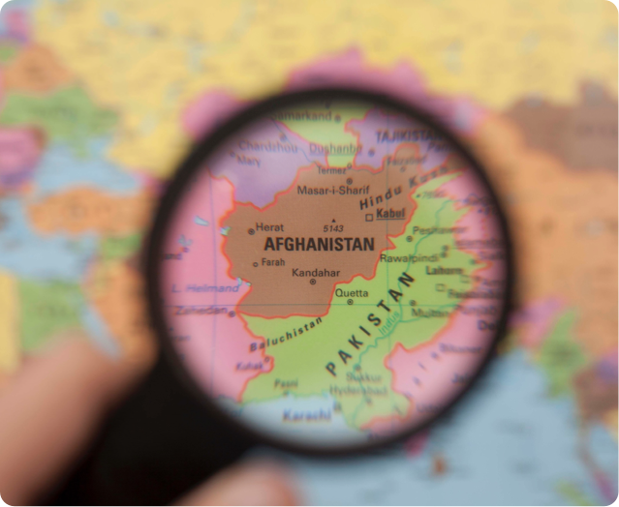

Energy & Economic
Growth
A Policymakers View

Slide 2
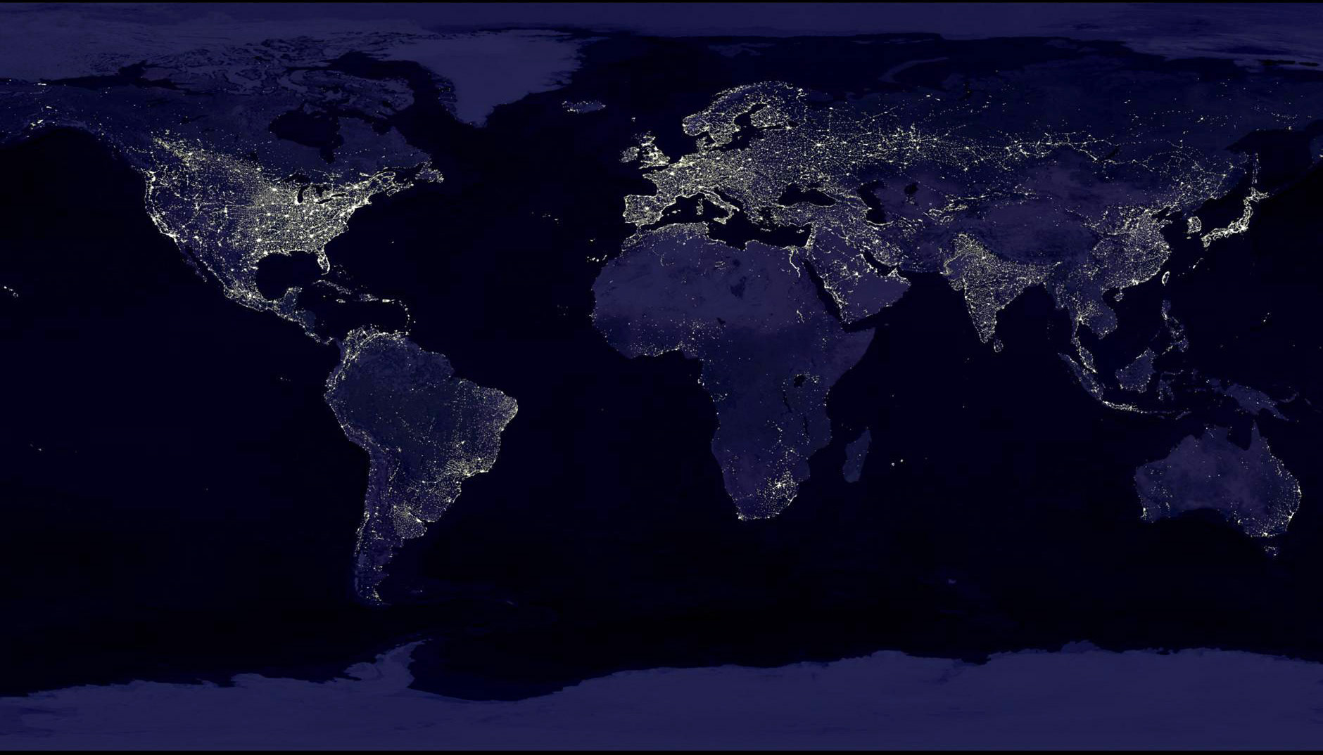
Energy and Economy

Slide 3
Key Topics to Address
What is your role in the Afghan government, and what types of energy-related decisions are you involved in making?
What are the biggest challenges you face in terms of improving the electricity sector in Afghanistan? What about South Asia more broadly?
- In what ways do you think energy can promote economic growth in Afghanistan (and South Asia more broadly)?

Slide 4
Unique Nature of Electricity
Clean and convenient to utilize
Not a primary energy source
Very capital intensive
Cannot be stored economically in bulk
Generation & consumption must be equal at all times

Slide 5
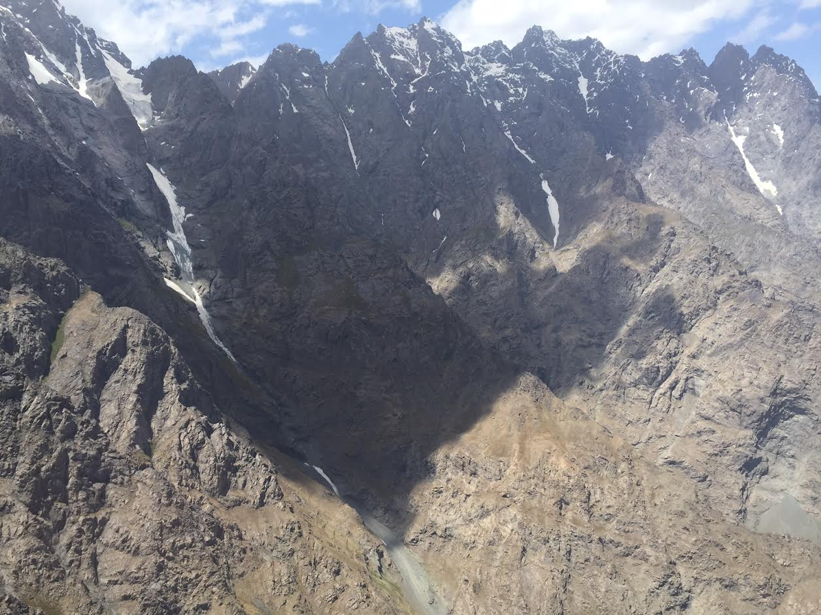
Role of the Afghan Government
(Achieving Self-Reliance)
What should we grow?
What should we extract?
What should we trade?
What should we manufacture?

Slide 6

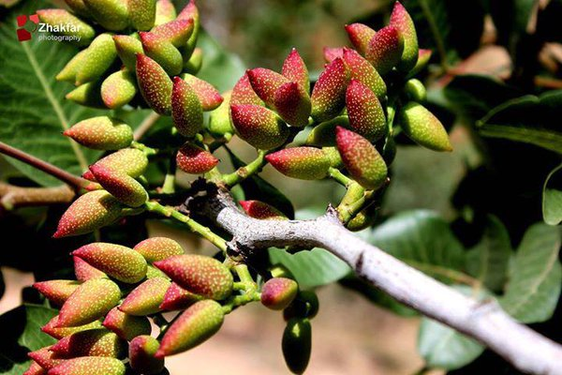
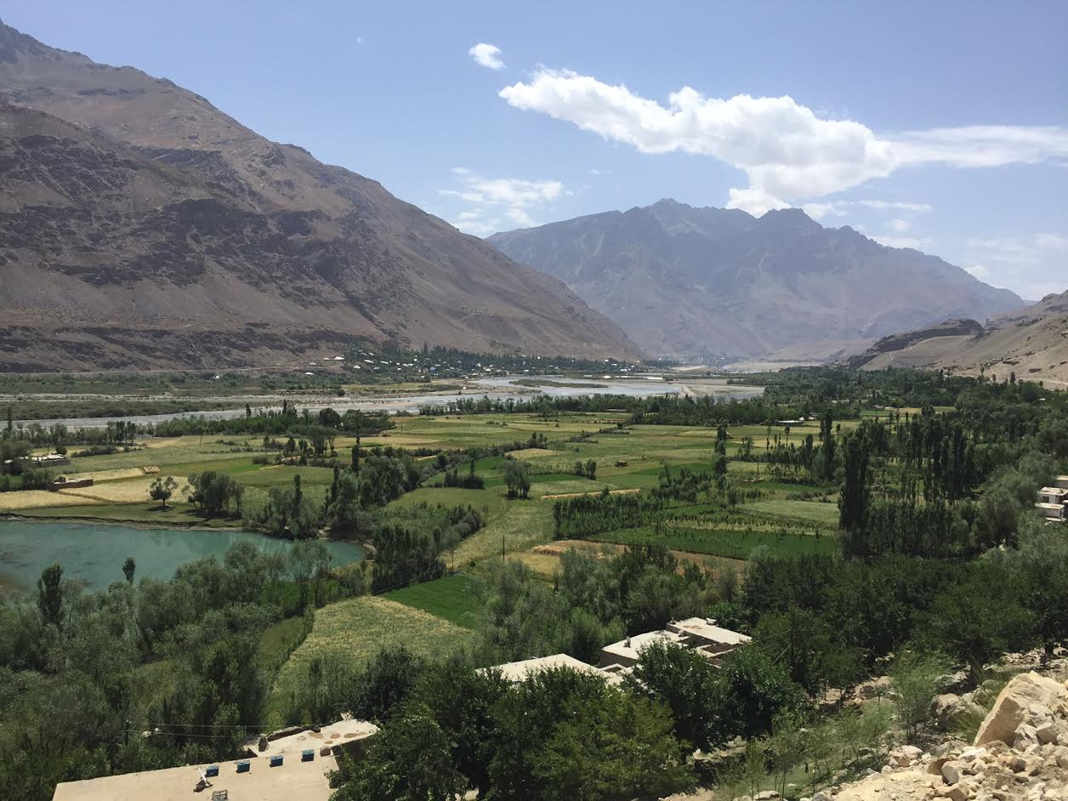

What Should we Grow?

Slide 7
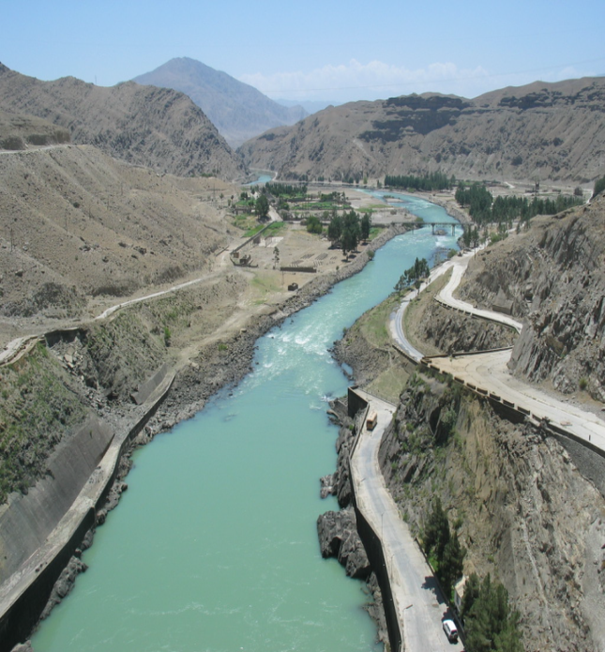
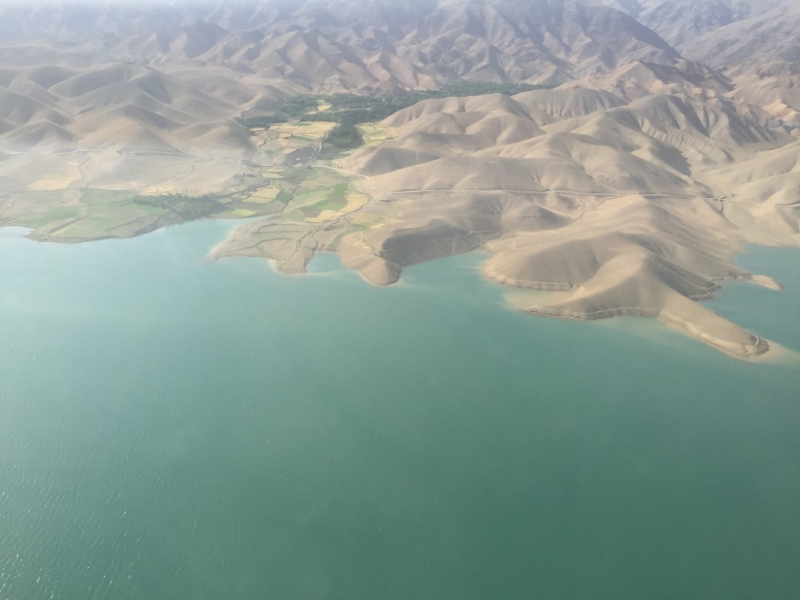
Afghanistan’s Natural Assets

Slide 8
What Should we extract?

Slide 9

What Should we Trade?
The emphasis on three fundamental areas:
Movement of Energy;
Movement of goods; and
Movement of data.

Slide 10
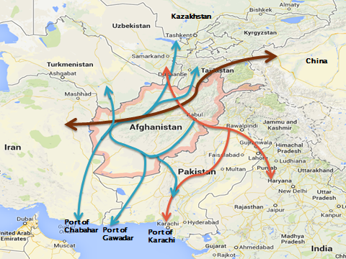
Our location: A Key Asset

Slide 11
Movement of Data:
Digital CASA:
Building better data connectivity for Central Asia and Afghanistan

Slide 12
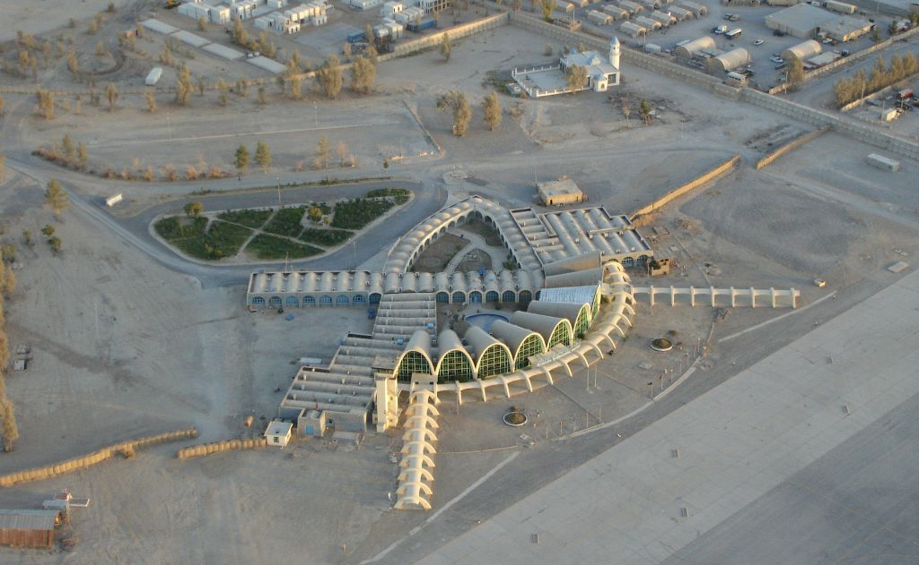
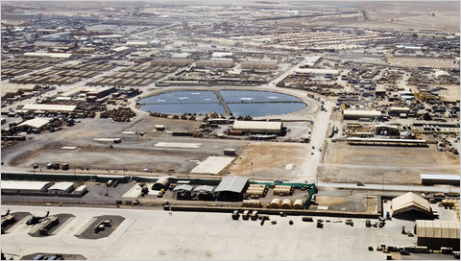
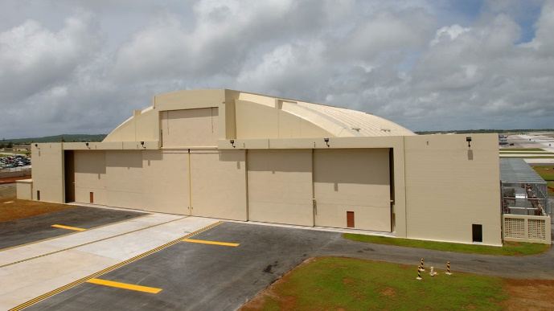
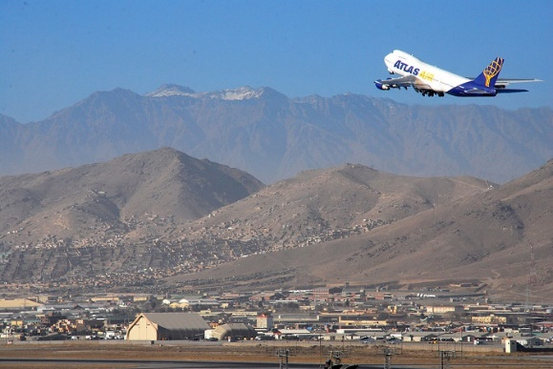
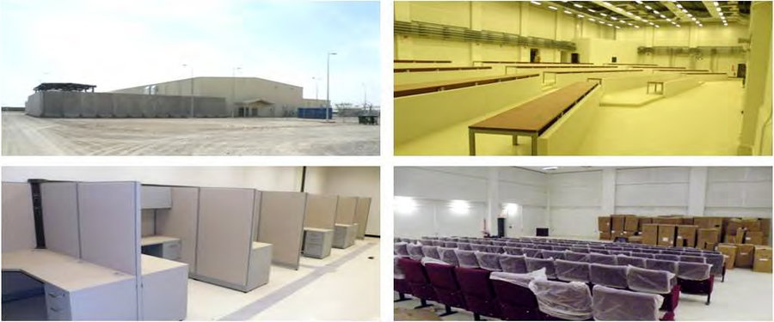
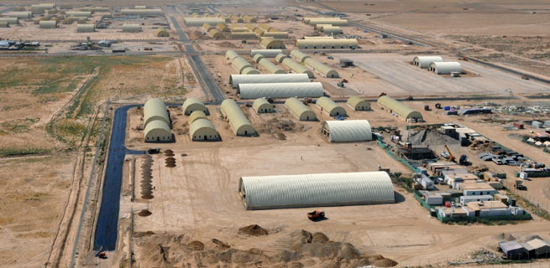
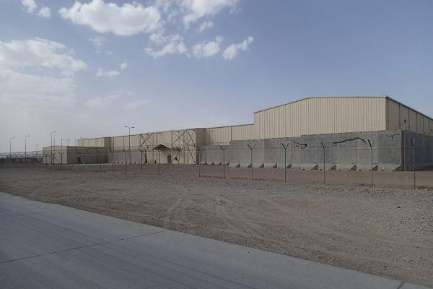
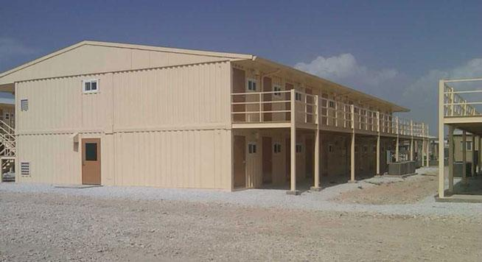
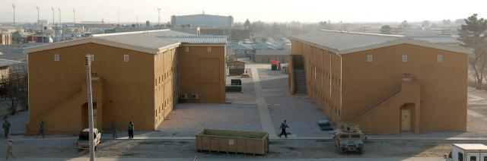
What to Manufacture: Envisioning Existing Assets as Vibrant SEZs

Slide 13
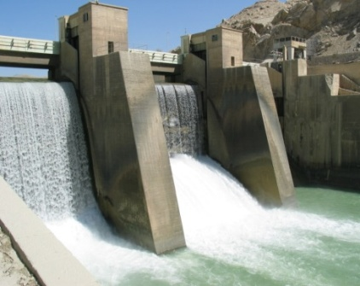
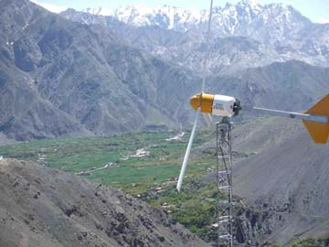
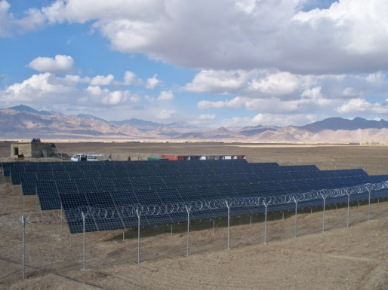
Hydro, Wind, and Solar Potentials

Slide 14
CENTRAL ASIA
Movement of Energy
CASA 1000 Transmission Line Transmitting over 1000 MW (Mega Watts) of electricity from Kyrgyzstan and Tajikistan to Pakistan; and
TAPI Gas Pipeline - Transporting natural gas from Turkmenistan to Pakistan and India.
TAP Transmission Line - Initially move 2000 MW from Turkmenistan to Pakistan via Western Afghanistan and could eventually carry up to 4000 MW.
CASA1000
TAP
TAPI
SOUTHERN ASIA

Slide 16
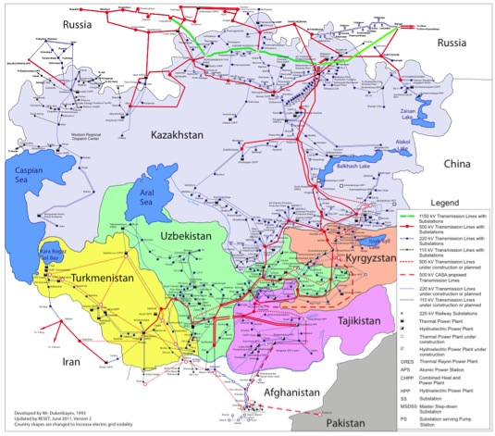
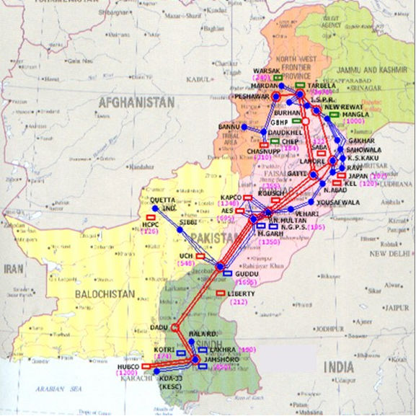

Slide 17
A Systemic View

Slide 18

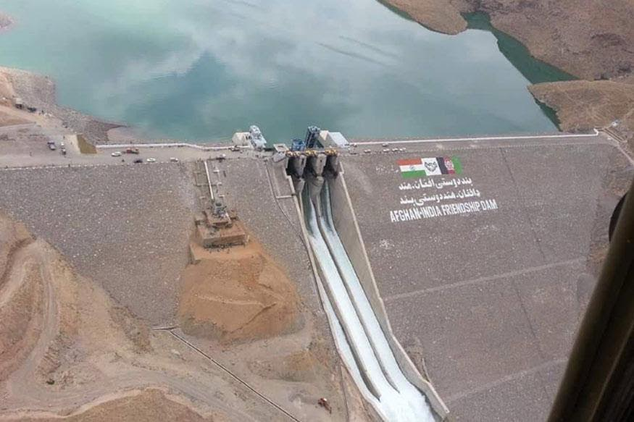
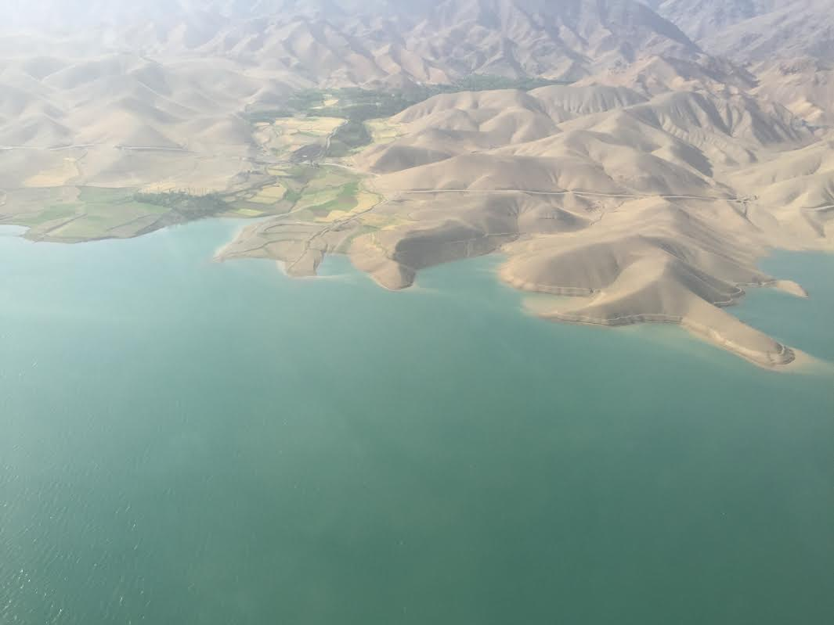
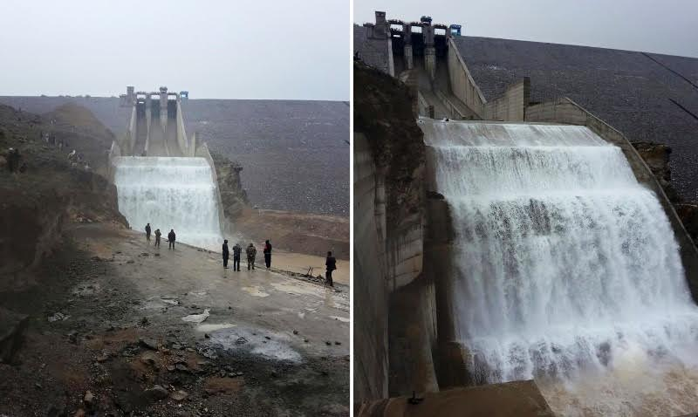
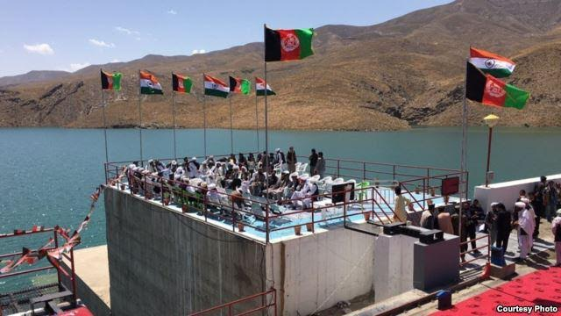
India-Afghan Friendship Dam in Salma

Slide 19
Summary of Dam Projects
Implementation of mentioned above dams will add another:
67.52 Cub-M/Cap/Year Storage and
327 MW of Hydro-Power
Ongoing Projects | Number | Construction Cost (M-US$)
Under Construction Dams | 4 | 246.6
Under Design & Construction | 6 | 241.3
Under Detail Design | 3 | 1256.75
Under Feasibility | 20 | 1,029

Slide 20
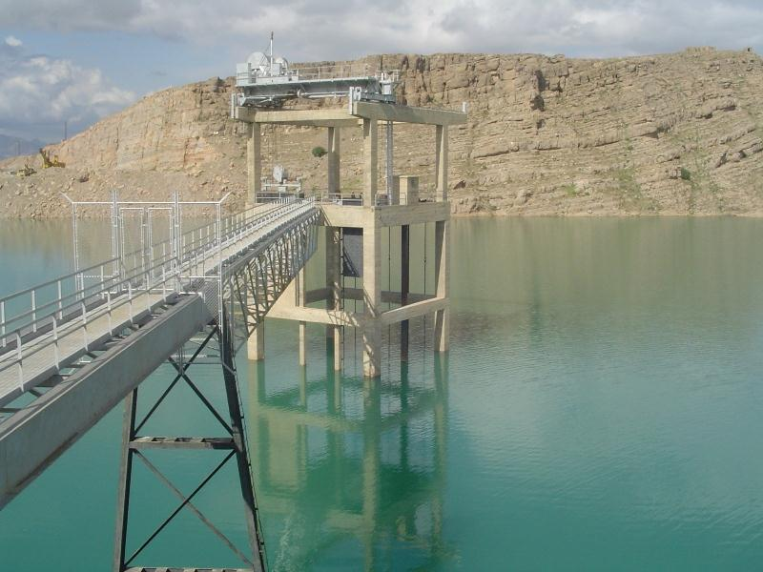
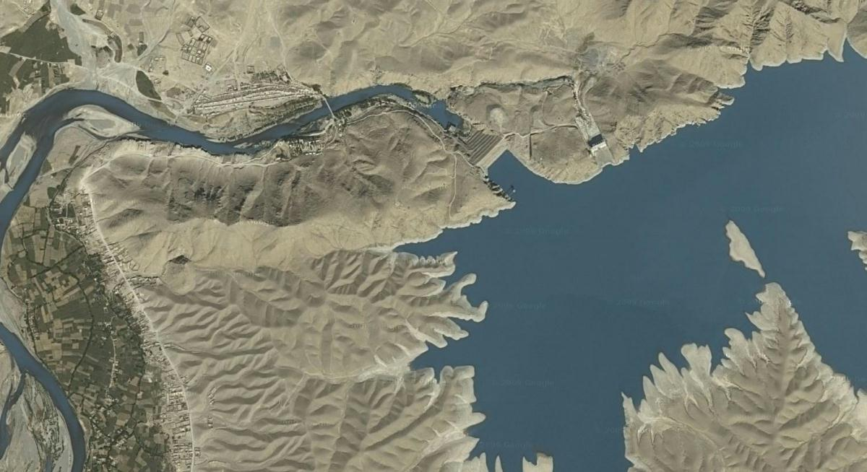
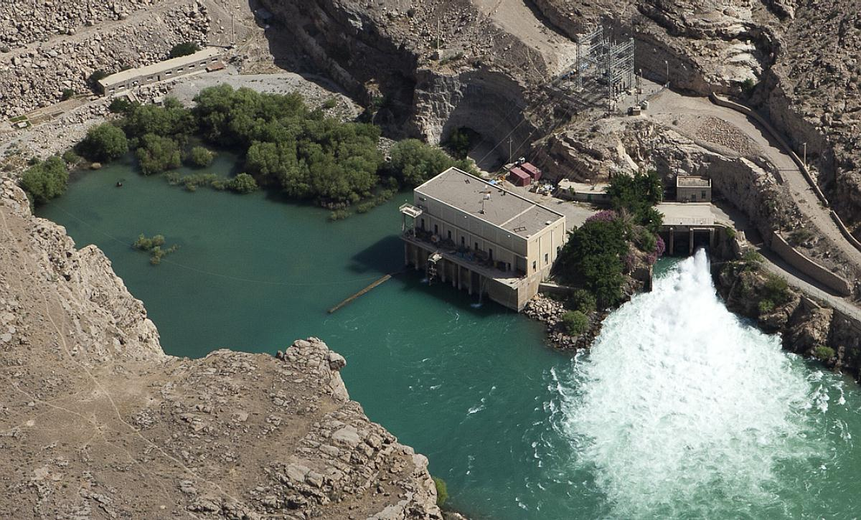
Kajakai Dam Phase I &II

Slide 21
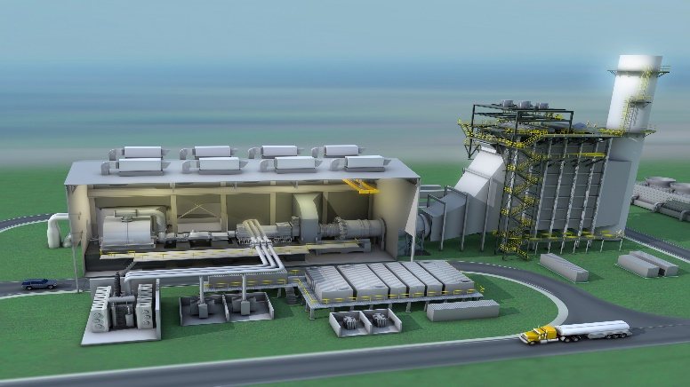
Sarobi II Hydropower Plant

Slide 22

50 MW Natural Gas Plant in Mazari Sahrif

Slide 23
Challenges in Improving Electricity Sector in Afghanistan
Lack of systemic approach in improving the economy
Capital requirements and time required
Lack of adequate technical and managerial staff
Political dimension of tariffs
Collection issues and power theft
Poor efficiency and high losses
Deciding between irrigation vs. hydropower
Lack of imagination of international consultants

Slide 24
Challenges in Improving Electricity Sector in South Asia
Governance issues
High population density
Limited primary energy source
High technical and non-technical losses
Corruption and lack of will for fundamental change
Electricity as a limiting factor for economic growth

Slide 25
How Energy Can Promote Economic Growth in Afghanistan & South Asia
The need for reliable energy supply and good quality power
The digital economy as a growing portion of the economy
The need for both supply-side and demand-side management within an integrated resource planning (IRP) framework
Regional solutions will be more optimal than national solutions

Slide 26
THANK YOU

