Slide 1
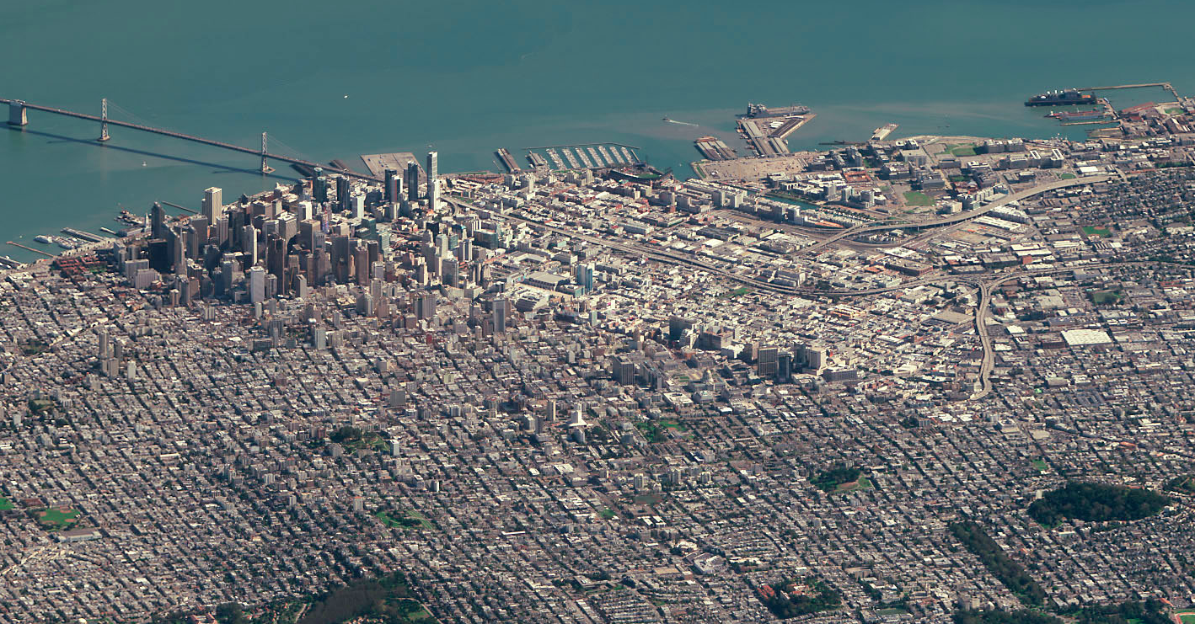
Every day, humanity creates 2.5 quintillion bytes of data
@iheartcrowds
Notes:
Each potentially having a story to tell – but which ones? These are pieces of a constantly evolving puzzle – but how do they fit together? Plus consider the thousands of new ideas, companies, research projects, devices and apps, etc. arising to solve GEOINT problems every day… How do we unlock the power of this data & technology and make it serve the one mission that matters most- YOURS…

Slide 2
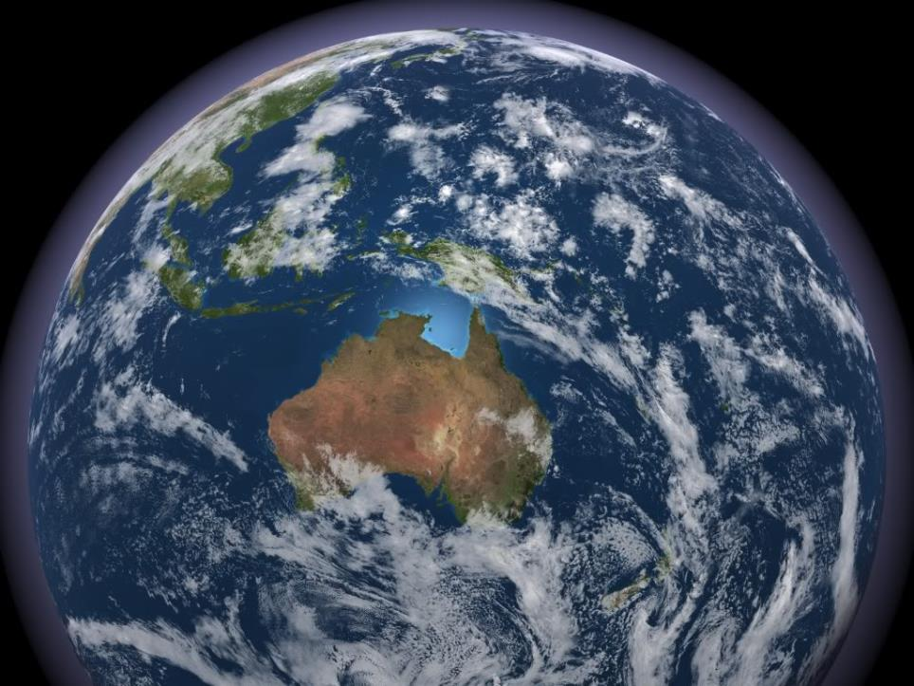
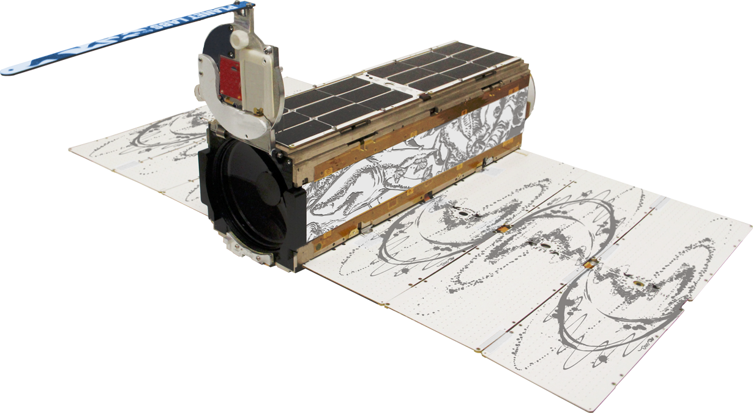
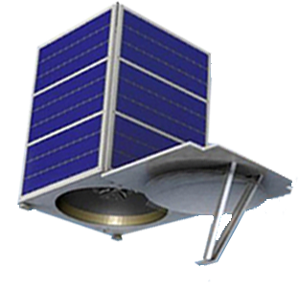
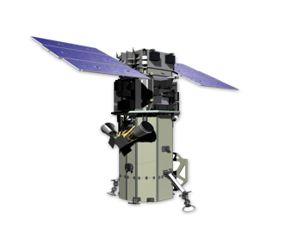
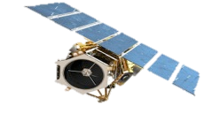
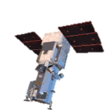
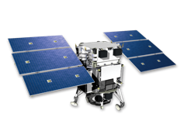
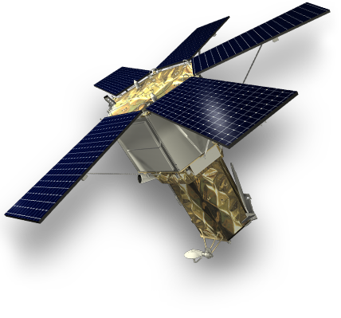

Slide 3
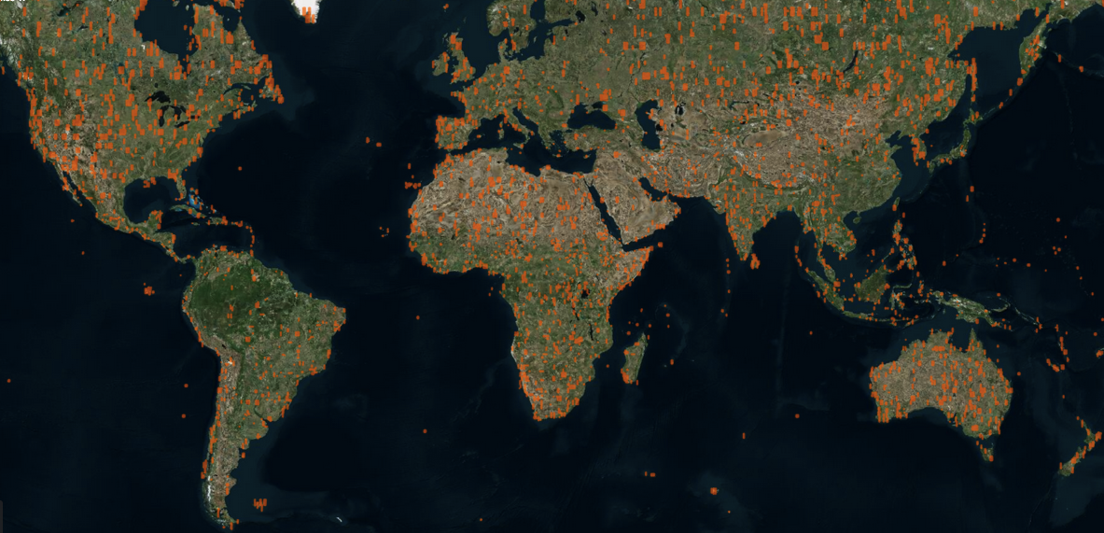
Last 3 Days

Slide 4
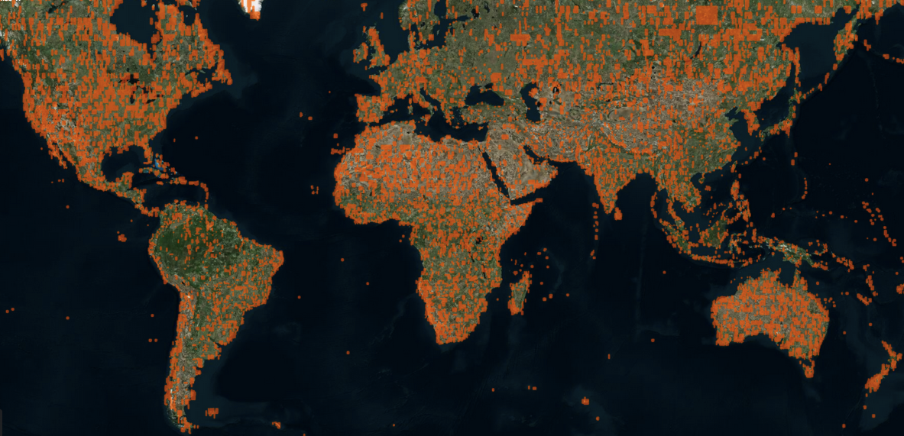
Last 14 Days

Slide 5
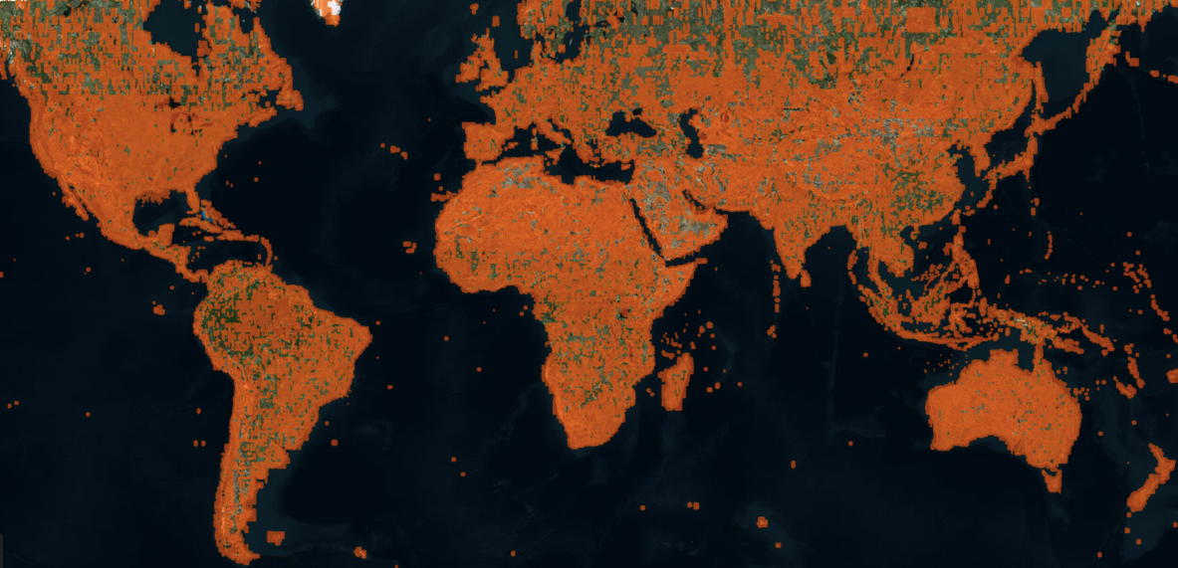
Last 3 Months

Slide 6
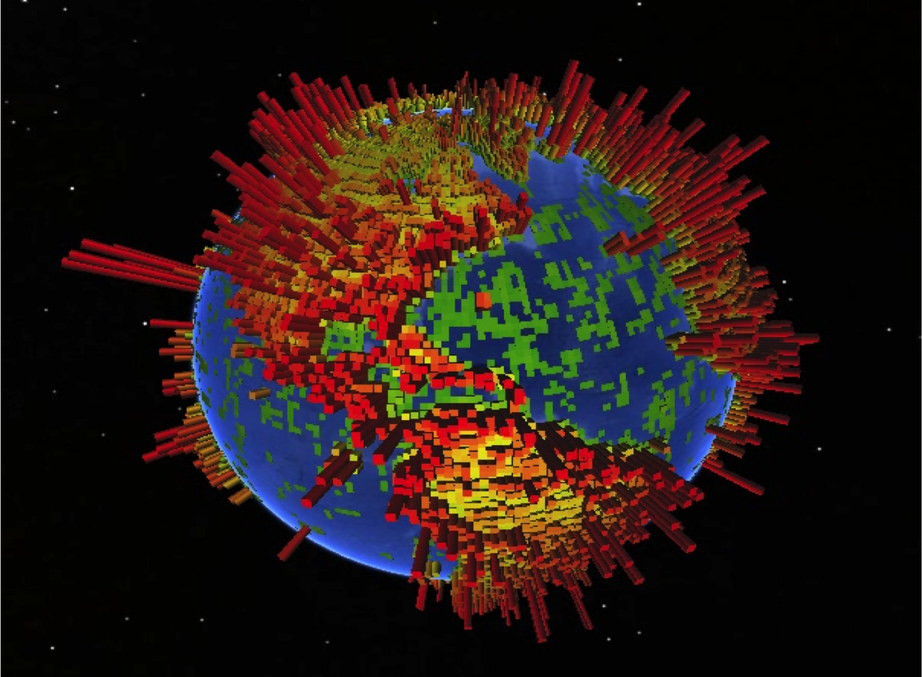
With frequent coverage of high interest areas

Slide 7
Landsat 8
15m GSD
Average scene size
0.5 GB
Planet Doves
3-5m GSD
Equivalent size
16 GB
WorldView 3
0.3m GSD
Equivalent size
941 GB
1900x size of Landsat8
60x size of PlanetLabs
©Landsat/USGS
* Planet Labs |http://creativecommons.org/licenses/by-sa/4.0/

Slide 8
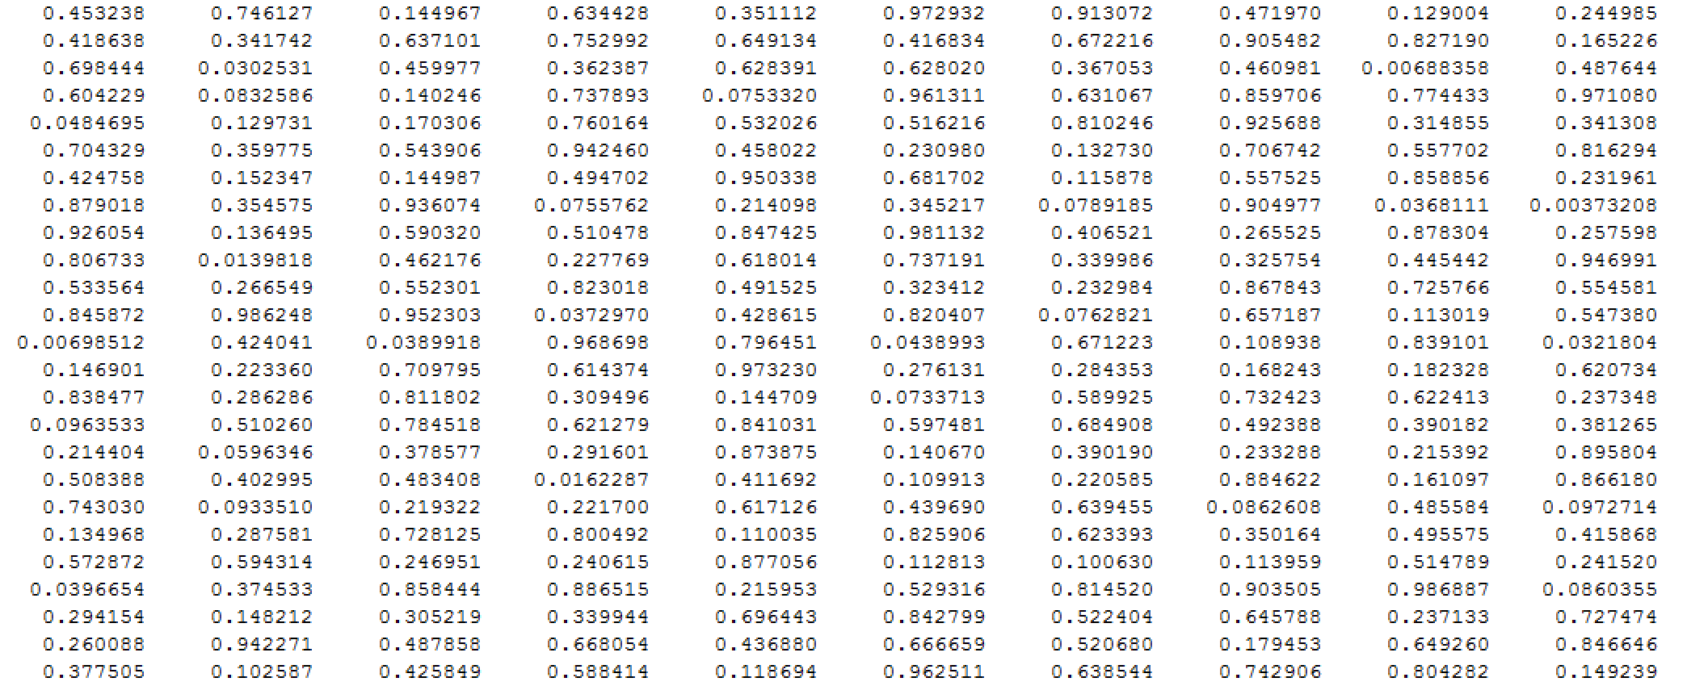
Goal: Large scale information extraction
Notes:
Where you see an image. I see data and information screaming to get out

Slide 9
Challenges
Most of your time is wasted on data management & pre-processing
Model portability across regions and collections
Leveraging (and loving!) the unknown

Slide 10
Three trends working in our favor
1.
Notes:
Cloud computing

Slide 11
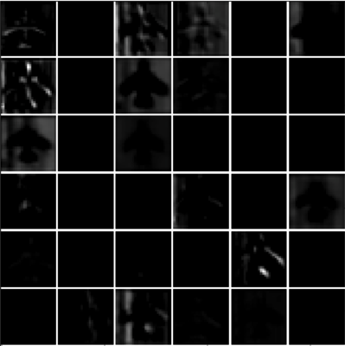
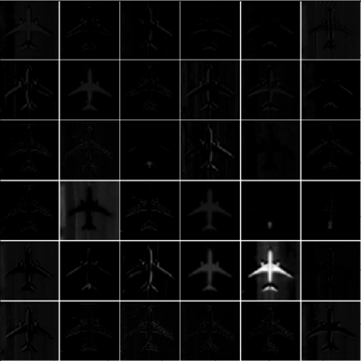
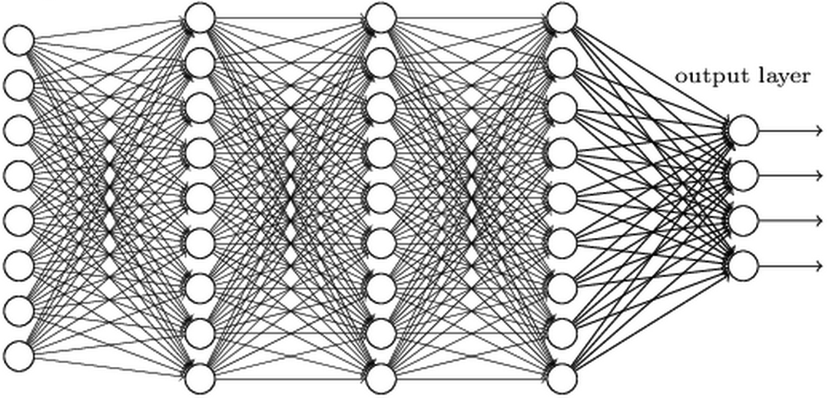
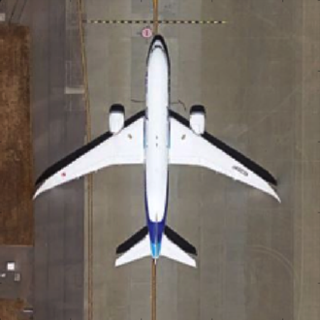
Three trends working in our favor
2.
hidden layer 1
hidden layer 2
hidden layer 3
Notes:
30 years of amazing Remote Sensing research

Slide 12
Three trends working in our favor
3.
Notes:
30 years of amazing Remote Sensing research

Slide 13
GBDX
Storage
Compute
GBD Partner Tools
Tools
MapsAPI
Catalog API
Workflow API
Notes:
Aligned with an affordable business model to enable large scale compute

Slide 14
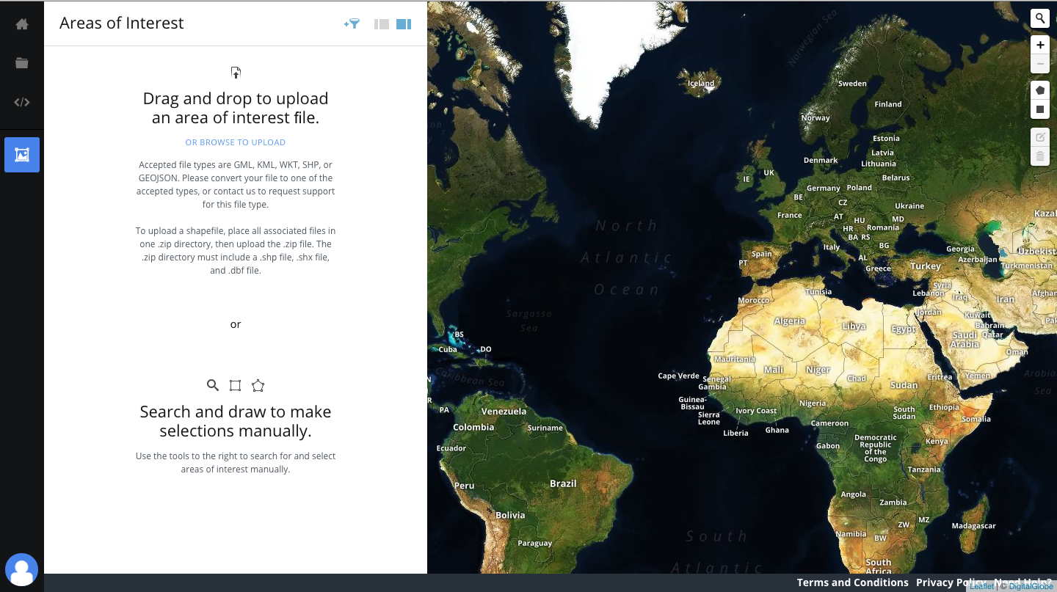
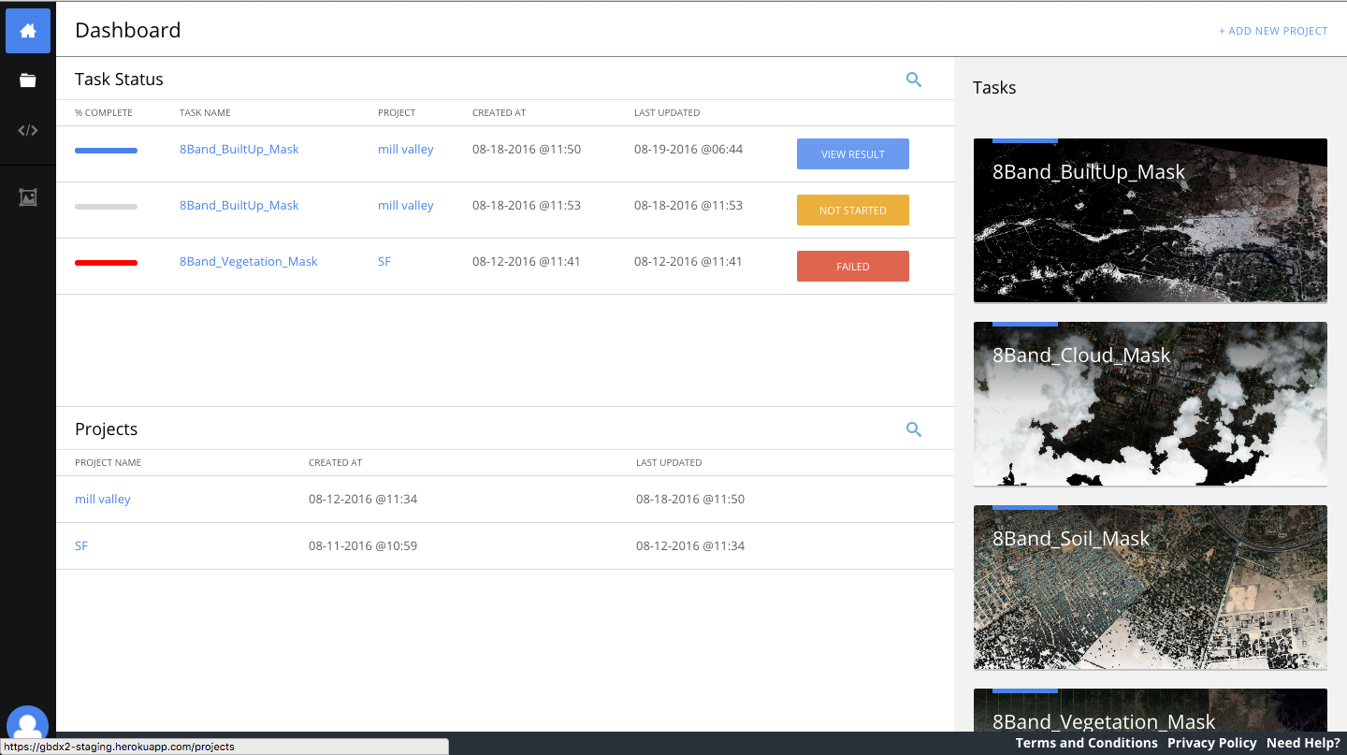
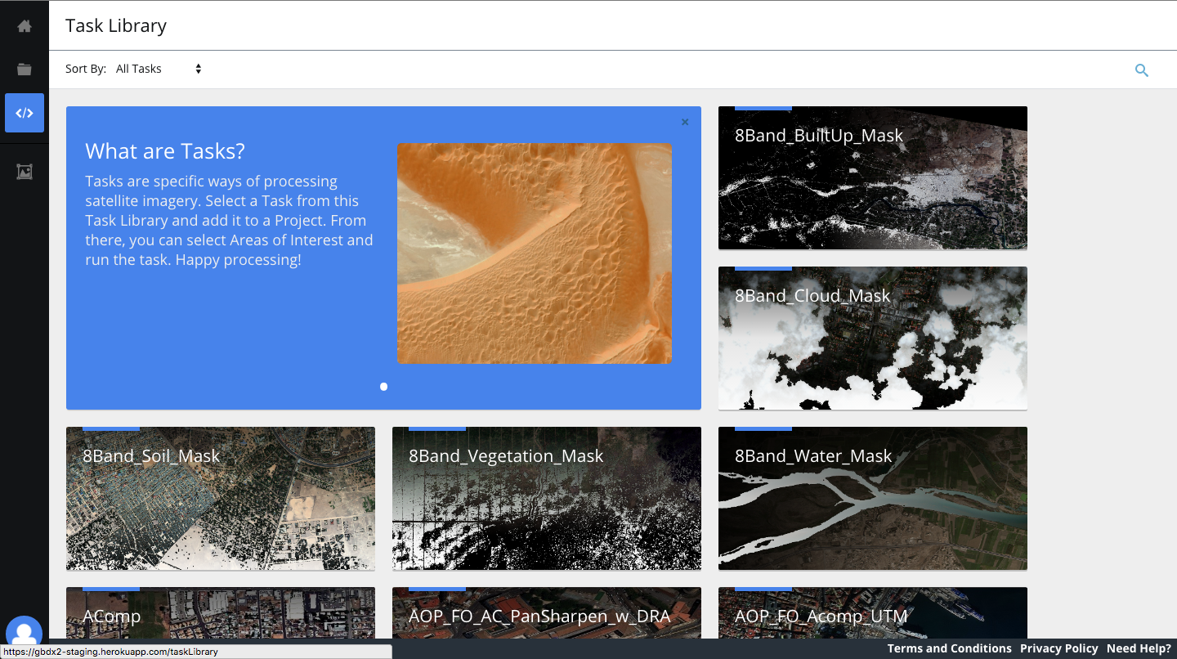
GBDX can be accessed via a UI

Slide 15
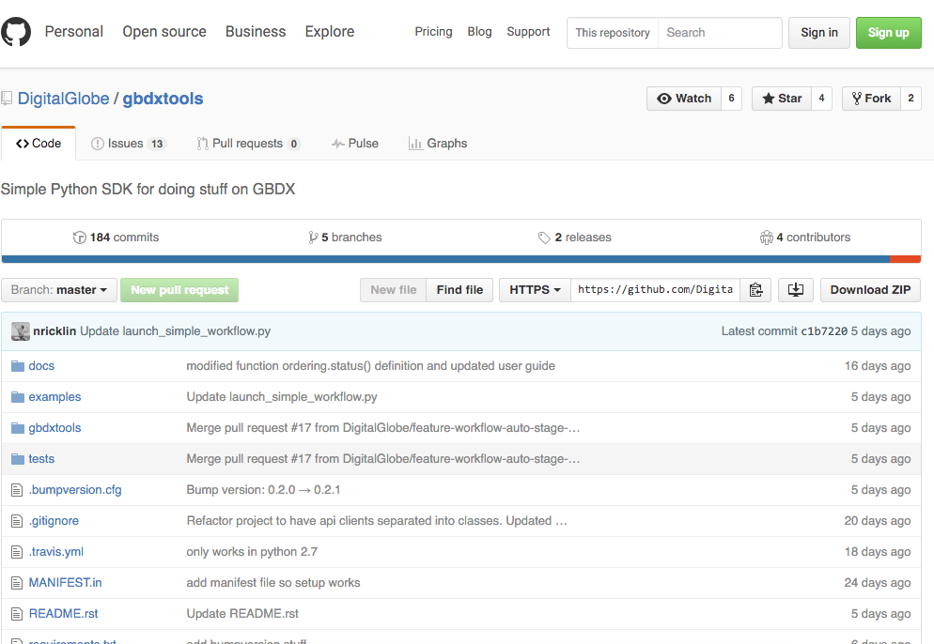
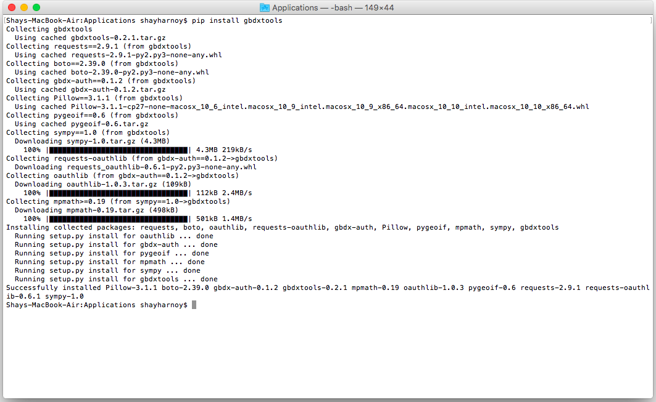
and an API

Slide 16
Detecting infrastructure change
Atmospheric Compensation
BUE
Impervious Layer
Alignment
Fancy Diff
Atmospheric Compensation
BUE
Impervious Layer
Notes:
BUE – built up extent

Slide 17
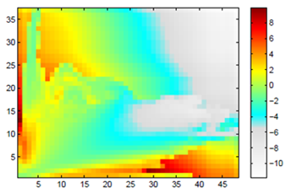
IL (before)
IL (after)
Change Index
LMI
Maps to area of strongly confident change
Maps to area of less confident change
Note: misalignment causes false-alarms
Notes:
Based on Localized Mutual Information

Slide 18
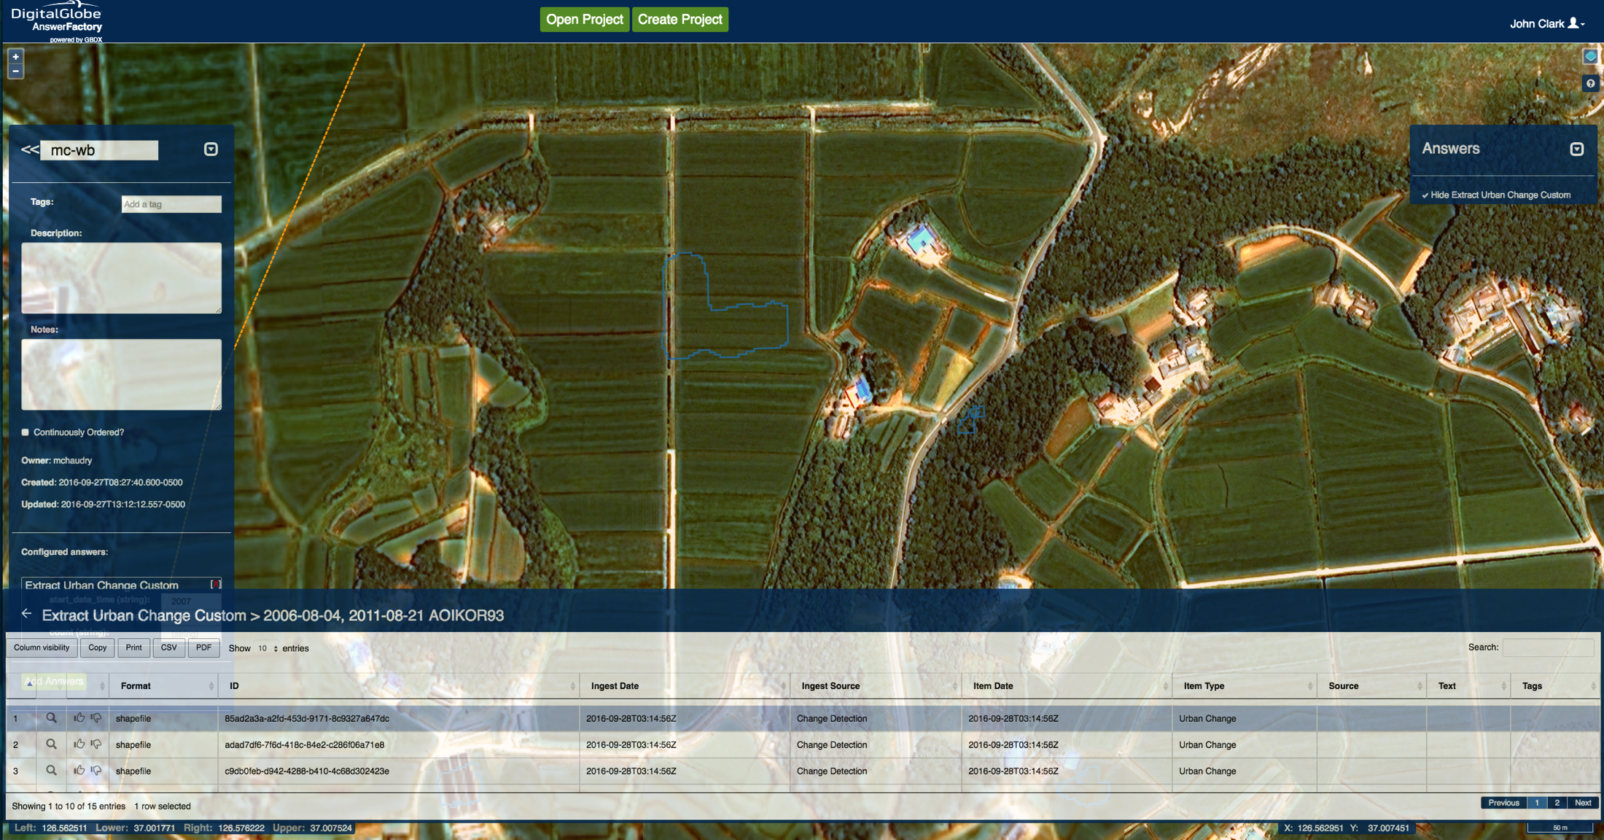
Detecting Infrastructure Change …. at scale
Notes:
Easy to use and running every time a new image is collected from space

Slide 19
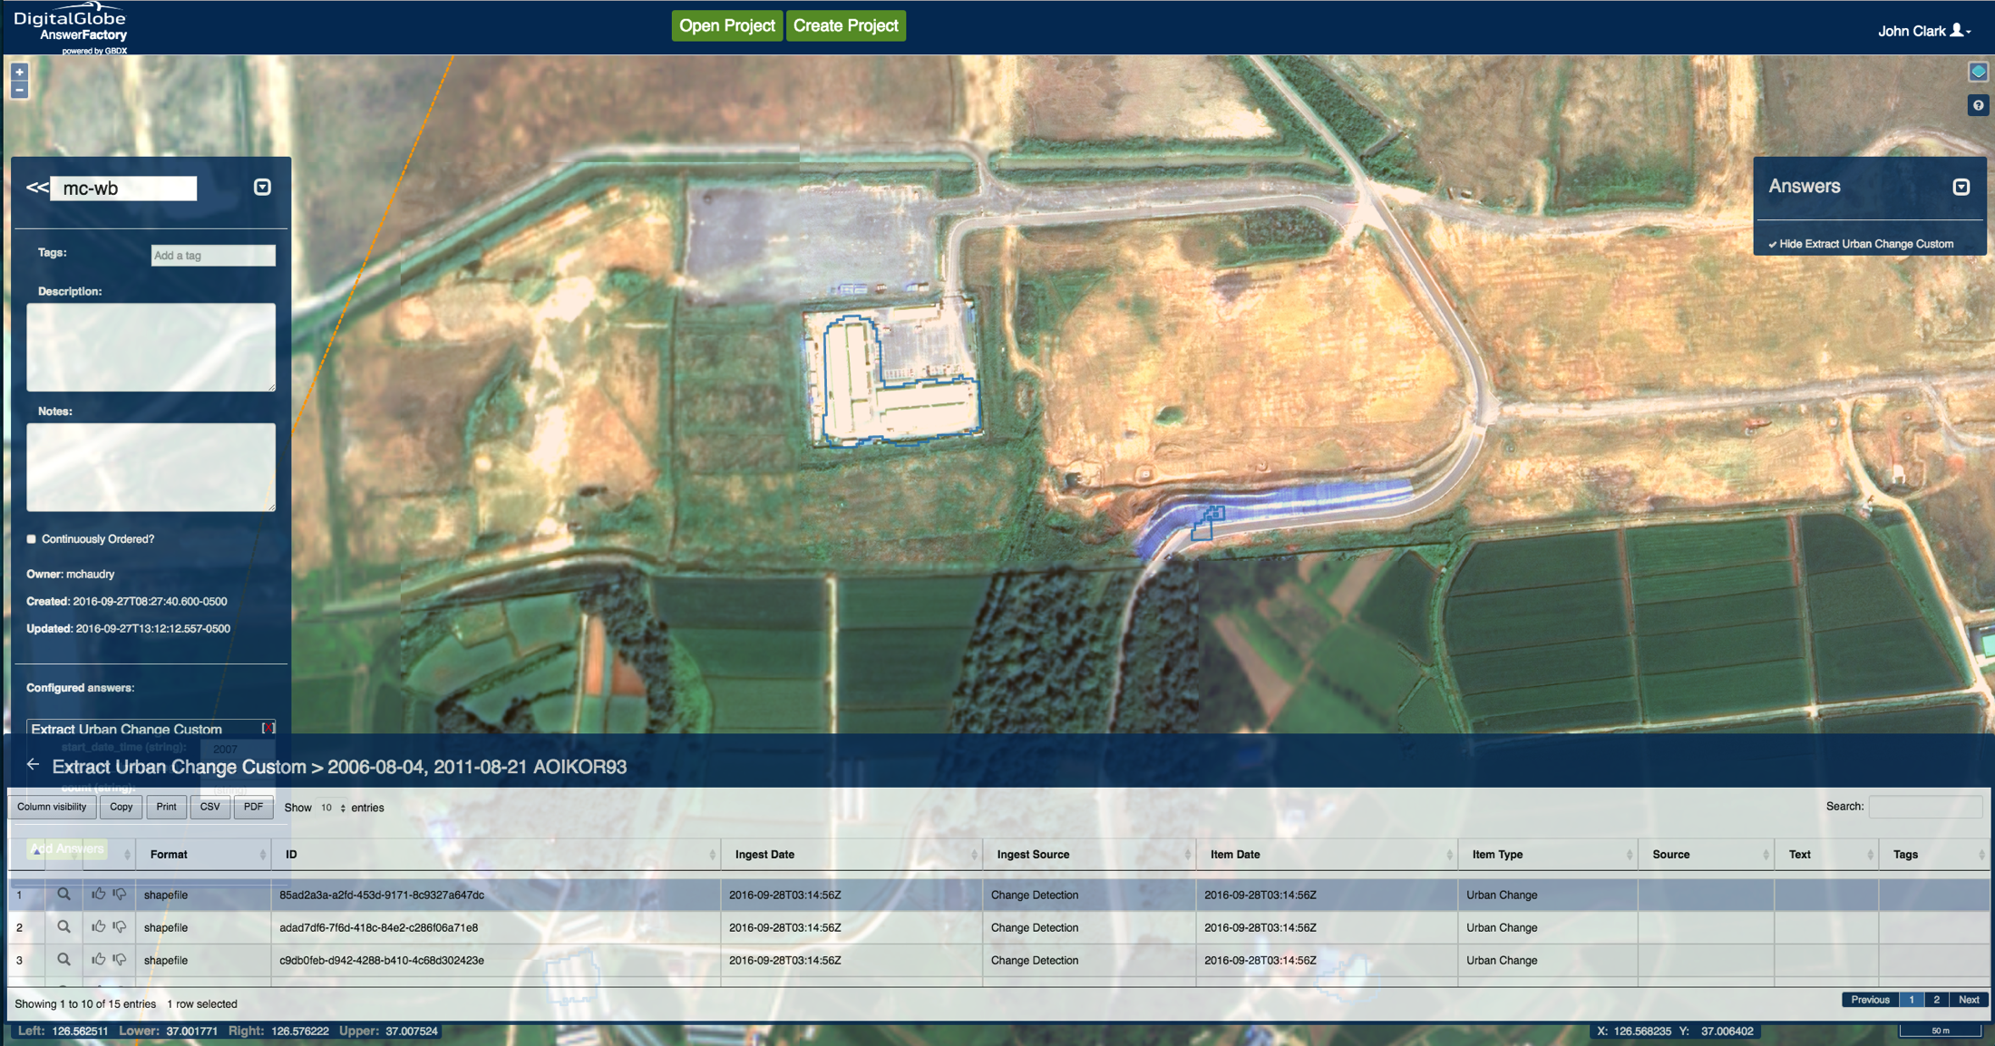
Detecting Infrastructure Change …. at scale
Notes:
Easy to use and running every time a new image is collected from space

Slide 20
~ 7.6M sqkm
~ 24M people
~ 13M structures
Geoscape for Australia
-> when good enough, needs to be really good

Slide 21
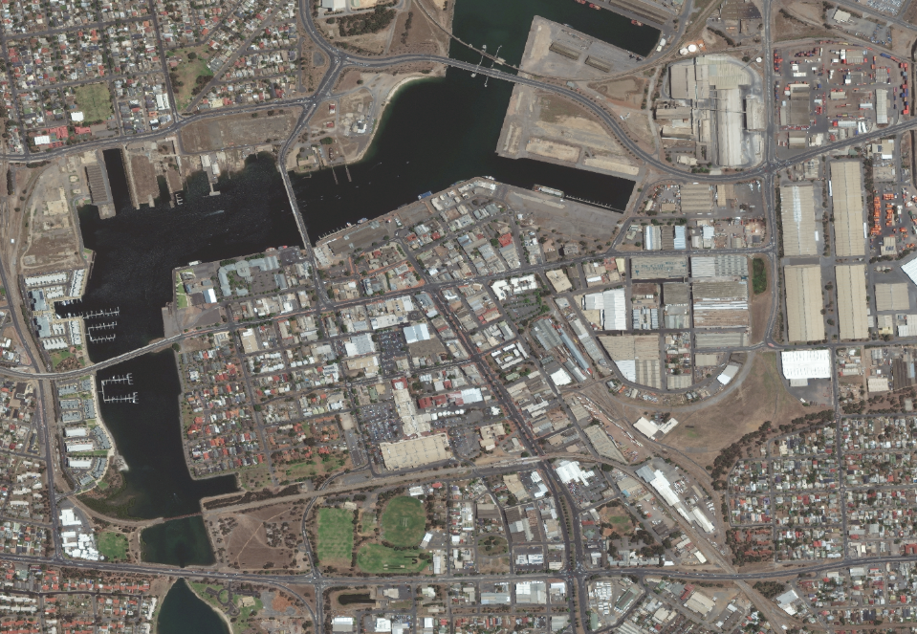
High Resolution Imagery

Slide 22
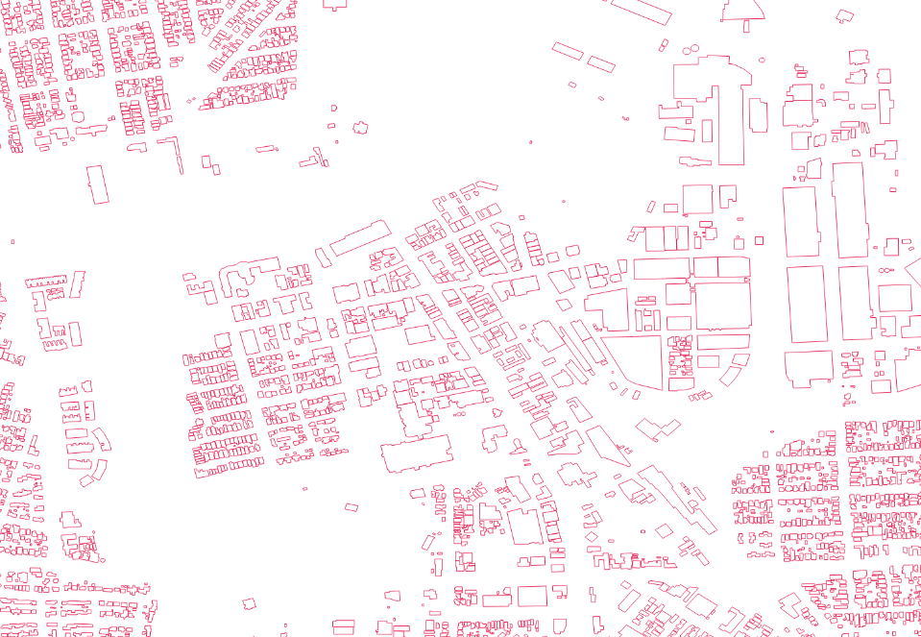
Extract Building Footprints

Slide 23
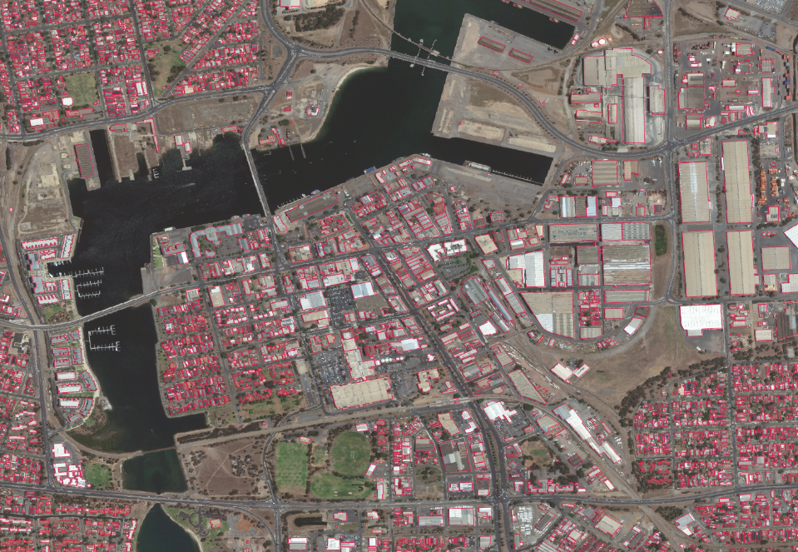
Building Footprints

Slide 24
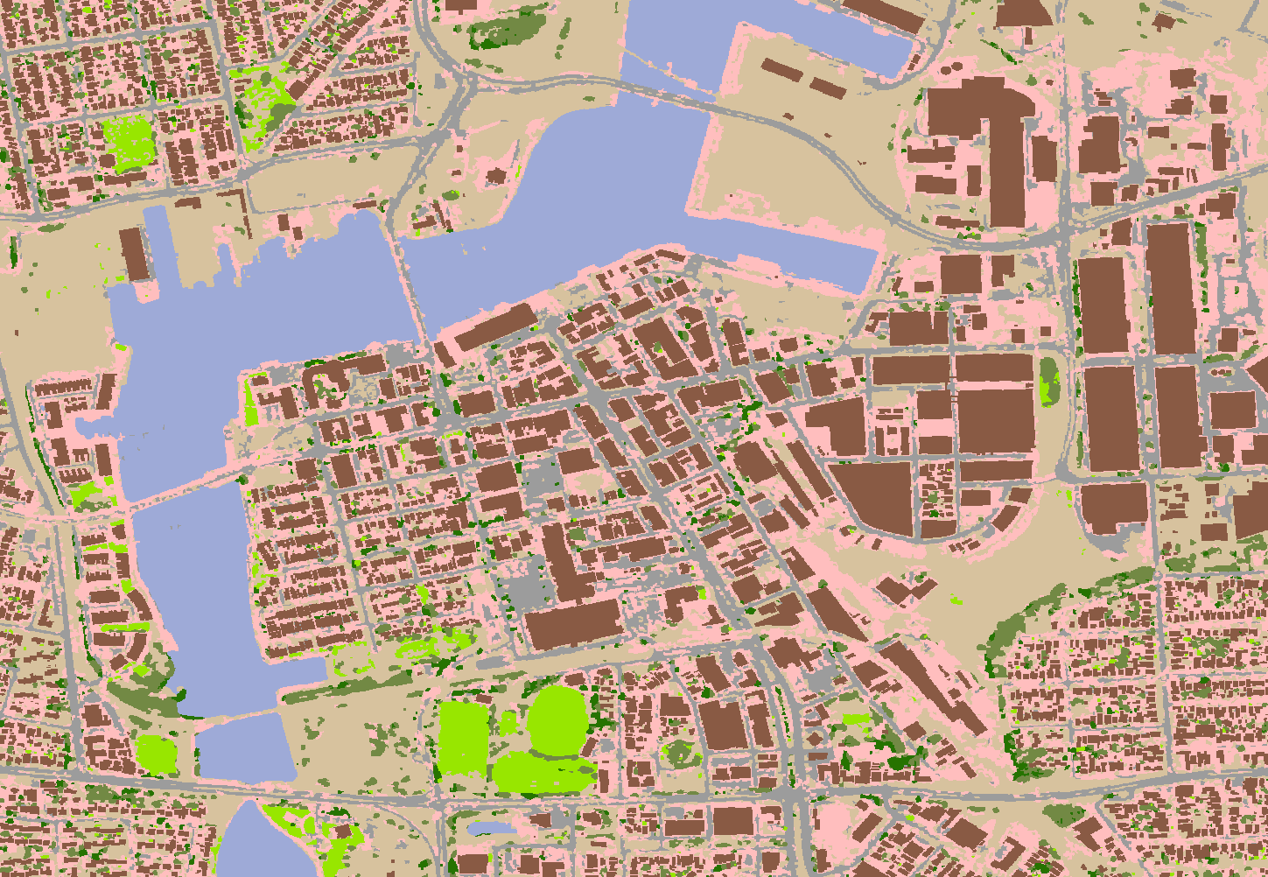
High Resolution Land Cover Map

Slide 25
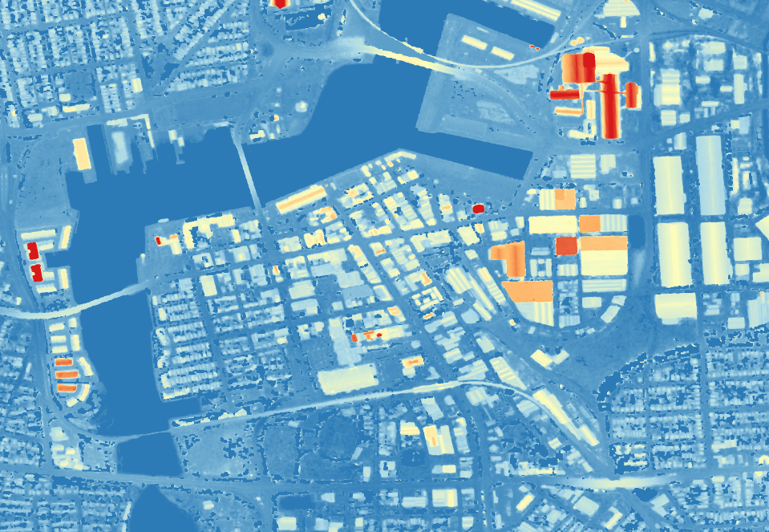
Digital Surface Model – Elevation Map

Slide 26
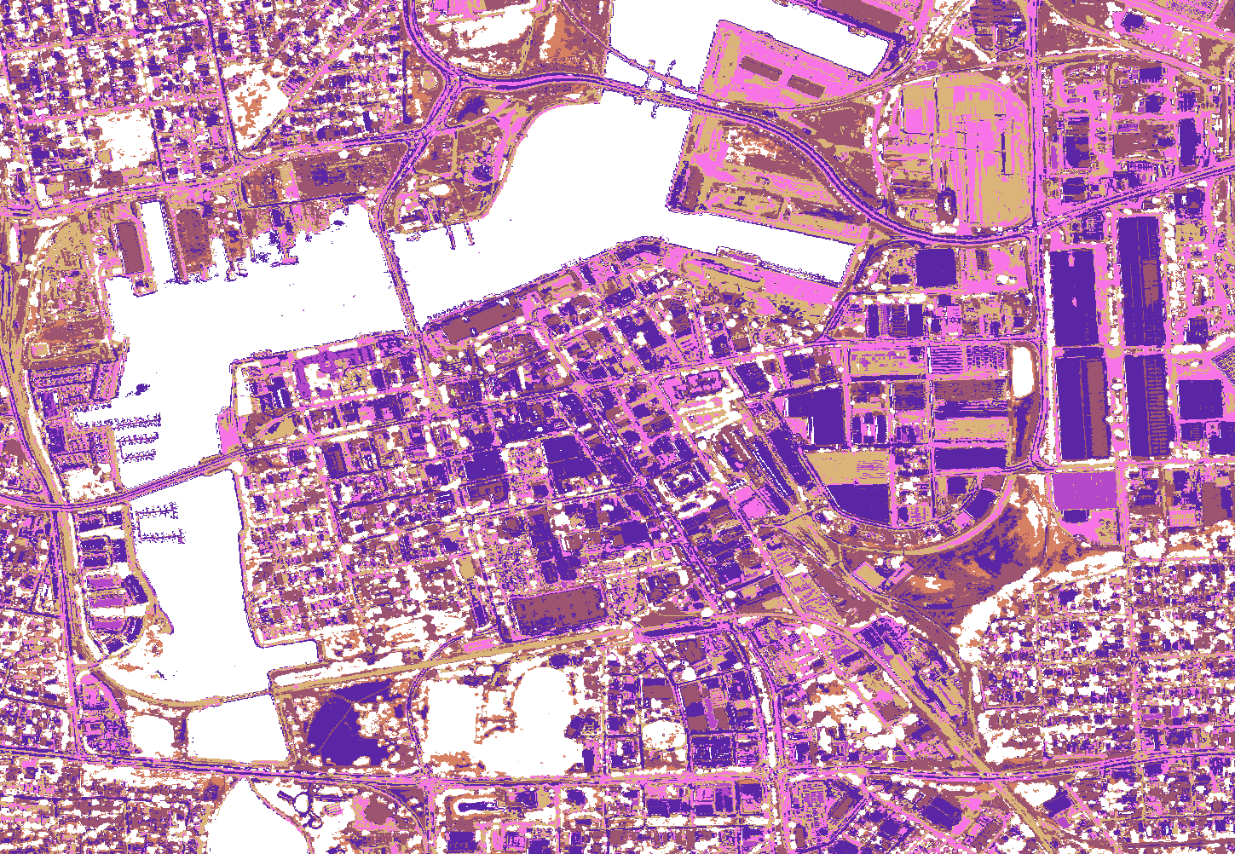
Spectral Analysis to Extract Roof Material Type

Slide 27
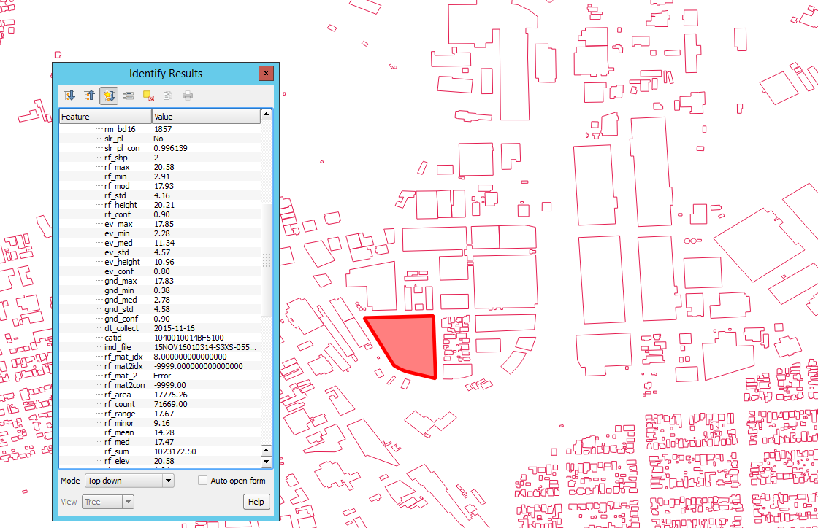
Spatial Database with Comprehensive Building Attributes

Slide 28
Challenges → Opportunities!
Most of your time is wasted on data management & pre-processing
Model portability across regions and collections
Leveraging (and loving!) the unknown
Notes:
GBDX
Leverage traditional methods along with new methods
Is statistical analysis good enough?

