Slide 1

Quantifying Risks and Performance of Infrastructure Investments
Michael D. Lepech
Associate Professor of Civil and Environmental Engineering
Thomas V. Jones Engineering Faculty Scholar
Senior Fellow at the Woods Institute for the Environment
Annual Conference on Measurement Technology
Civil Infrastructure Monitoring Panel
Hotel Shattuck Plaza
Berkeley, California USA
October 13, 2016

Slide 2
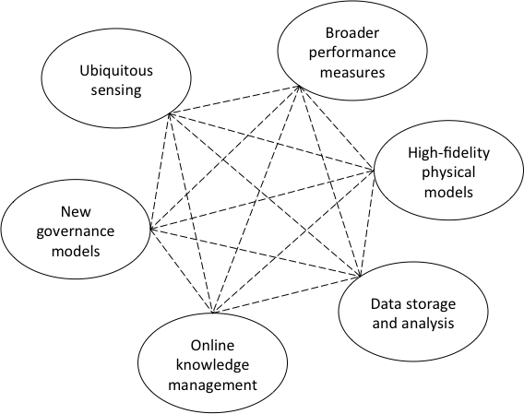
Macro-trends affecting infrastructure
Emerging Macro-Trends
Sundholm, V., Lepech, M., Wikstrom, K. (2015)

Slide 3
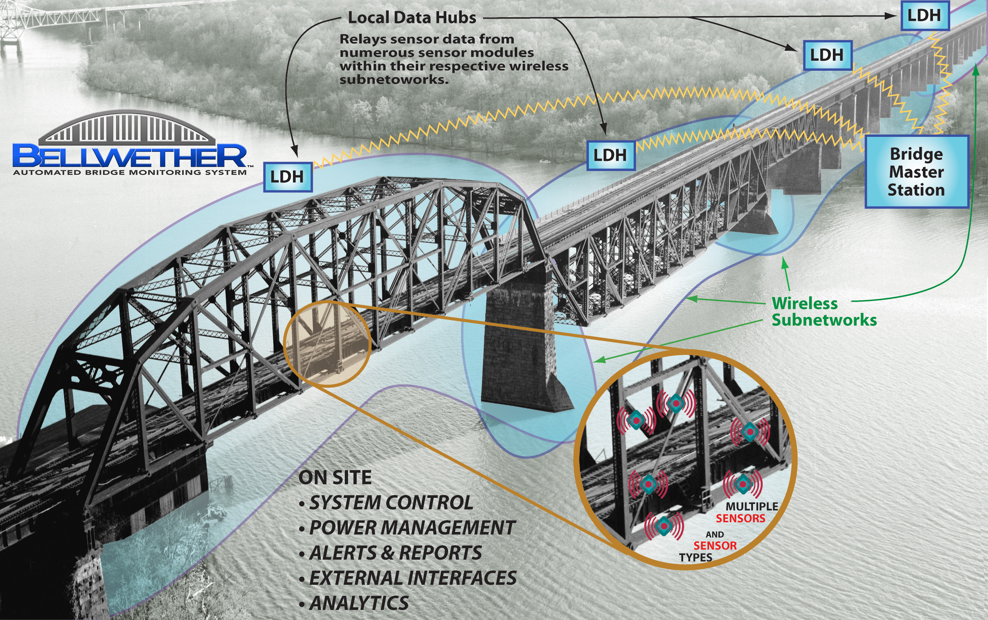
Distributed Sensor Networks
Infrastructure monitoring (Kiremidjian, 2001; Mollineaux et al., 2014)
  Structural health monitoring
  Bridges
  Tunnels
  Pipelines
  Wind turbines
Operational sensing (Tuegel et al., 2011)
  (Virtually) Real-time data collection and
  communication
Distributed private sensors (Mohan et al., 2008)
  Mobile phone interface
  Traffic conditions
  Vehicle efficiency/comfort measures
  Emergency response
  Service demand
Increasingly viewing sensing and collection of
data as a commodity marketplace
Bellweather by Heuristic Actions, Inc.
Surface Chloride Profile
Wu, Shen & Lepech (2016)

Slide 4
Macro-trends affecting infrastructure
Emerging Macro-Trends
Sundholm, V., Lepech, M., Wikstrom, K. (2015)

Slide 5
Coupled Multi-physics Service Life
Temperature
Microstructure
Moisture
Ions
Oxygen
Material and
Transport
Models
Service Life Prediction
Ions
Cracking
Mechanical
Models
Corrosion
Models
Resistivity
Debonding
Oxygen
Properties
Temperature
Moisture
Michel, A., Geiker, M, R., Stang, H., and Lepech, M.D., (2013)

Slide 6
Transport of Heat and Matter
Nernst-Planck Equation
Microstructure
Moisture
Material and
transport
model
Ions
Comparison experimental and
numerical results
Temperature
Oxygen
Service
life
prediction

Slide 7
Reinforcement Corrosion Modeling
Modeling reinforcement corrosion
  corrosion current and potential
  polarization
Service
life
prediction
Resistivity
Corrosion
model
Ions
Moisture
Oxygen
Temperature

Slide 8
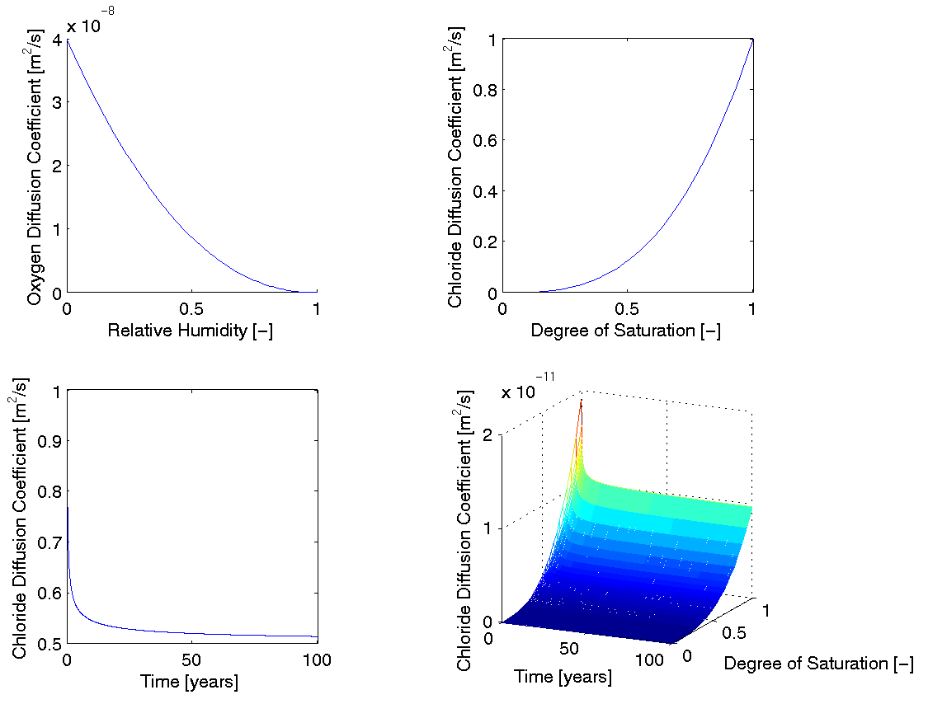
Multi-physics Transport Coupling

Slide 9
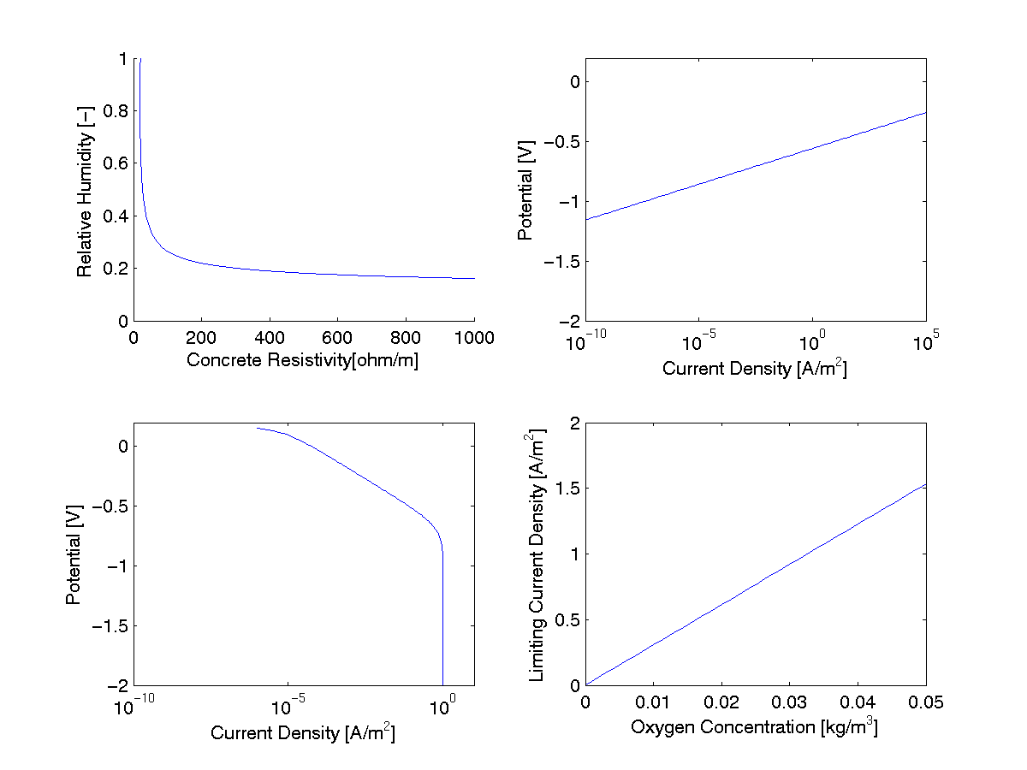
Multi-physics Corrosion Coupling

Slide 10
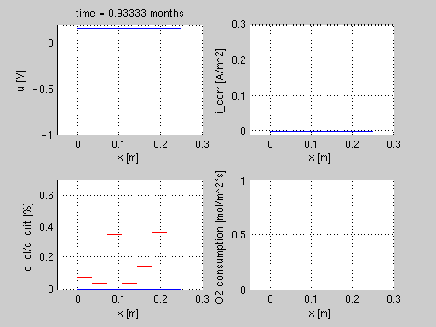
Corrosion Propagation (Cracked ECC)
Propagation Phase
Potential [V]
Corrosion Current [A/m²]
Cl Concentration [%]
O₂ Consumption [mol/m²-s]
Length along Beam [m]

Slide 11
Corrosion Propagation (Cracked ECC)
Propagation Phase
Potential [V]
Corrosion Current [A/m²]
Cl Concentration [%]
O₂ Consumption [mol/m²-s]
Length along Beam [m]

Slide 12
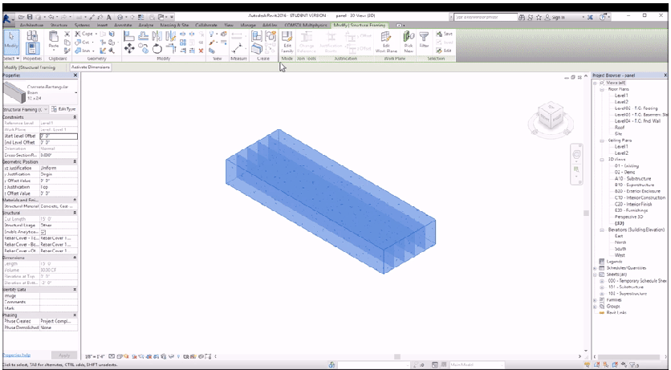
High-Fidelity Physical Modeling
Multi-physics Revit Plugin
Predictive Corrosion Mapping
Wu, Shen & Lepech (2016)

Slide 13
Macro-trends affecting infrastructure
Emerging Macro-Trends
Sundholm, V., Lepech, M., Wikstrom, K. (2015)

Slide 14
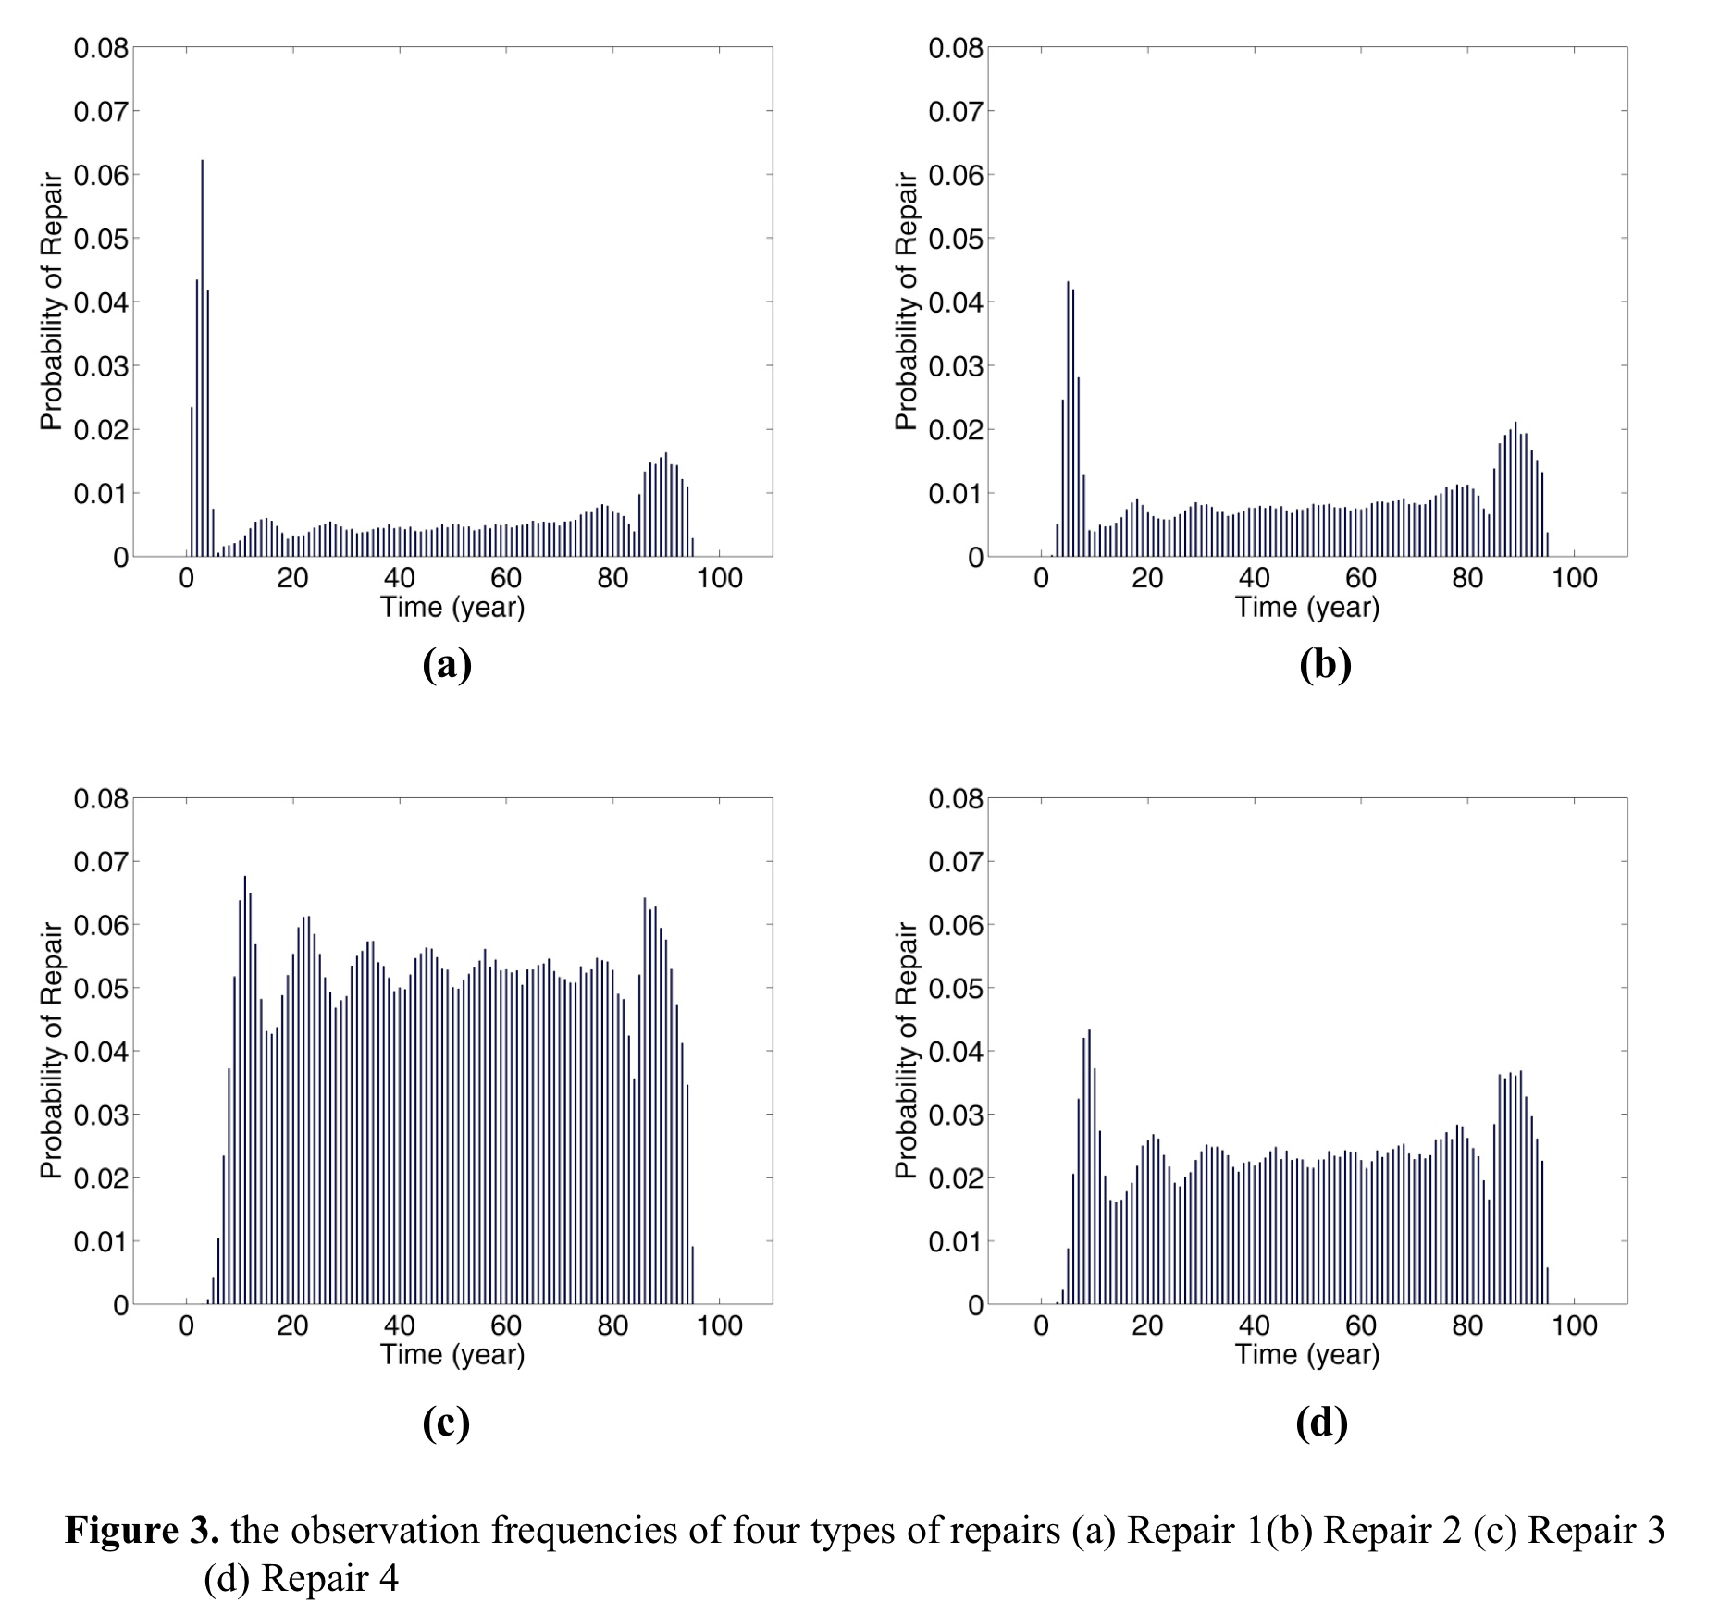
Financial Measures of Performance
Dynamic probability of cash flows of infrastructure over time
“Functional” Value at Risk Model (fVAR)
LS1
LS2
LS3
LS4
Shen & Lepech (2016)

Slide 15
fib 2010 Model Code
Section 3.4 – Design Principles for Sustainability
  Impacts
  Environmental Impact
    Urban Air Pollution
    Hazardous Substances
    ...
    Global Warming
    Waste Material
    - Resources Consumption
  Social Impact
  Aesthetics
  Life Cycle Concept
Removal and reuse
Use and
maintenance
Execution
Repair
Design
Demolition
Exchange of
elements
fib (2006)

Slide 16
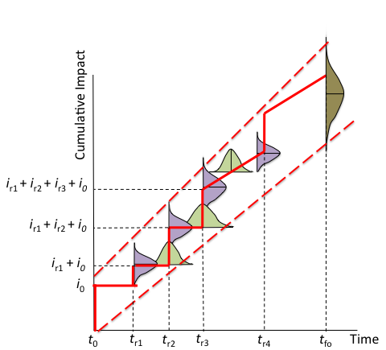
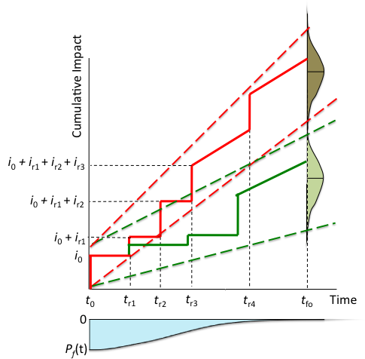
Design for Sustainability
Broader metrics of environmental and social performance
Code-based probabilistic design methodology
Lepech, M., Stang, H., Geiker, M. (2013)

Slide 17
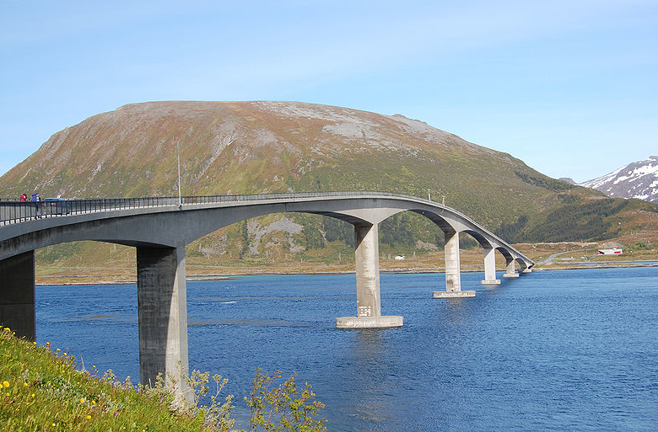
OFU Gimsøystraumen Bridge
Total span: 839 meters Maximum clearance to the sea: 30 meters
Spans: 9 Opened in 1981
Main span: 148 meters
Lepech, M., Stang, H., Geiker, M. (2013)

Slide 18
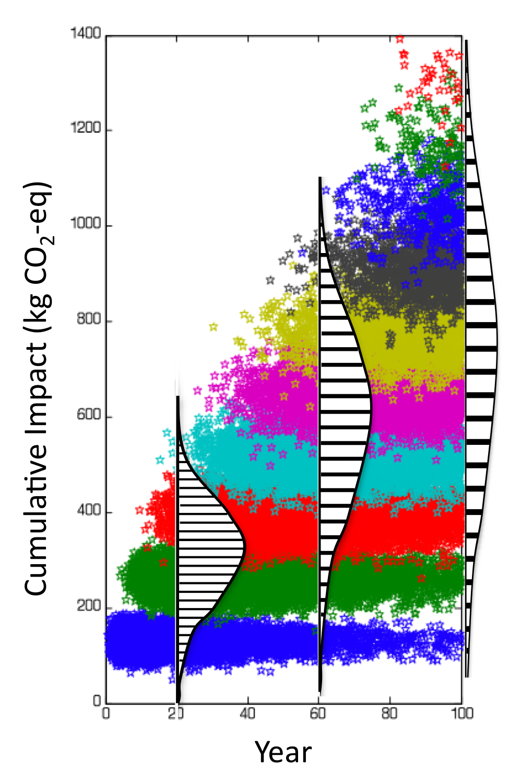
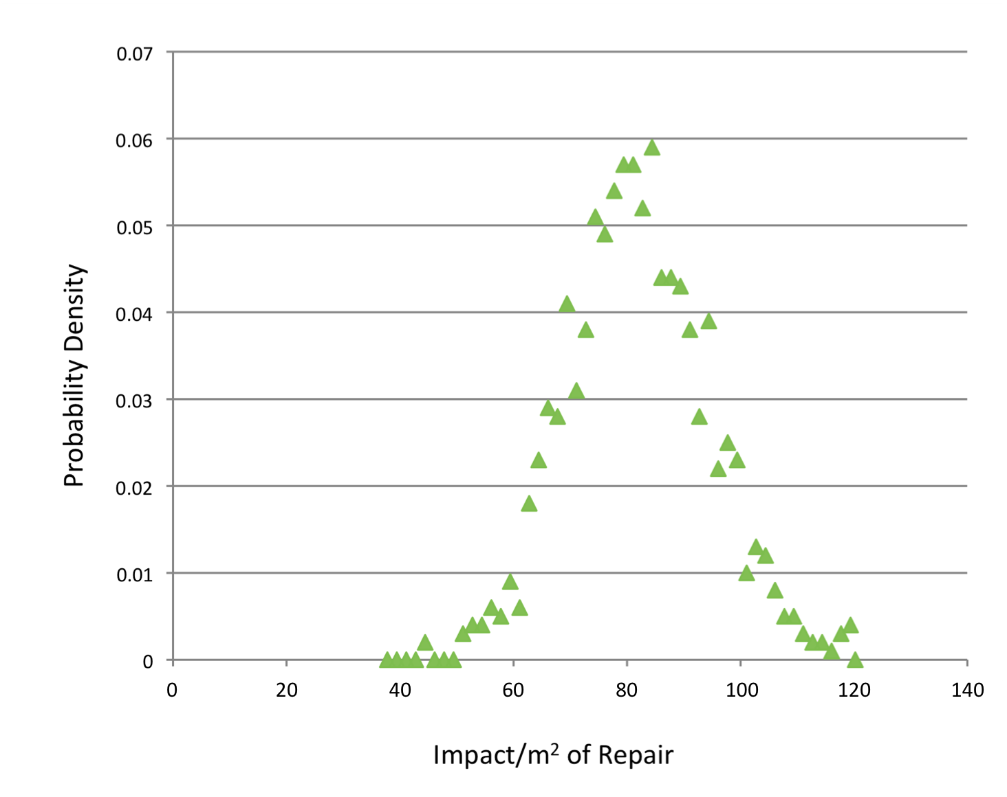
Design for Sustainability
Broader metrics of environmental and social performance
Code-based probabilistic design methodology
Lepech, M., Stang, H., Geiker, M. (2013)

Slide 19
Macro-trends affecting infrastructure
Emerging Macro-Trends
Sundholm, V., Lepech, M., Wikstrom, K. (2015)

Slide 20
Accounting for Broad Metrics
FY2012
Global Alliance for Banking on Values (GABV)

Slide 21
Conclusions
Emerging Macro-Trends
Sundholm, V., Lepech, M., Wikstrom, K. (2015)

Slide 22
Acknowledgements
US National Science Foundation
  CAREER: Multi-physics Modeling for Probabilistic Design and Engineering of Sustainable Infrastructure Grant No. 1453881
Nordic Innovation Centre
  Project No. 08190 SR
Stanford University
  John A. Blume Fellowship
  Center for Integrated Facility Engineering
  Thomas V. Jones Faculty Developmental Fellowship
  Stanford Sustainable Banking Initiative
Danish Expert Centre for Infrastructure Construction
Silicon Valley Bank
COWIfonden

Slide 23
References
Shen, B., Lepech, M. (2016). “Probabilistic Design and Optimization of Environmentally Sustainable Maintenance of Reinforced Concrete Infrastructure”. Accepted to ASCE Journal of Infrastructure Systems.
Sundholm, V., Lepech, M. D., Wikström, K. (2015). The dynamic nature of governance structures for large investments-measurement and modeling, organizational fit, and lifecycle value. Proceedings of the 2015 Engineering Project Organization Conference. Edinburgh, Scotland. June 24-26, 2015.
Wu, J., Shen, B., Lepech, M. (2016). “Assessing and Managing the Sustainability of Reinforced ECC Panels by Integrating Optimization with Multi-physics Corrosion Modeling.” 9th RILEM International Symposium on Fiber Reinforced Concrete. Eds. N. Banthia and S. Mindess. Vancouver, British Columbia, Canada. September 19-21, 2016
Michel, A., M.R. Geiker, H. Stang, M. Lepech (2013) “Integrated modeling of corrosion-induced deterioration in rein-forced concrete structures” 2013 European Corrosion Congress. Estoril, Portugal. September 1-5, 2013.
Kiremidjian, A.S. (2011) Structural health monitoring for civil infrastructure - from instrumentation to decision support, in Chang, F-K. (ed.) Proceedings of the 8th International Workshop on Structural Health Monitoring 2011: Condition-based Maintenance and Intelligent Structuers, Vol. 1., DEStech Publications, Lancaster, pp. 27-38.
Mollineaux, M., Balafas, K., Branner, K., Nielsen, P., Tesauro, A., Kiremidjian, A. and Rajagopal, R. (2014) Damage detection methods on wind turbine blade testing with wired and wireless accelerometer sensors, in 7th European Workshop on Structural Health Monitoring, 8-11 July, Nantes, pp. 1863–1870.
Tuegel, E.J., Ingraffea, A.R., Eason, T.G. and Spottswood, S.M. (2011) Reengineering aircraft structural life prediction using a digital twin. International Journal of Aerospace Engineering, 2011, 1–14.
Mohan, P., Padmanabhan, V. N., & Ramjee, R. (2008, November). Nericell: rich monitoring of road and traffic conditions using mobile smartphones. In Proceedings of the 6th ACM conference on Embedded network sensor systems (pp. 323-336). ACM.
Lepech, M., Stang, H., Geiker, M. (2013) “Probabilistic Design and Management of Environmentally Sustainable Repair and Rehabilitation of Reinforced Concrete Structures” Cement and Concrete Composites. 47:19-31
Federation International du Benton (2006) “Model Code for Service Life Design – Bulletin 34” Lausanne, Switzerland. Pp. 116
Global Alliance for Banking on Values (2012) Strong, Straightforward and Sustainable Banking Financial Capital and Impact Metrics of Values Based Banking. Available at: http://www.gabv.org//wp-content/uploads/Full-Report-GABV-v9d.pdf

Slide 24
Questions?
Mike Lepech
mlepech@stanford.edu
Any opinions, findings, and conclusions or recommendations expressed in this material are those of the authors and do not necessarily reflect the views of the United States National Science Foundation.

