Slide 1
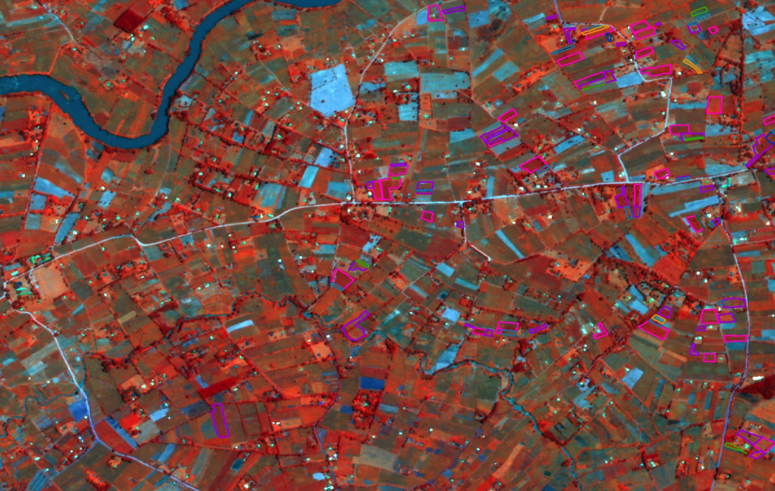
Measuring agricultural productivity and poverty from space
Marshall Burke & David Lobell
Dept. of Earth System Science, and
Center on Food Security and the Environment
Stanford University
* With thanks to collaborators Stefano Ermon, Neal Jean, Michael Xie, Matt Davis
CEGA/World Bank Conference on Measurement Technology
Berkeley, Oct 13 2016

Slide 2
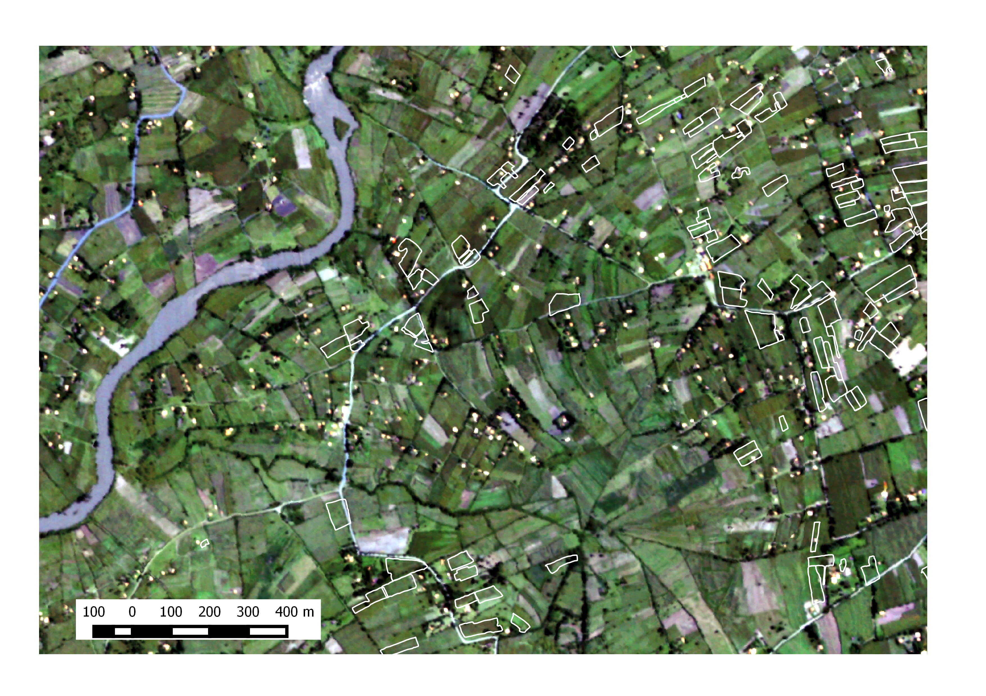
Imagine, for a moment…
Real-time data on agricultural yields for all fields
Real-time data on markets
Real-time data on household outcomes
Would have huge implications for our ability to:
Monitor progress and target assistance
Understand variation and evaluate interventions
Notes:
Imagine possibilities for monitoring, targeting assistance, and for improved insight into the drivers of food insecurity

Slide 3
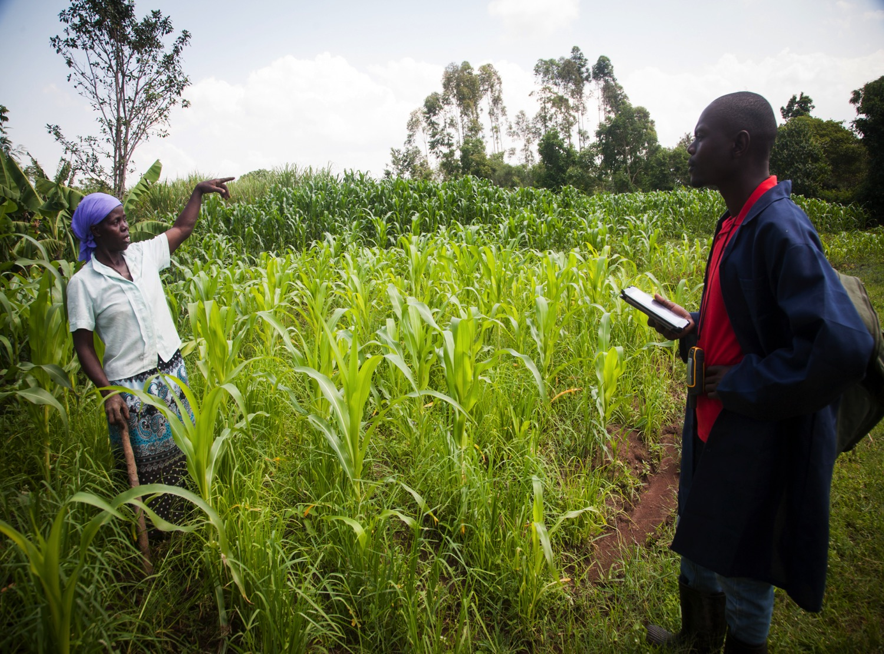
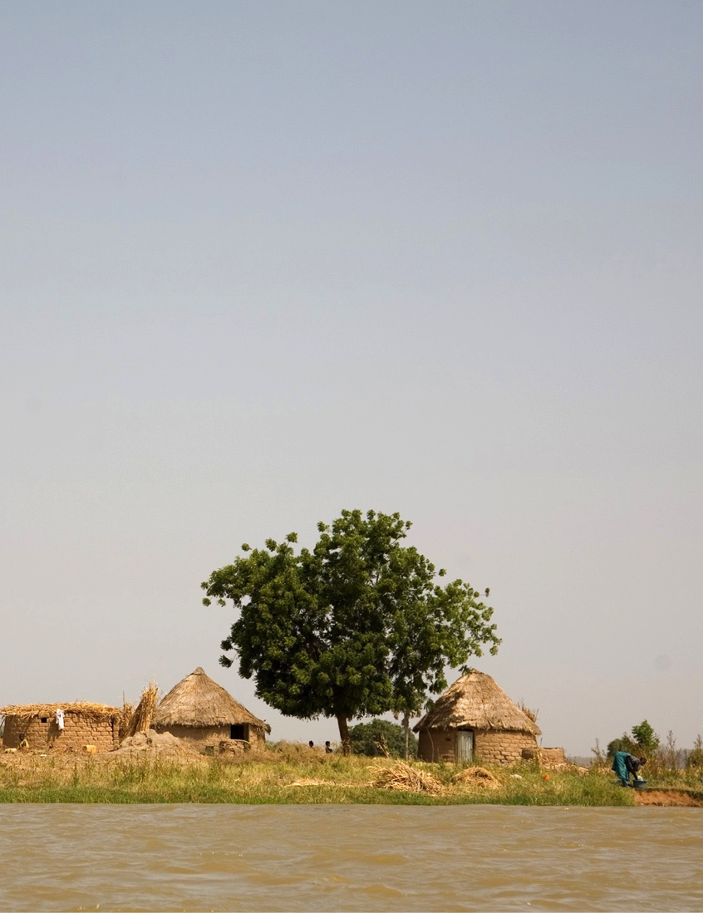
In next 15 min: Using satellites to do 2 things
1. Predict smallholder yields at field scale
2. Predict consumption and assets at village scale
Notes:
Emphasize that nothing here will suggest that satellites are a panacea. But they have a lot to offer in combination with other approaches.

Slide 4
Traditional challenges to satellite-based approach
Availability of low-cost, high-resolution imagery (temporal and spatial)
Lack of ground truth
Computational tools for analysis, scaling up

Slide 5

Historically, we’ve had 30m resolution data
Notes:
A comparison of the older “free” data (landsat) and the new “free” data (planet labs)

Slide 6
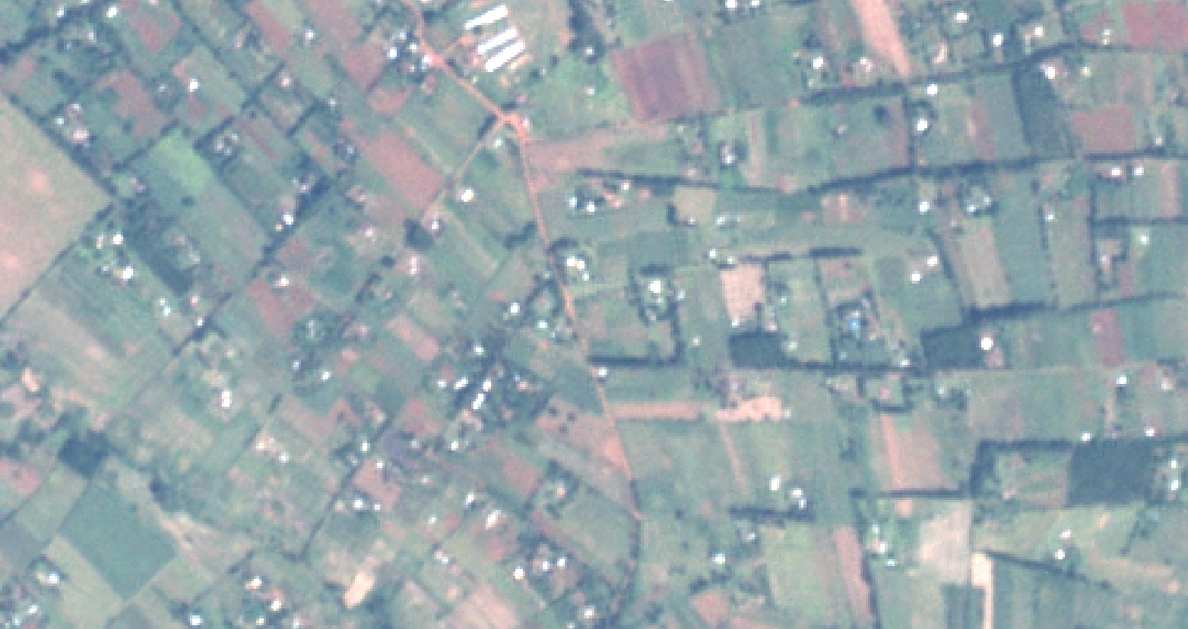
Now, 5m is routine
Dec 18, 2015 Planet Labs Image, Uganda
Notes:
A comparison of the older “free” data (landsat) and the new “free” data (planet labs)

Slide 7
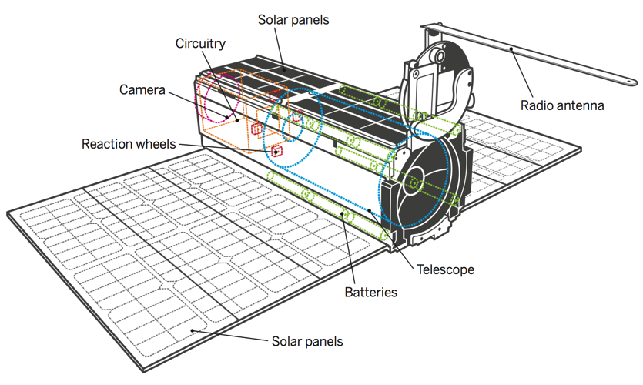
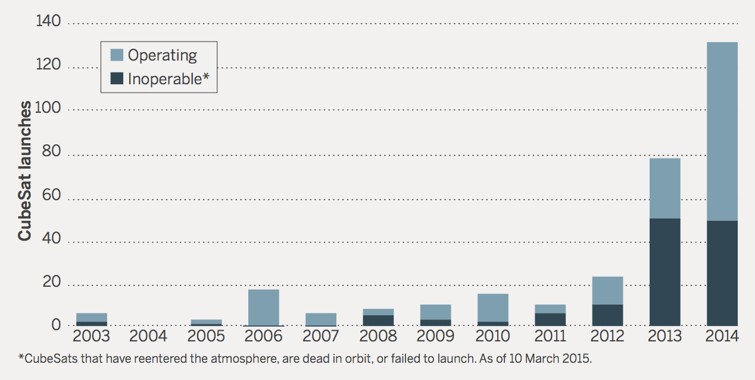
CubeSat launches since 2003
Hand, Science News, 2015

Slide 8
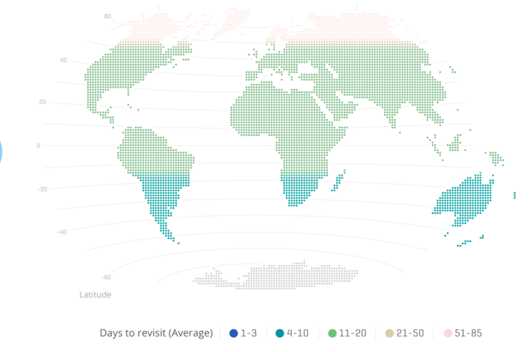
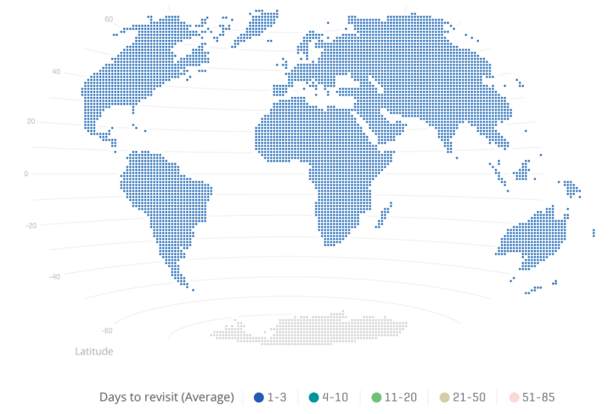
Planet Labs revisit rate:
2015 Q4
2016 Q2

Slide 9
This talk: Using satellites to do 2 things
1. Predict smallholder yields at field scale

Slide 10
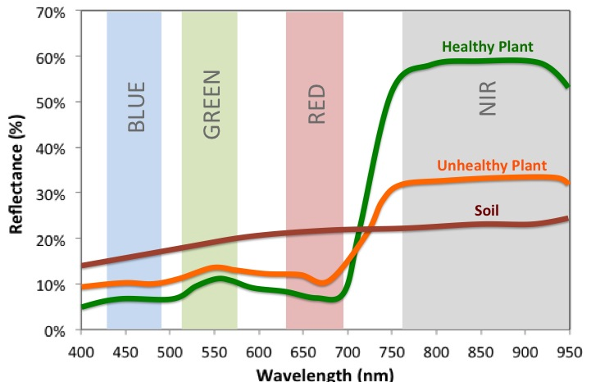
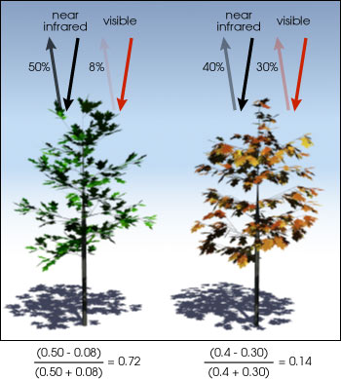

Satellites should be useful here
micasense.com, NASA.gov
Notes:
Healthy plants absorb in the visible spectrum and reflect strongly in the NIR. So ratios of reflectance in the NIR are generally highly correlated with healthy vegetation.

Slide 11
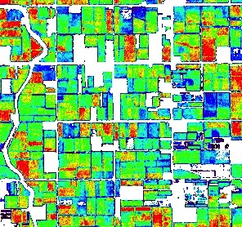
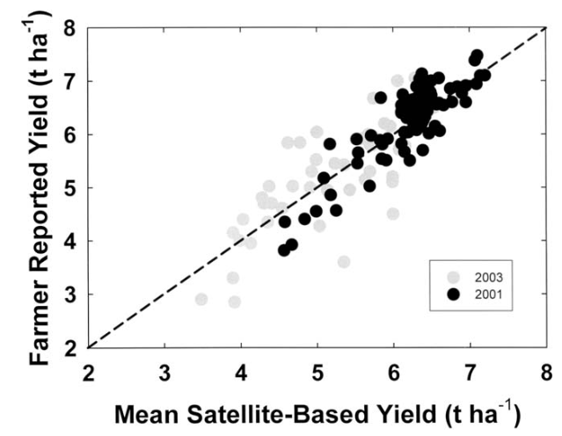
It works pretty well on big fields (irrigated wheat, Mex.)
R² = 0.76
1km
~4.0 ton/Ha
~7.0 ton/Ha
Lobell et al 2005

Slide 12
Problem in smallholder systems: tiny plots, no ground data

Slide 13
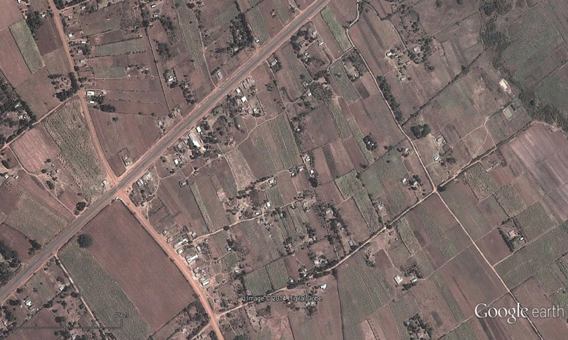
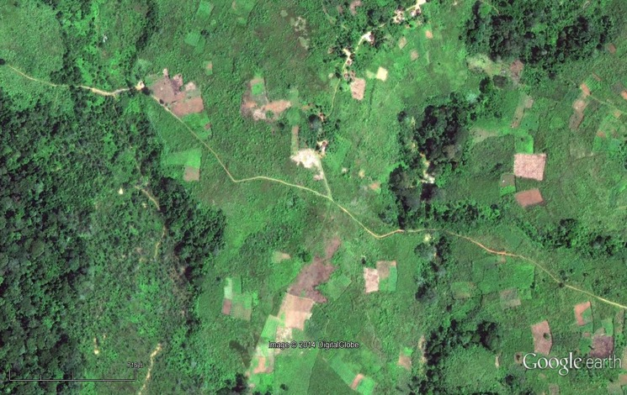
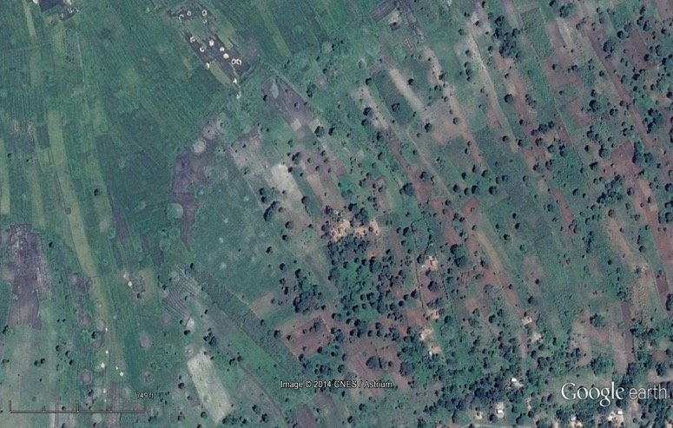
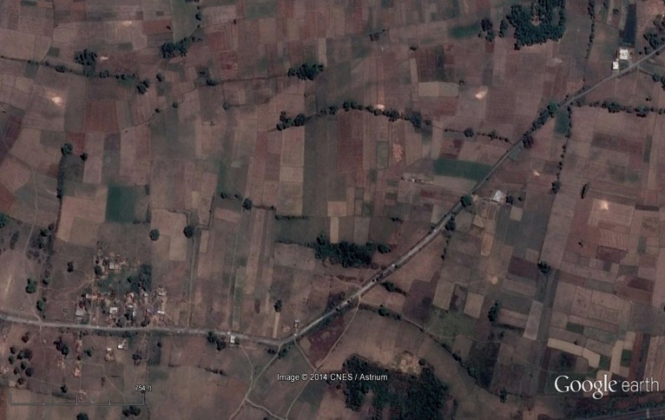
Rwanda
(with World Bank)
W Kenya
E Uganda
(with World Bank)
NE India
(with Meha Jain)

Slide 14
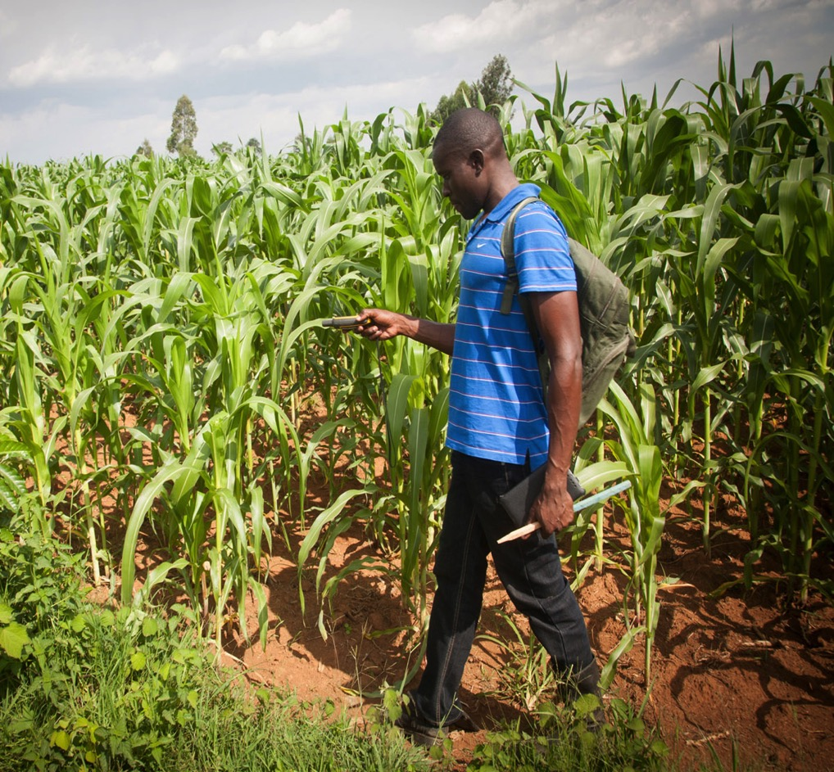
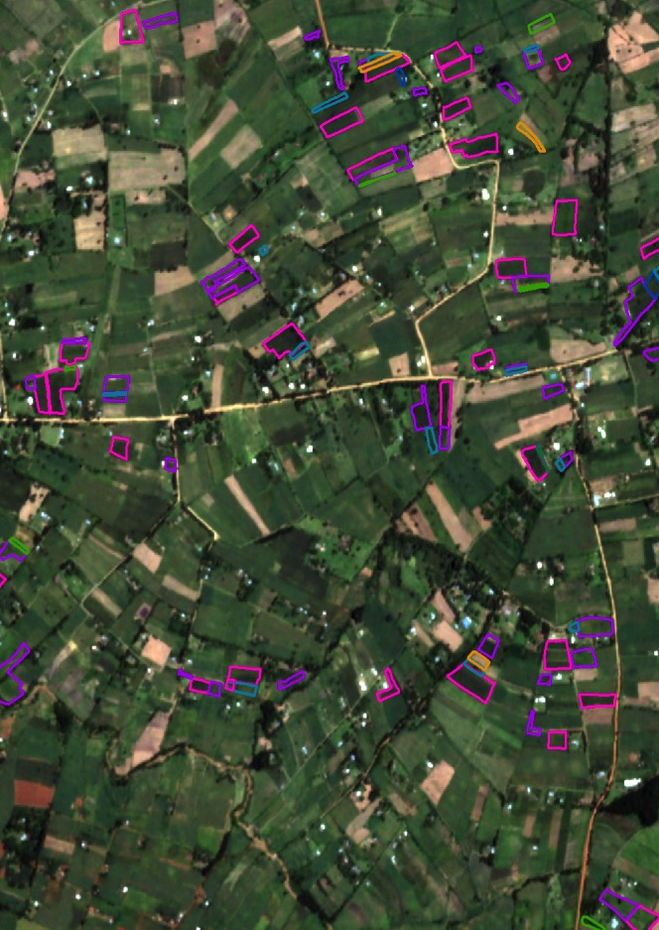

Slide 15
Performance on Kenyan smallholder maize fields
2014: 1 Skybox image
2015: 2 Skybox images
2015, pure-stand, >0.5 acres
Basic approach:
Likely understates true performance!
Burke & Lobell, under review

Slide 16
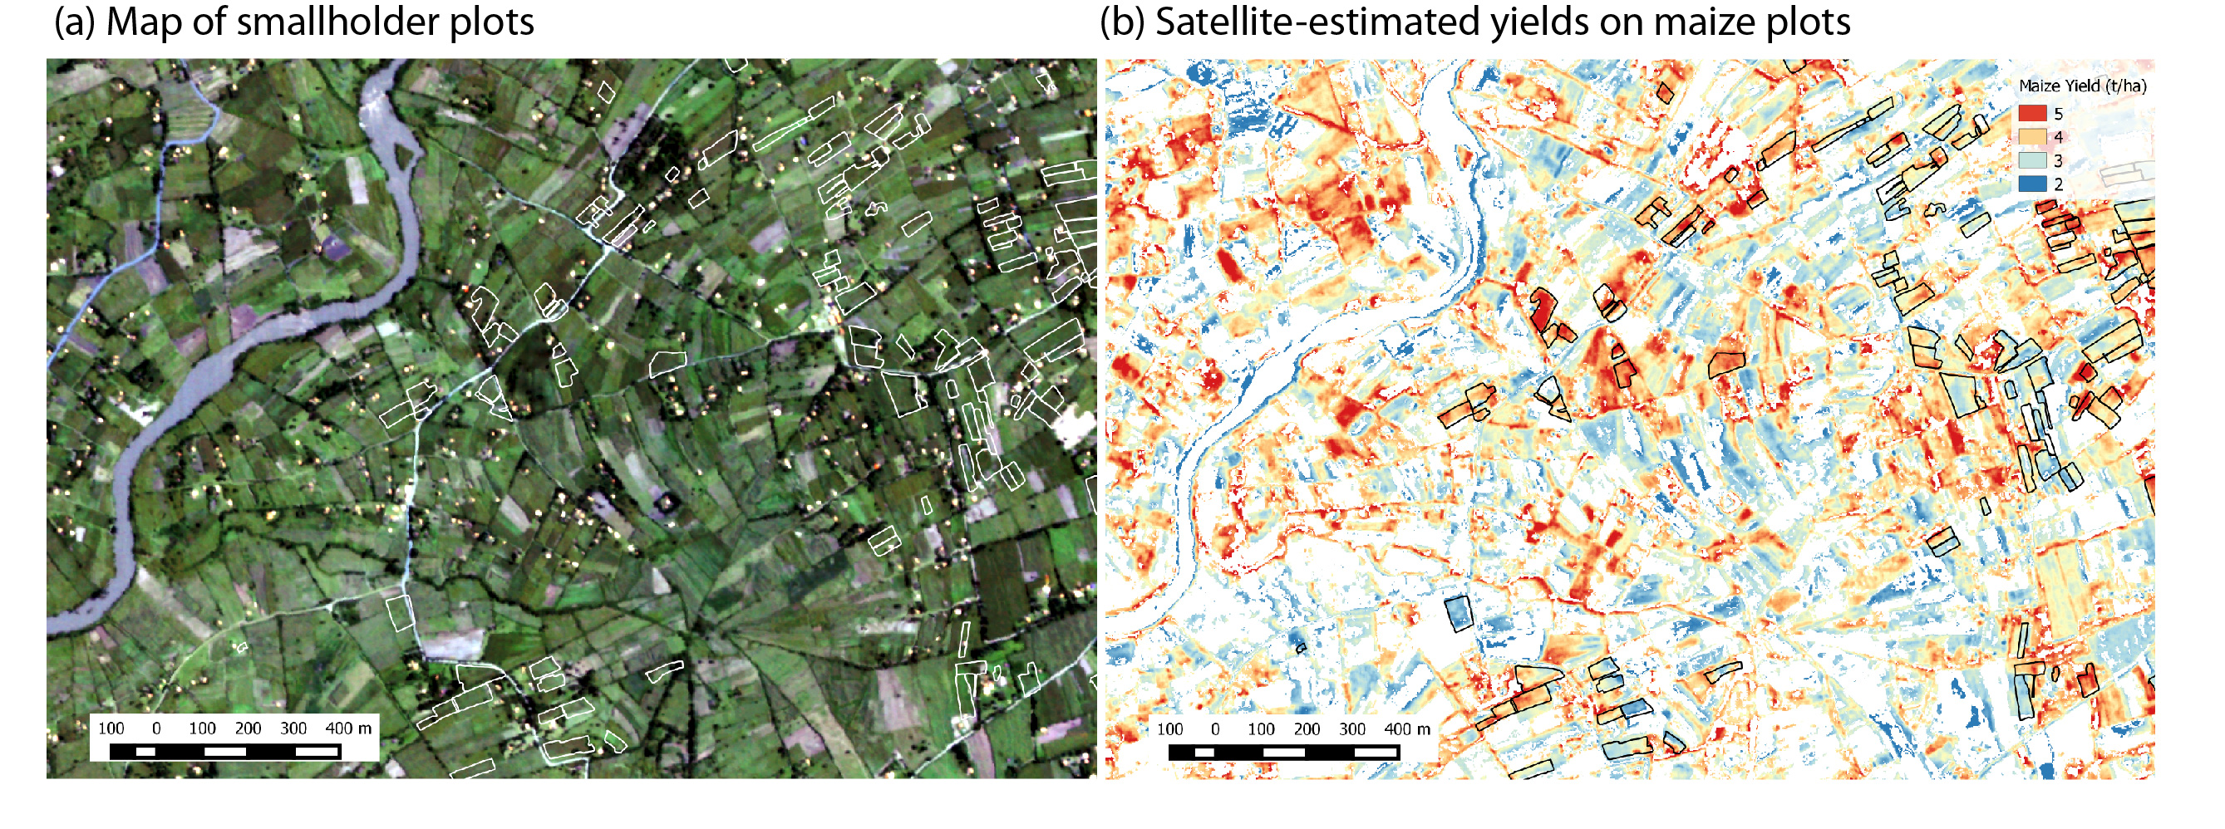
Then with addition of crop classification model, we can do something this:
Kenya, 2015
Burke & Lobell, under review

Slide 17
Imagine, for a moment…
Real-time data on agricultural yields for all fields
Our estimates likely understate true performance
Estimates should improve with more frequent imagery
Nevertheless: plentiful but noisy

Slide 18
This talk: Using satellites to do 2 things
1. Predict smallholder yields at field scale
2. Predict consumption and assets at village scale

Slide 19

Predicting economic well-being
Focus on 2 things measured in geo-referenced, publicly available surveys
  Consumption expenditure (LSMS)
  Asset wealth (DHS)
2015 UN Sustainable Development Goals

Slide 20
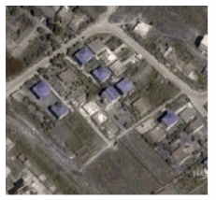
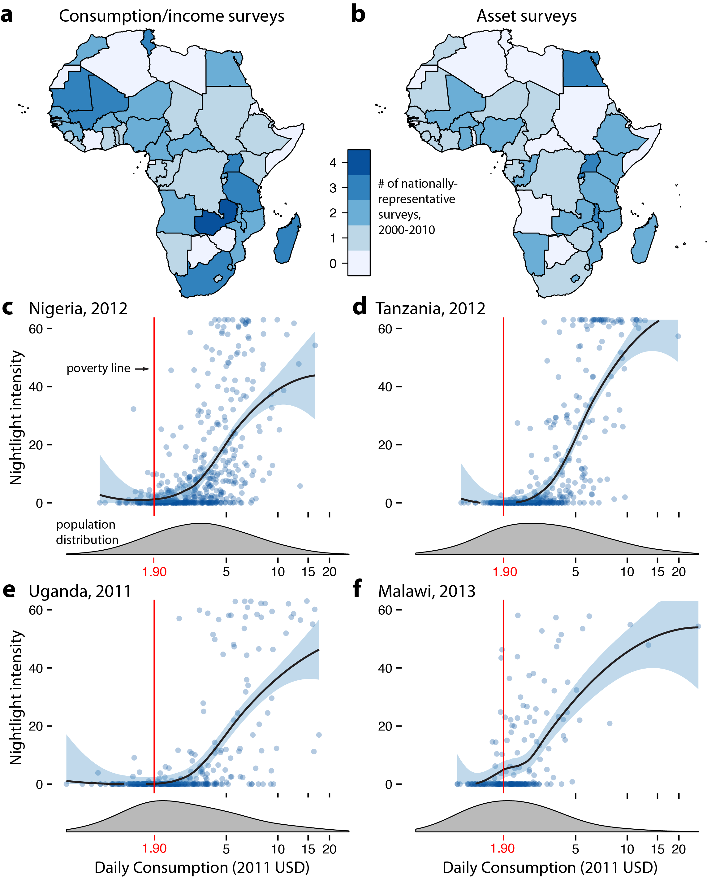
Challenges to using satellites here
What to look for in imagery?
Again, little training data

Slide 21

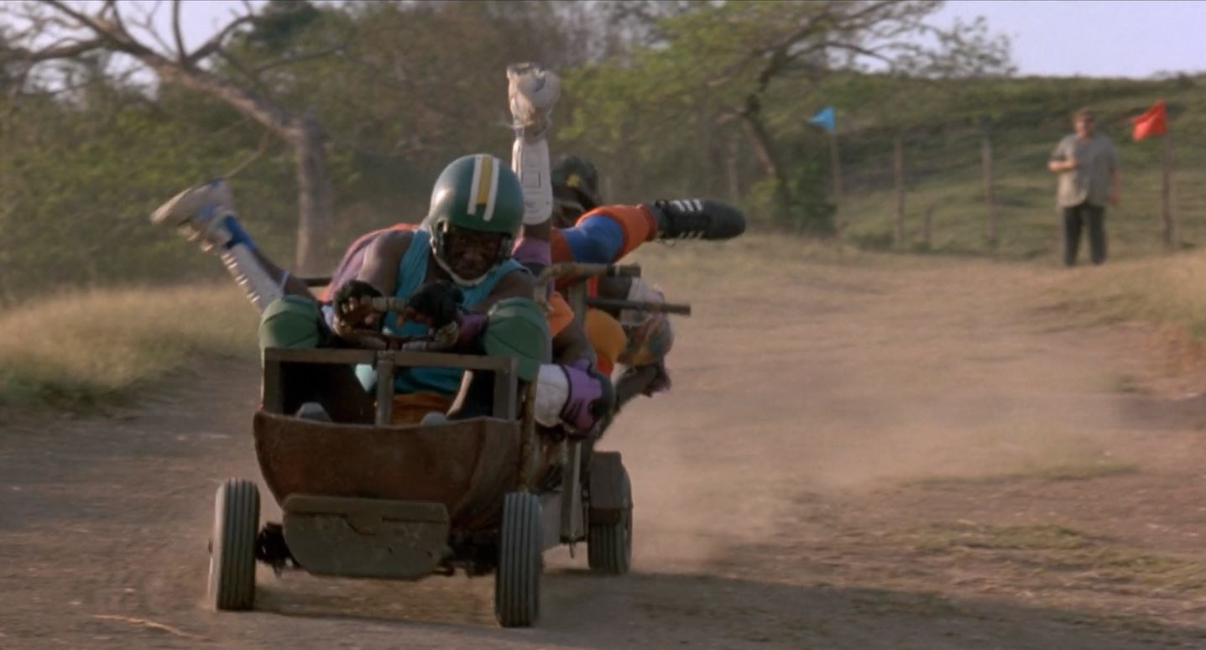
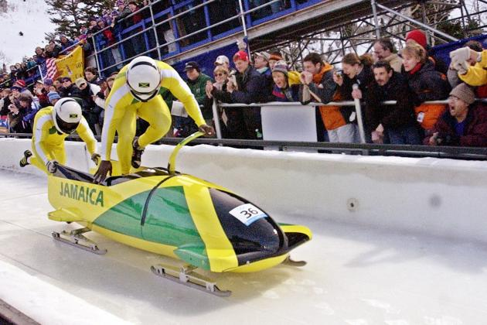
“Transfer learning” approach
Train here
Perform here
Transfer

Slide 22
“Transfer learning” approach
Satellite images
Poverty measures
-- Don’t know what to look for
-- Limited training data

Slide 23
“Transfer learning” approach
Data rich proxy:
Nighttime light intensities
Deep learning model
Model learns to identify features in imagery predictive of nightlights
Satellite images
Poverty measures

Slide 24
“Transfer learning” approach
Data rich proxy:
Nighttime light intensities
We then relate these extracted features to observed poverty measures in a regression
Deep learning model
Satellite images
Poverty measures

Slide 25
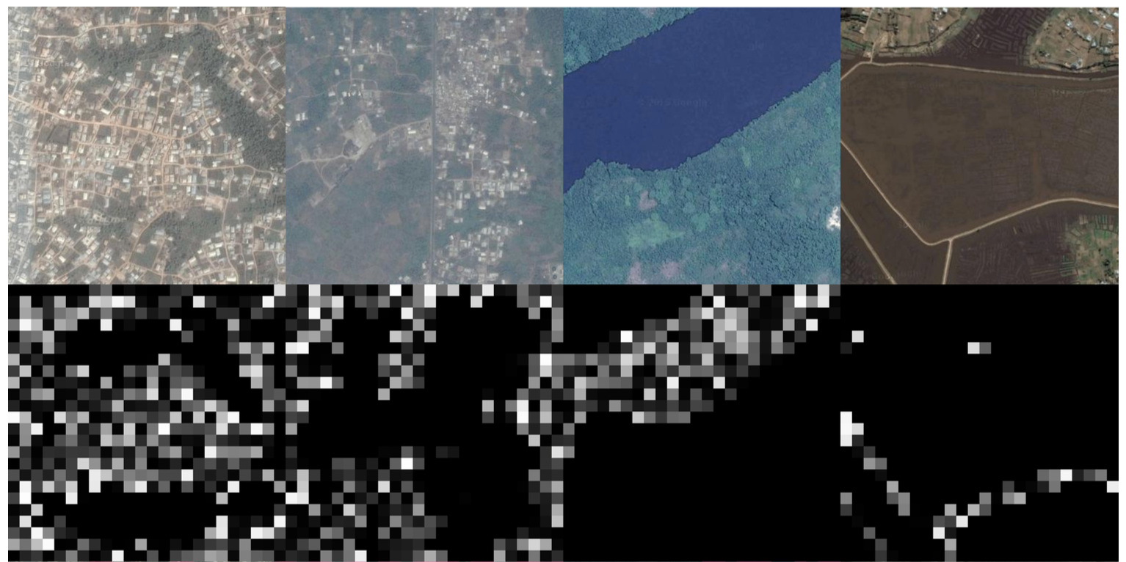
Some features the model picks out
Notes:
Here you see four different raw images drawn from google maps, and four different filters in the model that are particularly activated by these images (and the parts of the image that activate each filter). These appear to correspond to semantically meaningful things. E.g. the filter at left is one that lights up when it sees things that look like urban areas, the second cropland, the third water, the fourth roads. So without any supervision, the model is learning to identify things that we might think of as correlated with the well-being of a location.

Slide 26
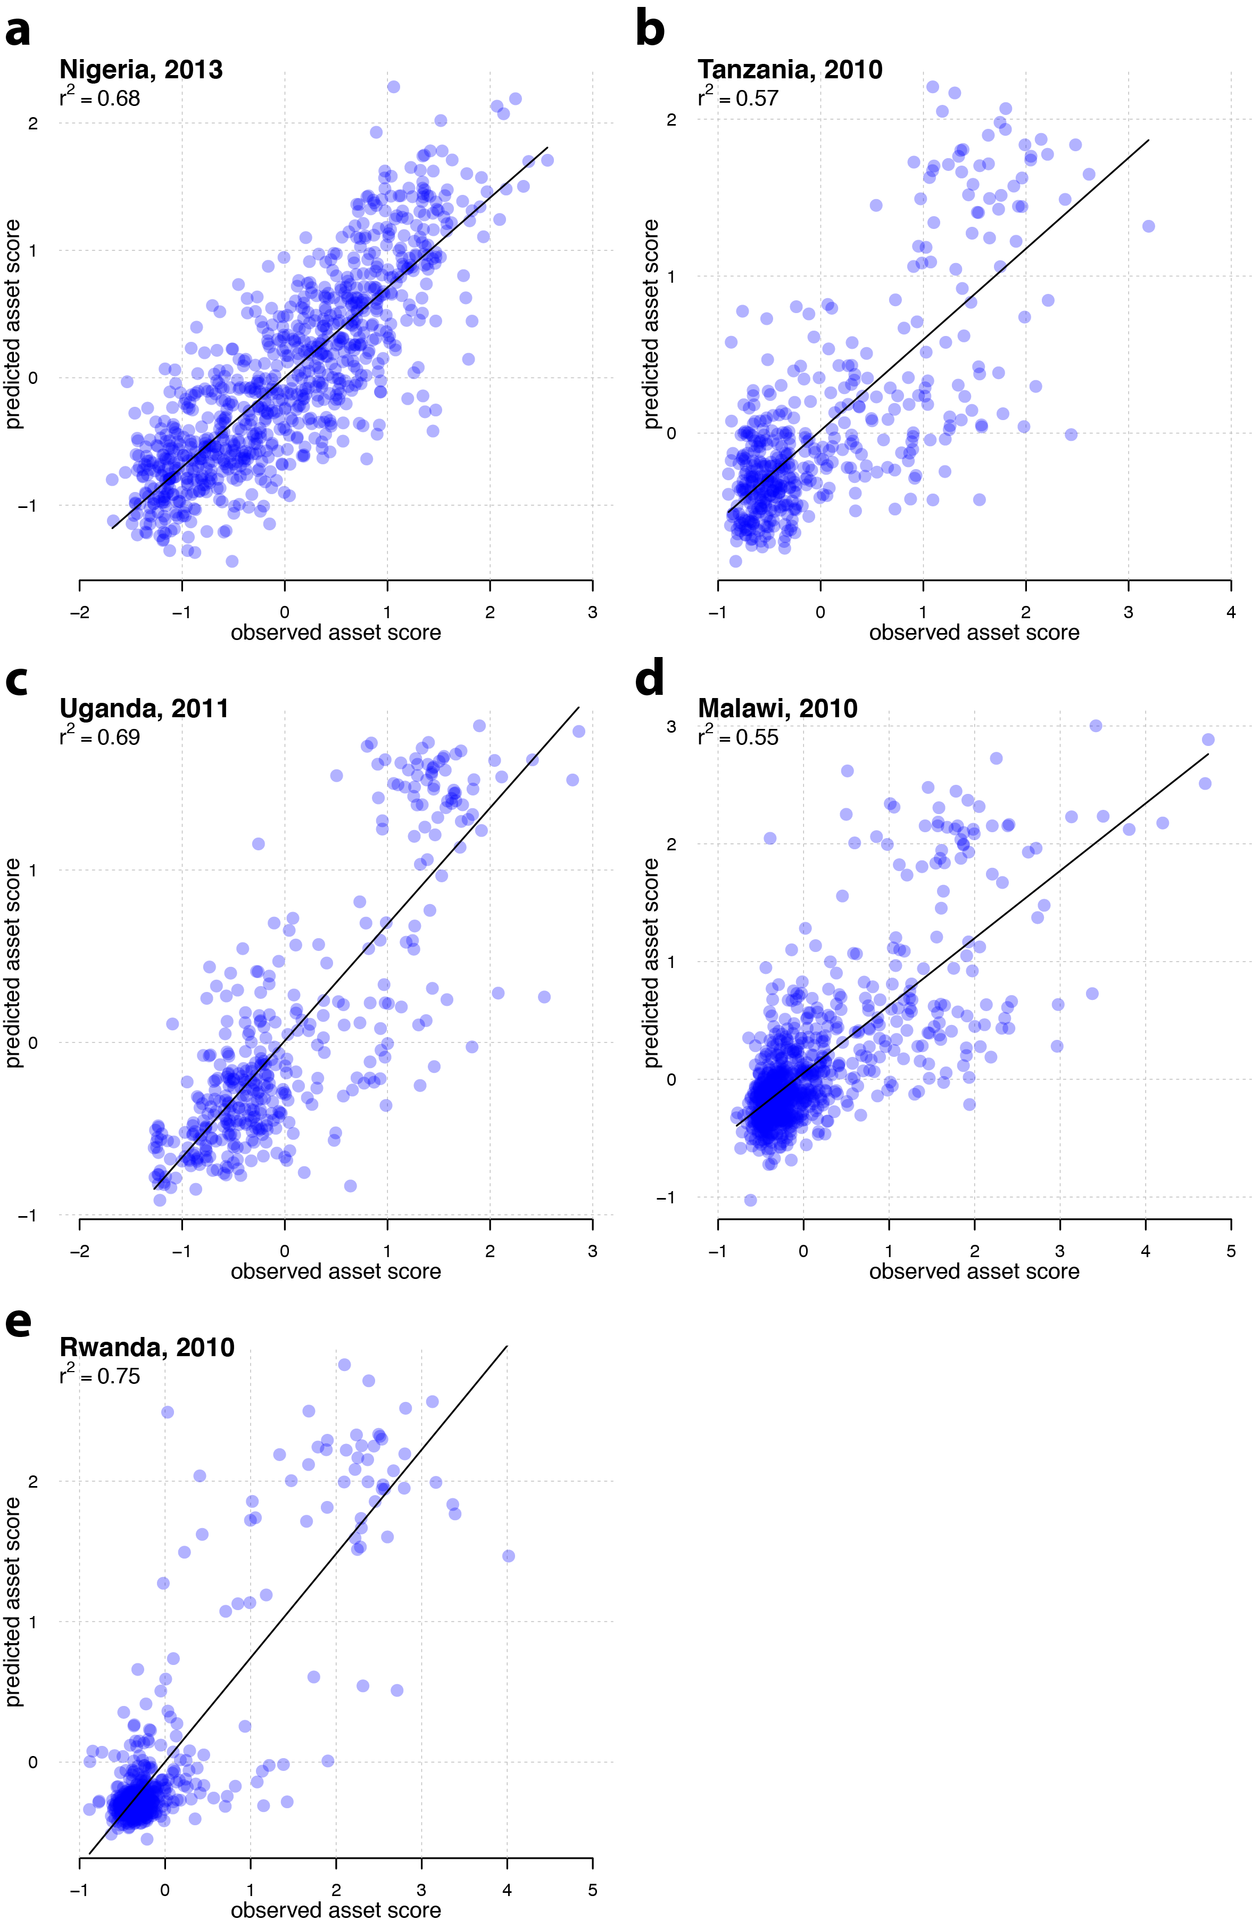
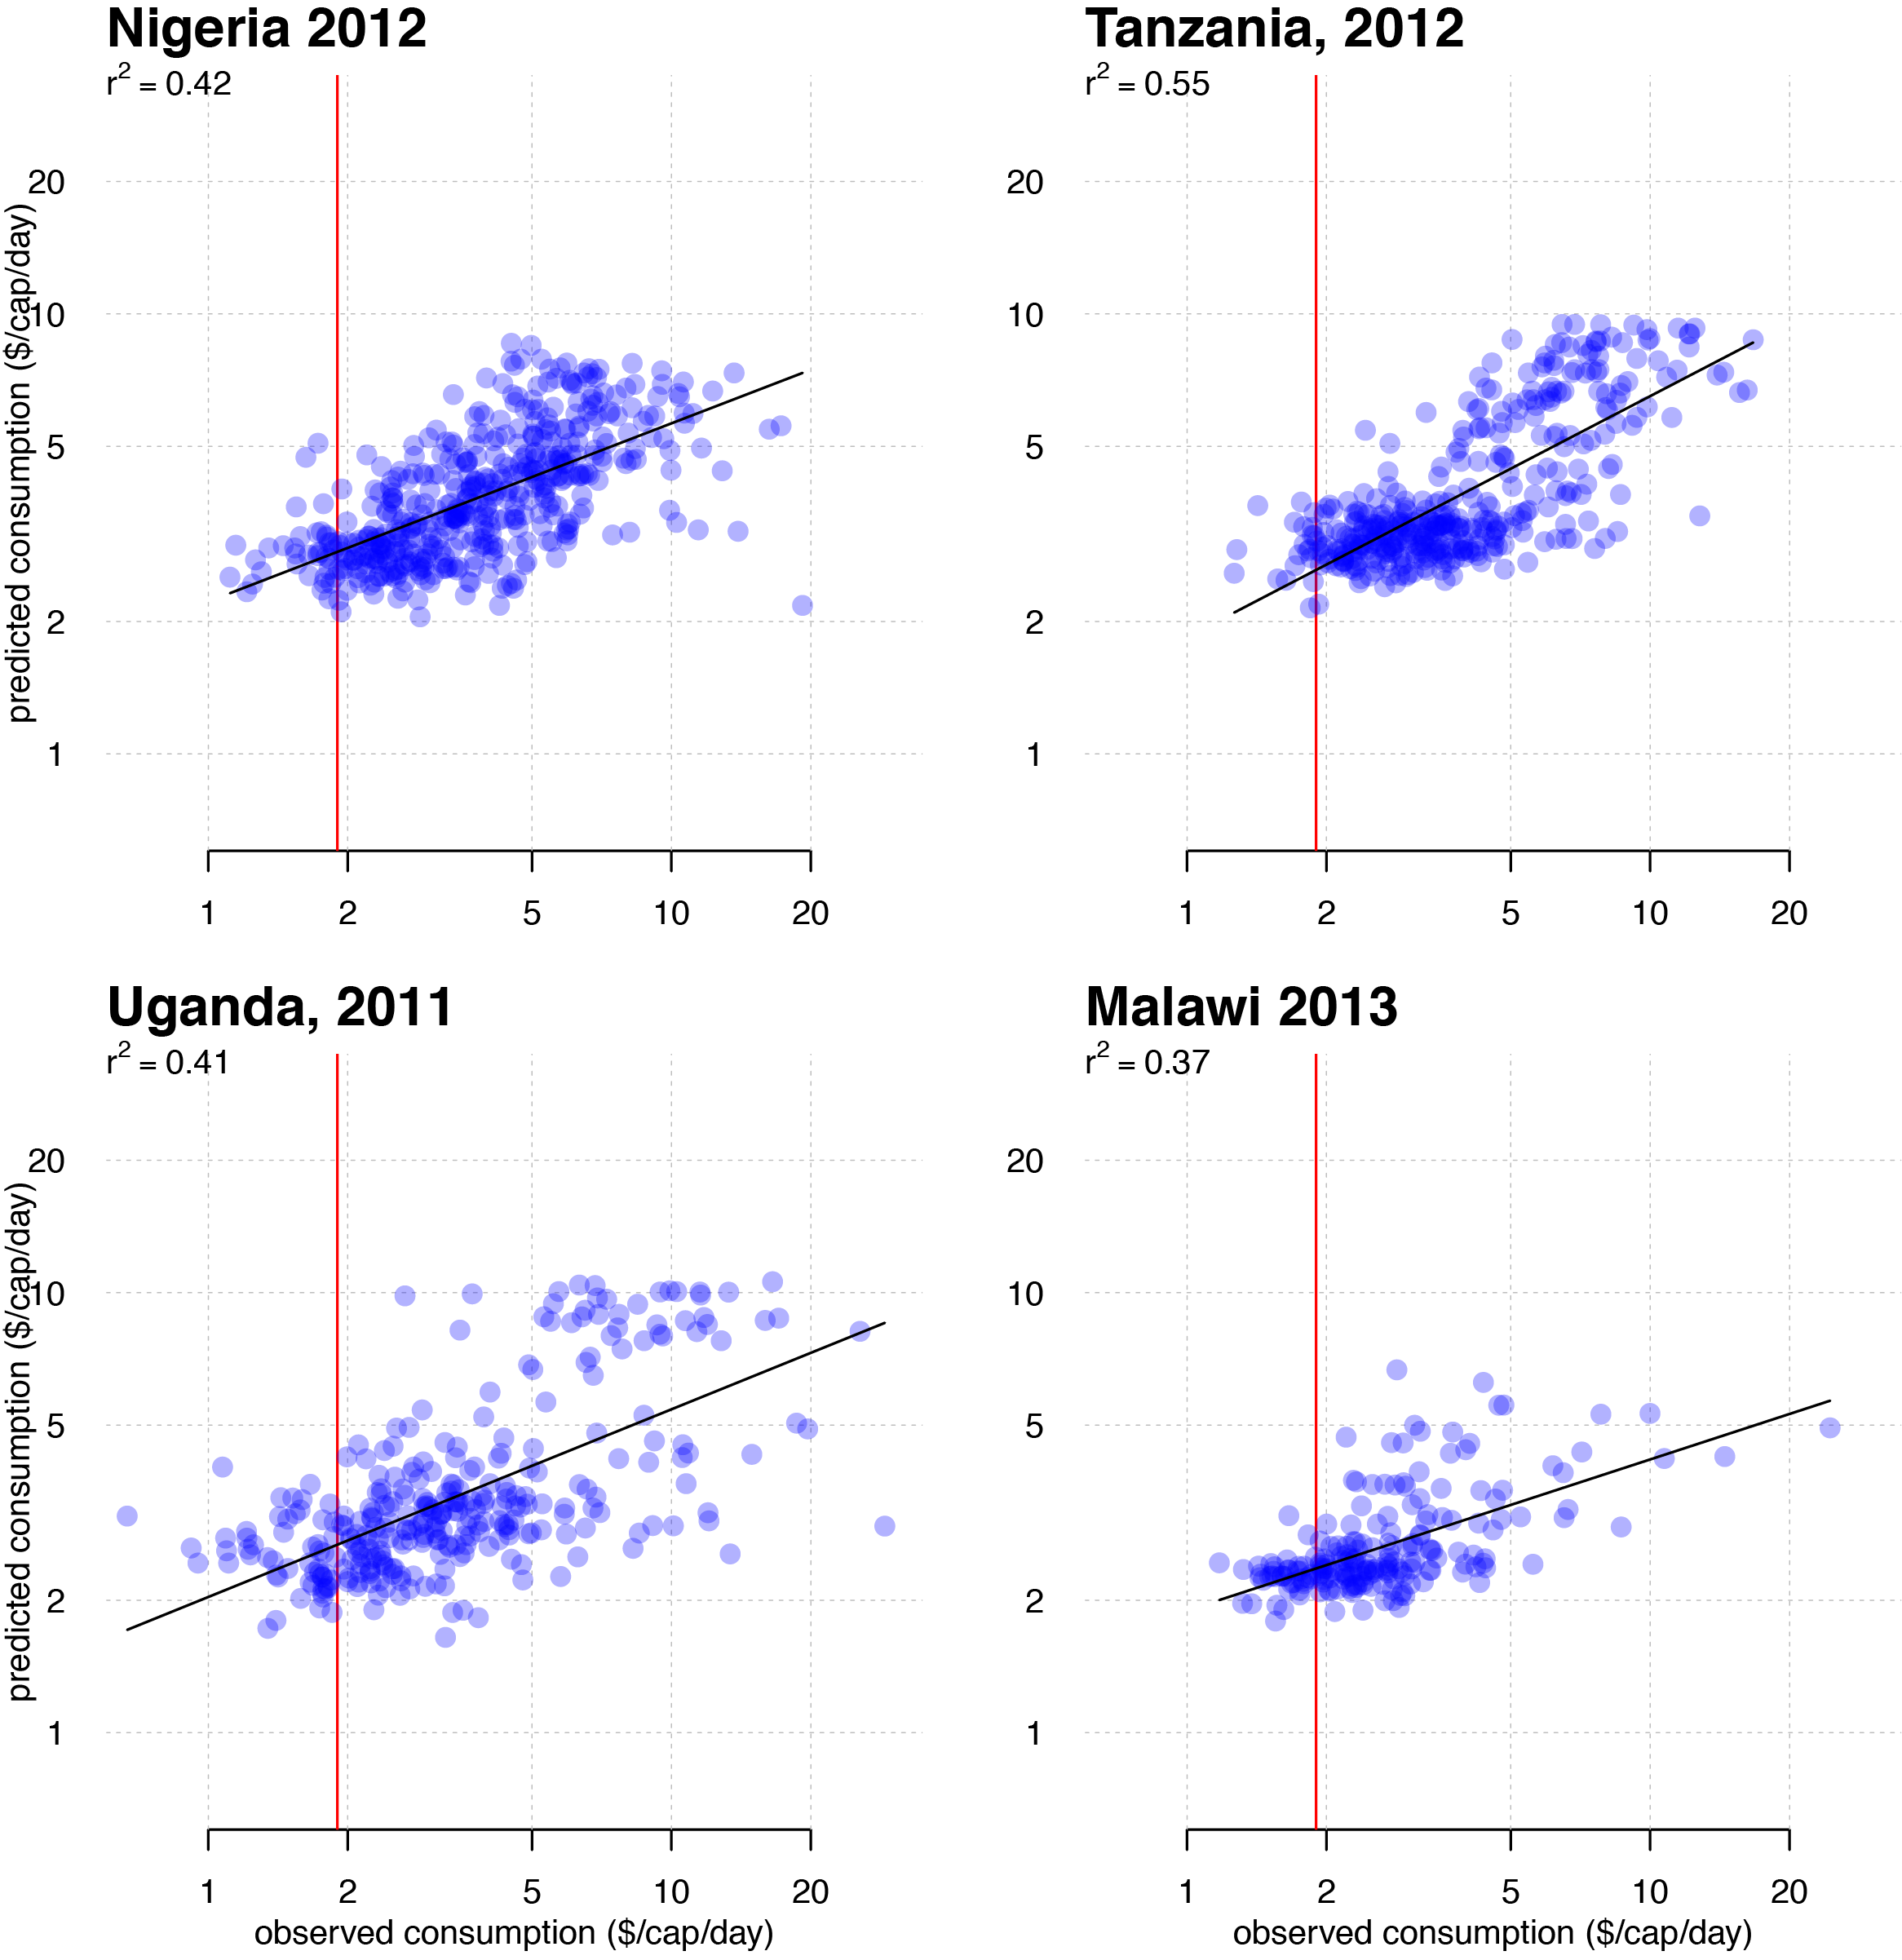
How well does it do?
Consumption expenditure at village level (LSMS)
Average asset score at village level (DHS)
Poverty line
Observed consumption
Jean, Burke, Xie, Davis, Lobell, Ermon, Science 2016

Slide 27
How well does it do?
For consumption expenditure R² between (0.37, 0.55)
(Nigeria, Malawi, Tanzania, Uganda)
For asset wealth R² between (0.55, 0.75)
(Nigeria, Malawi, Tanzania, Uganda, Rwanda)
And models “travel well”.
Modest decline in R² when building model in one country, applying to another
Jean, Burke, Xie, Davis, Lobell, Ermon, Science 2016

Slide 28
Real-time data on agricultural yields for all fields
Real-time data on markets
Real-time data on household outcomes
With satellites + strategic on-the-ground surveys, perhaps a reality within a few years

Slide 29
Thanks!
Marshall Burke (mburke@stanford.edu)
David Lobell (dlobell@stanford.edu)

Slide 31
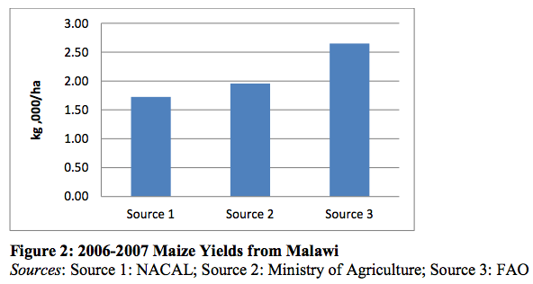
Improved agricultural data are needed
Many key data are questionable
Other key sources of data are rare, expensive
Poor agricultural data constrains our ability to:
Monitor progress and target assistance
Understand variation and evaluate interventions
Carletto et al 2015; Jean, Burke et al in prep

Slide 32
Scaling this up
“field calibrations” potentially hard to scale across different management regimes, different years
Approach 2: “simulation calibration”

Slide 33
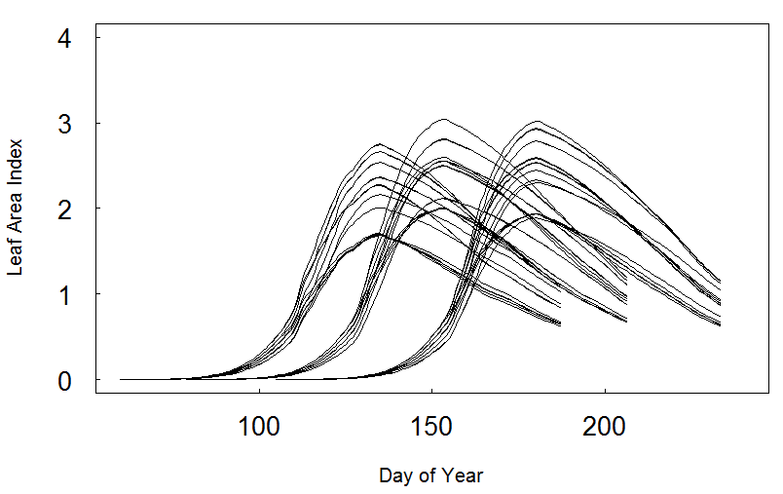
Simulation calibration
Fields could look different for a lot of reasons: planting date, N, water stress
We run simulations with APSIM model for Kisumu, Kenya with different:
Sow dates
N rates
Planting density
Soil moisture
Literature tells us LAI → remote-sensed VI, e.g. GCVI (=NIR/Green -1)

Slide 34
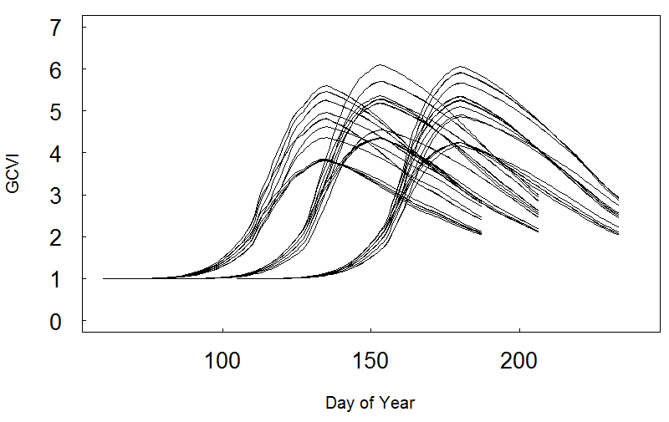
Simulation calibration
2015, pure-stand, >0.5 acres
Hypothetical
observation dates
Train reg. in model world
Predict using observed VIs

Slide 35
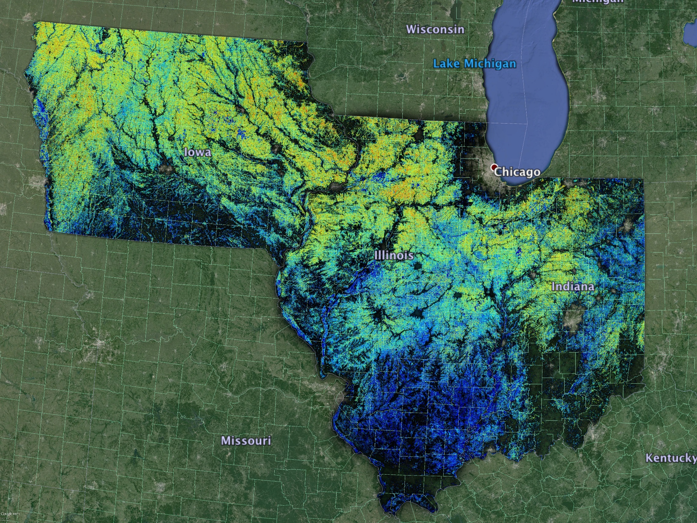
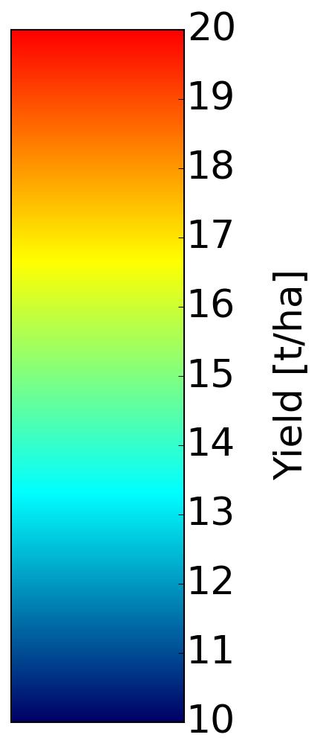
Scaling up
Lobell et al 2015: “simulation calibration” with Landsat in Google Earth Engine
Average maize yield, 2000-13

Slide 36

Implications for use as an evaluation tool
Say we want to study yield as an outcome of some intervention or program
Noise in y increases uncertainty in β
  Either increases size of effect we are able to detect, or means we need a larger N
Satellites provide a noisy measure of “true” yield but at low cost and huge N

Slide 37
How much would sample size need to increase?
Depends on
Correlation between true and measured yield
Correlation between true yield and treatment
Increase in N needed for a given “minimum detectable effect”
R2 in treatment effect regression
 | 0.5 | 0.2 | 0.05
0.2 | 840% | 500% | 420%
0.5 | 190% | 130% | 110%
0.8 | 44% | 32% | 25%
R2 in yield regression
Burke and Lobell, in prep

Slide 38
How much does sample size increase?
Lit review of RCTs/ impact evals. with yield as outcome
Median R² across studies = 0.15
So in a typical study, would need ~2x sample size if the remote sensing estimate had an R² = 0.5. Or ~6x if R² = 0.2.
(This assumes past yield measures were perfect!)

Slide 39
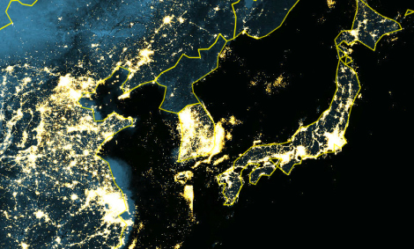
Nightlights

Slide 40
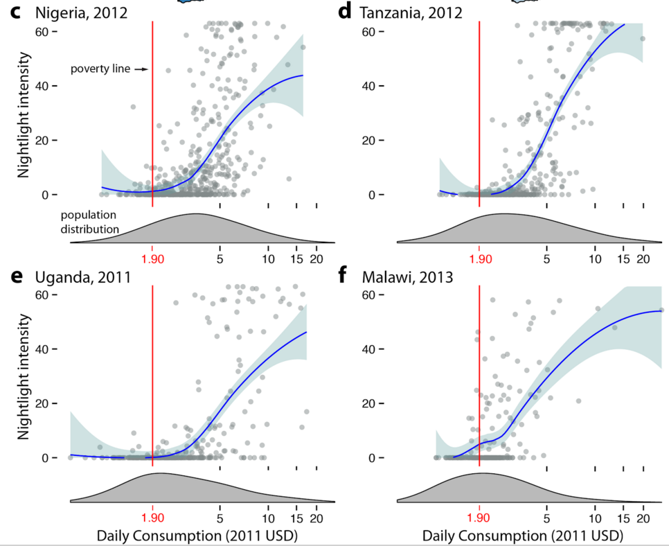
Nightlights – not directly useful for very poor areas
Almost no variation below the poverty line

Slide 41
Deep learning model: images summarized as low-dimensional feature vectors
Inputs: daytime satellite images from Google Maps
Convolutional Neural Network (CNN)
Outputs: Nighttime light intensities
Target task
f₁
f₂
…
f₄₀₉₆
Poverty
Nonlinear mapping
Notes:
Convolutional neural networks are a type of deep learning model specifically designed to take images as input
State of the art performance on classic computer vision tasks such as image classification, object detection, etc.
Many layers -> “deep learning”
Each of these layers has many “neurons”, which learn to look for different things in the image. In the lower layers, neurons may be activated by low-level features such as edges and corners. In higher layers, neurons may be sensitive to thing like faces, ears, noses, etc. in the example of face recognition.
In our case, we can think of the CNN as a nonlinear mapping from images to lower-dimensional feature vector representation that summarizes the information contained in the image.
When we train on nighttime lights data, our CNN learns to extract features that are useful for the proxy task of predicting nighttime lights
Our hope is that a subset of these features are also useful for predicting poverty, which is the target task
Developed a fully-convolutional CNN architecture:
Can handle arbitrary sized images (no cropping needed)
Average pooling layer in the last layer
55 million parameters vs. 621 million parameters for a 400x400 pixel images
Final accuracy: 73%

Slide 42
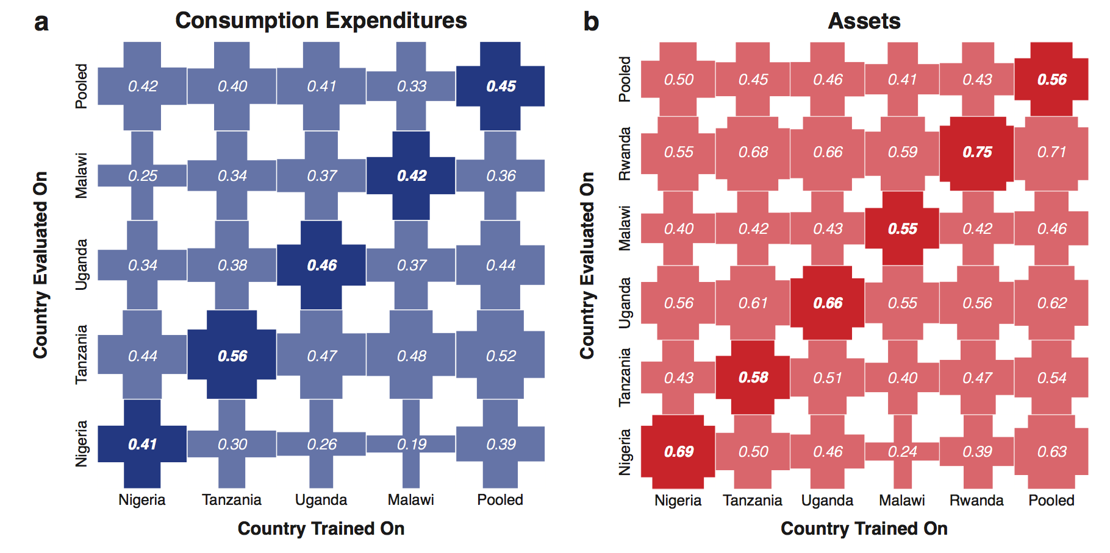
Models appear to “travel well”
Fit model in one country, apply to imagery in another
Jean, Burke, Xie, Davis, Lobell, Ermon, in review

Slide 43
(many) remaining questions
Can approach work in time series as well as cross section?
Can we do better with
    Higher res imagery
    Un-jittered outcome data
    Adding other data streams (prices, cell phone data)
Could it work for other outcomes?

